Slide 1
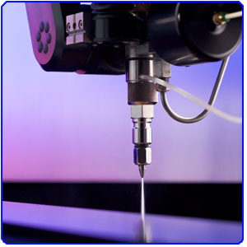
The cut ability of rock using a high pressure water jet

Slide 2
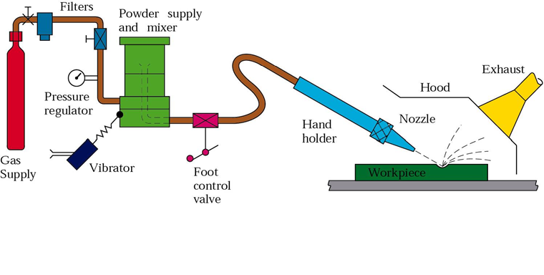
Abrasive WJ Cutting

Slide 3
Comparison of conventional and Abrasive water jet machining
Conventional machining
Abrasive water jet machining
Contact mechanisms
Detonation of an explosive with in a confined space
damage is normally in the form of a narrow slot of varying depth
non‐contact mechanisms
application of high Pressure water jets
--
Lower machine vibration
increased product size.
lower levels of respirable dust
reduced occurrence of incendiary ignitions

Slide 4
Experiments were undertaken to assess the effects of a high pressure water jet in rock cutting.

Slide 5
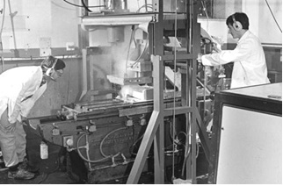
LABORATORY APPARATUS
A linear cutting machine was used to move the rock samples with respect to a stationary water jet

Slide 6
APPARATUS
The test program made use of the following
high pressure, low volume pump
Filtered town water was feed through one of two hydraulically actuated double‐ended,reciprocating cylinders(20:1 pressure intensification factor)
Sapphire nozzles (The discharge co‐efficient 0.65) with a conical outlet(nozzle aperture diameters varies from 0.15 to 0.36 m).

Slide 7
The principal variables in cutting with a water jet include:
jet variables:
Nozzle diameter,
Water pressure,
Nozzle discharge coefficient
water density
Operational variables:
Standoff distance
Nozzle traverse speed
Jet attack angle
Number of multiple passes

Slide 8
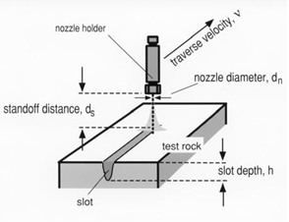
Main variables in water jet cutting

Slide 9
Other variables
Other variables include those of the rock (for example compressive strength, fracture toughness, porosity, grain size and surface roughness) and of the rock mass (for example structure)
The minimum pressure required to initiate fracture, commonly referred to as the threshold pressure, is typically of the same order as the rock compressive strength

Slide 10
RESULTS

Slide 11
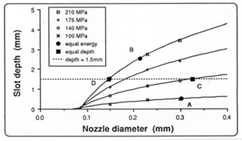
Slot width
Figure ) Effect of nozzle diameter on slot depth
at different pressures in Woodlawn Shale.
Traverse speed was fixed at 150 mm/s.
There were little discernible changes in slot width with either water pressure or traverse speed

Slide 12
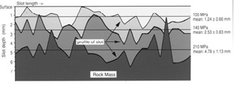
Superimposition of the depth profiles for three
slots formed by a water jet at three different
water pressures in Gosford Sandstone

Slide 13
Effect of nozzle diameter
E
the rate of
increase in slot depth increases with nozzle diameter
Traverse speed was fixed at 150 mm/s

Slide 14
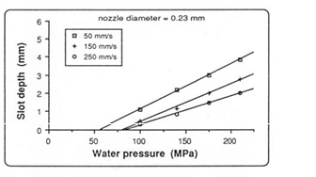
Effect of water pressure
linear relation between water pressure and slot depth
threshold water pressure appears to be independent of nozzle diameter

Slide 15
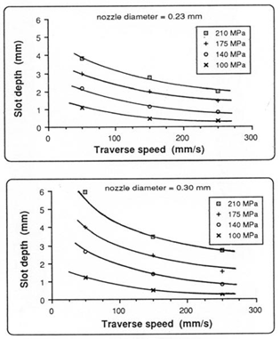
Effect of traverse speeds on slot depth at different nozzle diameters
the rate of increase in slot depth decreases with the traverse speed.

Slide 16
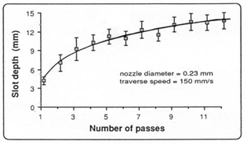
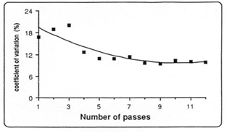
Effect of multiple jet passes
Effect of multiple pass slotting
by a water jet on cumulative slot depth.
Effect of multiple pass slotting
on the variation in slot depth.

Slide 17
CONCLUSION
There is little discernible change in slot width with any of the variables tested other than nozzle diameter.
Slot depth increases marginally with nozzle diameter at low water pressures but tends to become more significant as the pressure increases
The results infer the existence of a critical nozzle diameter. There is evidence of an optimum nozzle diameter above which no useful increase in slot depth is found.
Slot depth increases linearly with water pressure. The slope of this curve increases directly with nozzle diameter and inversely as the traverse speed.
There appears to be a minimum water pressure necessary to cut rock. This pressure, termed the threshold water pressure, appears to be only marginally affected by nozzle traverse speed. The threshold pressure is of a similar order as the minimum measured value of compressive strength or about twelve times the lowest measured value of tensile strength. Values for threshold pressure were found to vary from 68.8 to 86.7 MPa for traverse speeds ranging from 50 to 250 mm/s.

Slide 18
Slot depth decreases with traverse speed in a hyperbolic fashion. Normalised slot depth varies as the inverse of traverse speed to some power
Slot depth can be increased by multiple passes of a water jet. Despite this it can be an inefficient process especially after several passes. Total slot depth becomes asymptotic to some depth value with the number of passes

