Slide 1
RESERVOIR
MODULE- III
Prepared by
Bibhabasu Mohanty
Dept. of Civil Engineering
SALITER, Ahmedabad

Slide 2
Content…
Types, Investigations, Site selection, Zones of storage, Safe yield, Reservoir capacity, Reservoir sedimentation and control.

Slide 3
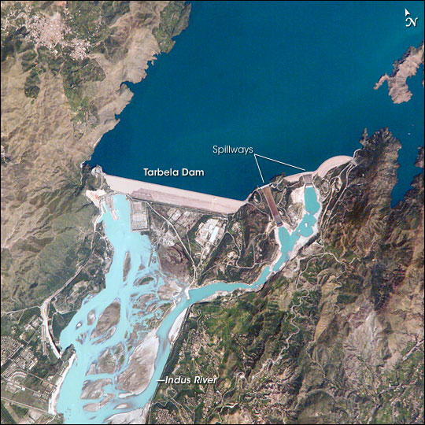
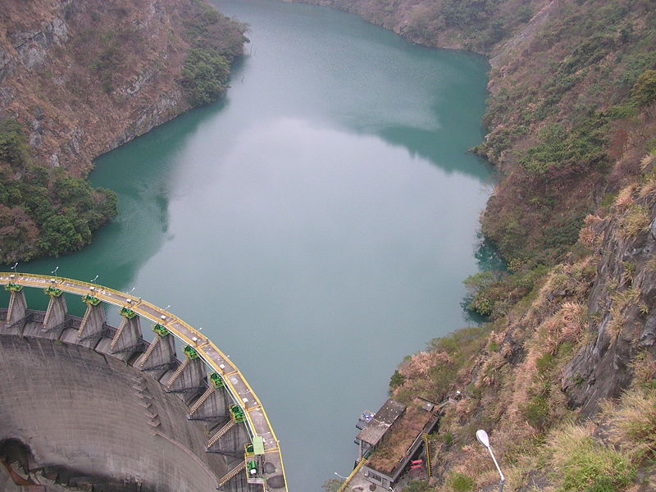
What is a Reservoir?
It is an area developed by water body due to construction of dam.
Tarbela Dam
JungHua Dam (Taiwan)

Slide 4
Storage reservoir serve the following purpose :
Irrigation
Water supply
Hydroelectric power generation
Flood control
Navigation
Recreation
Development of fish & wild life
Soil conservation

Slide 5
Classification
Storage Reservoirs: Storage reservoirs are also called conservation reservoirs because they are used to conserve water. Storage reservoirs are constructed to store the water in the rainy season and to release it later when the river flow is low
Flood Control Reservoirs: A flood control reservoir is constructed for the purpose of flood control. It protects the areas lying on its downstream side from the damages due to flood.

Slide 6
Retarding Reservoirs: A retarding reservoir is provided with spillways and sluiceways which are ungated. The retarding reservoir stores a portion of the flood when the flood is rising and releases it later when the flood is receding.
Detention Reservoirs : A detention reservoir stores excess water during floods and releases it after the flood. It is similar to a storage reservoir but is provided with large gated spillways and sluiceways to permit flexibility of operation.

Slide 7
Distribution Reservoirs: A distribution reservoir is a small storage reservoir to tide over the peak demand of water for municipal water supply or irrigation. The distribution reservoir is helpful in permitting the pumps to work at a uniform rate. It stores water during the period of lean demand and supplies the same during the period of high demand.
Multipurpose Reservoirs: The are constructed for more than single purpose.
Balancing Reservoirs: A balancing reservoir is a small reservoir constructed d/s of the main reservoir for holding water released from the main reservoir.

Slide 8
Investigations
Engineering surveys
Geological investigations
Hydrological investigations

Slide 9
Engineering surveys
Conducted for dam, reservoir and other associated work.
Topographic survey of the area is carried out and the contour plan is prepared
The horizontal control is usually provided by triangulation survey, and the vertical control by precise levelling.

Slide 10
Geological investigation
Geological investigations of the dam and reservoir site are done for the following purposes.
(i) Suitability of foundation for the dam.
(ii) Watertightness of the reservoir basin
(iii) Location of the quarry sites for the construction materials.

Slide 11
Hydrological investigations
The hydrological investigations are conducted for the following purposes :
(i) To study the runoff pattern and storage capacity.
(ii) To determine the maximum discharge at the site.

Slide 12
Site selection
Large storage capacity
River valley should be narrow, length of dam to constructed is less.
Watertightness of reservoir.
Good hydrological conditions
Deep reservoir

Slide 13
Small submerged area
Low silt inflow
No objectionable minerals
Low cost of real estate
Site easily accessible

Slide 14
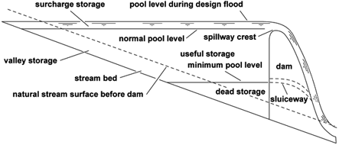
Zones of storage

Slide 15
Full reservoir level (FRL): The full reservoir level (FRL) is the highest water level to which the water surface will rise during normal operating conditions.
Maximum water level (MWL): The maximum water level is the maximum level to which the water surface will rise when the design flood passes over the spillway.
Minimum pool level: The minimum pool level is the lowest level up to which the water is withdrawn from the reservoir under ordinary conditions.

Slide 16
Dead storage: The volume of water held below the minimum pool level is called the dead storage. It is provided to cater for the sediment deposition by the impounding sediment laid in water. Normally it is equivalent to volume of sediment expected to be deposited in the reservoir during the design life reservoir.
Live/useful storage: The volume of water stored between the full reservoir level (FRL) and the minimum pool level is called the useful storage. It assures the supply of water for specific period to meet the demand.

Slide 17
Bank storage: is developed in the voids of soil cover in the reservoir area and becomes available as seepage of water when water levels drops down. It increases the reservoir capacity over and above that given by elevation storage curves.
Valley storage: The volume of water held by the natural river channel in its valley up to the top of its banks before the construction of a reservoir is called the valley storage. The valley storage depends upon the cross section of the river.

Slide 18
Flood/Surcharge storage: is storage contained between maximum reservoir level and full reservoir levels. It varies with spillway capacity of dam for given design flood.

Slide 19
Safe yield
Yield is the volume of water which can be withdrawn from a reservoir in a specified period of time.
Safe yield is the maximum quantity of water which can be supplied from a reservoir in a specified period of time during a critical dry year.

Slide 20
Secondary yield: is the quantity of water which is available during the period of high flow in the rivers when the yield is more than the safe yield.
Average yield: The average yield is the arithmetic average of the firm yield and the secondary yield over a long period of time.
Design yield: The design yield is the yield adopted in the design of a reservoir. The design yield is usually fixed after considering the urgency of the water needs and the amount of risk involved.

Slide 21
Reservoir capacity
depends upon the inflow available and demand
inflow in the river is always greater than the demand, there is no storage required
if the inflow in the river is small but the demand is high, a large reservoir capacity is required

Slide 22
The required capacity for a reservoir can be determined by the following methods:
1. Graphical method, using mass curves.
2. Analytical method

Slide 23
Graphical method
1. Prepare a mass inflow curve from the flow hydrograph of the site for a number of consecutive years including the most critical years (or the driest years) when the discharge is low.
2. Prepare the mass demand curve corresponding to the given rate of demand. If the rate of demand is constant, the mass demand curve is a straight line. The scale of the mass demand curve should be the same as that of the mass inflow curve.

Slide 24
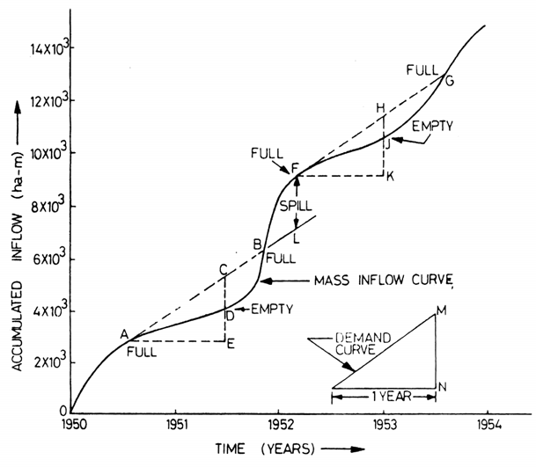

Slide 25
3. Draw the lines AB, FG, etc. such that
(i) They are parallel to the mass demand curve, and
(ii) They are tangential to the crests A, F, etc. of the mass curve.
4. Determine the vertical intercepts CD. HJ, etc. between the tangential lines and the mass inflow curve. These intercepts indicate the volumes by which the inflow volumes fall short of demand.

Slide 26
Assuming that the reservoir is full at point A, the inflow volume during the period AE is equal to ordinate DE and the demand is equal to ordinate CE. Thus the storage required is equal to the volume indicated by the intercept CD.
5. Determine the largest of the vertical intercepts found in Step (4). The largest vertical intercept represents the storage capacity required.

Slide 27
The following points should be noted.
(i) The capacity obtained in the net storage capacity which must be available to meet the demand. The gross capacity of the reservoir will be more than the net storage capacity. It is obtained by adding the evaporation and seepage losses to the net storage capacity.

Slide 28
(ii) The tangential lines AB, FG; etc. when extended forward must intersect the curve. This is necessary for the reservoir to become full again, If these lines do not intersect the mass curve, the reservoir will not be filled again. However, very large reservoirs sometimes do not get refilled every year. In that case, they may become full after 2-3 years.
(iii) The vertical distance such as FL between the successive tangents represents the volume of water spilled over the spillway of the dam.

Slide 29
Analytical method
capacity of the reservoir is determined from the net inflow and demand.
storage is required when the demand exceeds the net inflow.
the total storage required is equal to the sum of the storage required during the various periods.

Slide 30
1. Collect the stream flow data at the reservoir site during the critical dry period. Generally, the monthly inflow rates are required. However, for very large reservoirs, the annual inflow rates may be used.
2. Ascertain the discharge to be released downstream to satisfy water rights or to honour the agreement between the states or the cities.

Slide 31
3. Determine the direct precipitation volume falling on the reservoir during the month.
4. Estimate the evaporation losses which would occur from the reservoir ‘The panevaporation data are normally used for the estimation of evaporation losses during the month.
5. Ascertain the demand during various months.

Slide 32
6. Determine the adjusted inflow during different months as follows:
Adjusted inflow = Stream inflow + Precipitation - Evaporation – Downstream Discharge
7. Compute the storage capacity for each months.
Storage required = Adjusted inflow – Demand
8. Determine the total storage capacity of the reservoir by adding the storages required found in Step 7.

Slide 33
Determination of Yield of a Reservoir
The yield from a reservoir of a given capacity can be determined by the use of the mass inflow curve
1. Prepare the mass inflow curve from the flow hydrograph of the river.
2. Draw tangents AB, FG, etc. at the crests A, F, etc. of the mass inflow curve in such a way that the maximum departure (intercept) of these tangents from the mass inflow curve is equal to the given reservoir capacity.

Slide 34
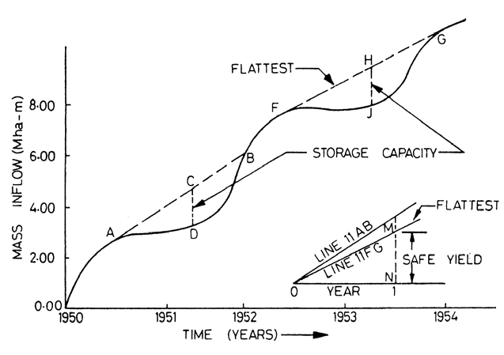

Slide 35
3. Measure the slopes of all the tangents drawn in Step 2.
4. Determine the slope of the flattest tangent.
5. Draw the mass demand curve from the slope of the flattest tangent (see insect). The yield is equal to the slope of this line

Slide 36
Reservoir Sedimentation
is a difficult problem for which an economical solution has not yet been discovered, except by providing a “dead storage” to accommodate the deposits during the life of the dam.
Disintegration, erosion, transportation, and sedimentation, are the different stages leading to silting of reservoir.

Slide 37
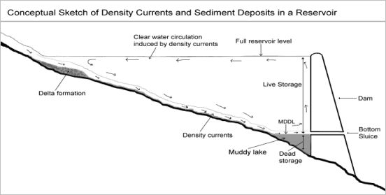

Slide 38
Causes of sedimentation
Nature of soil in catchment area
Topography of the catchment area
Cultivation in catchment area
Vegetation cover in catchment area
Intensity of rainfall in catchment area

Slide 39
Sediment Management
Maximum efforts should water should be released so that less sediments should retain in reservoir. Following options are:
Catchment Vegetation
Construction of coffer dams/low height barriers
Flushing and desilting of sediments
Low level outlets / sediment sluicing

Slide 40
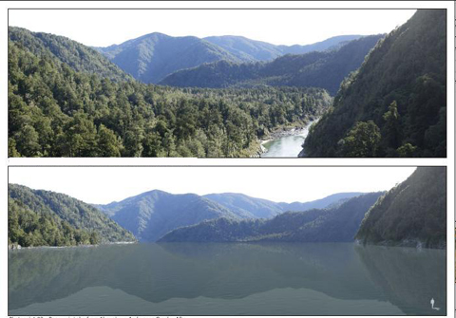
Catchment vegetation

Slide 41
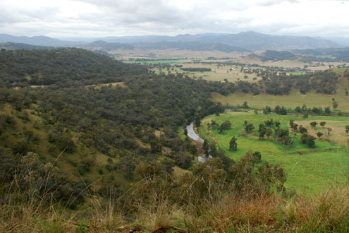
Catchment vegetation

Slide 42
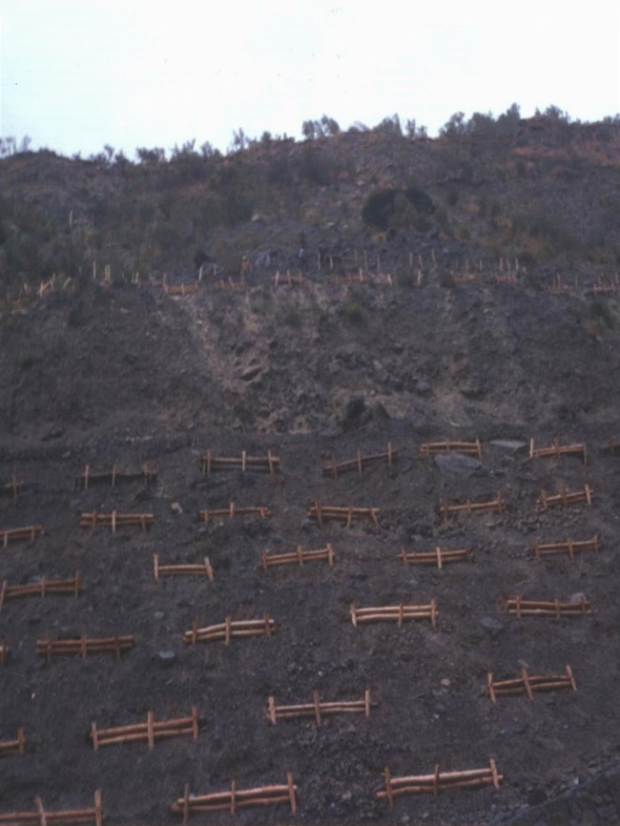
Wooden barriers

Slide 43
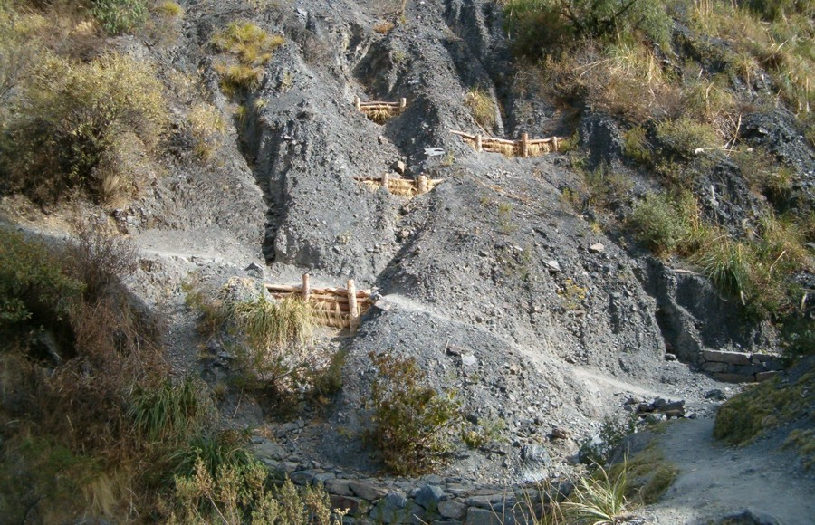
Wooden barriers

Slide 44
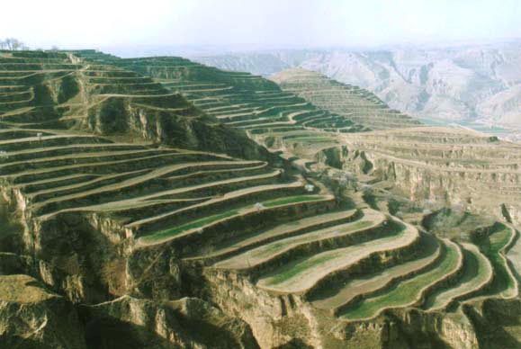
Stepped watershed for sediment control

Slide 45
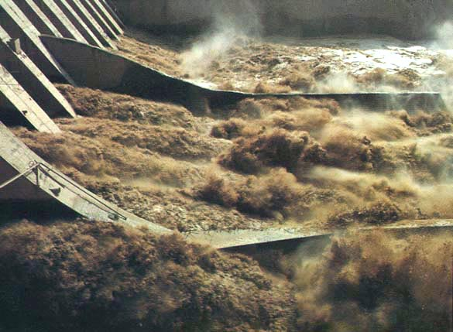
Flushing of sediments from reservoir

Slide 46
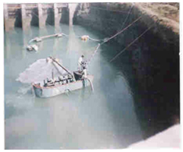
Mechanical desilting from reservoir

Slide 47
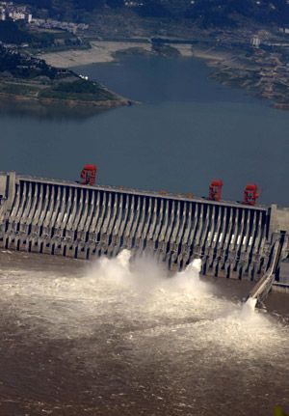
Sediment sluicing

Slide 48
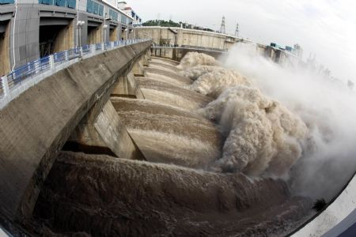
Sediment sluicing

