Slide 1
Self Compacting Concrete (SCC)
Prepared By Ravi Kumar

Slide 2
Contents
Introduction
Problems with conventional concrete
Benefits of SCC
Mix design principles
Constituent materials
Properties of fresh SCC
Tests
Application
References

Slide 3
Introduction
Fresh concrete that can flow around reinforcement and consolidate within formwork under its own weight that exhibits no defects due to segregation or bleeding.
The guiding principle for this type of concrete is that the sedimentation velocity of a particle is inversely proportional to the viscosity of the floating medium in which the particle exists.
Source: https://wwwbuildipedia.com

Slide 4
Problems with Conventional Concrete
Requirement of skilled worker for compaction in conventional concrete
Difficult to use mechanical compaction for
Underwater concreting
Cast in-situ pile foundation
Columns with congested reinforcement

Slide 5
Benefits of SCC
Faster construction
Reduction in site manpower
Safer working environment
Improved aesthetics
Easier placing
Improved durability

Slide 6
Requirements for Self-compacting concrete
Filling ability
Passing ability
Segregation resistance

Slide 7
Mix design principles
The flowability and viscosity of the paste is adjusted by proportioning the cement and additives water to powder ratio and then by adding super plasticizers and VMA .
The paste is the vehicle for the transport of the aggregate, therefore the volume of the paste must be greater than the void volume in the aggregate.
In order to control temperature rise and thermal shrinkage cracking as well as strength, the fine powder should be added to keep the cement content at an acceptable level. e.g. fly ash, mineral filler, silica fume etc.

Slide 8
Contd.
SCC should have
Low coarse aggregate content
Increased paste content
Low water powder ratio
Increased super plasticizer dosage
Viscosity modifying agents

Slide 9
Flow Chart for achieving self compactibility
Reduction of water to binder ratio
Limitation of coarse aggregate content & maximum size
Addition of mineral admixture
Usage of Super plasticizer & VMA
High segregation resistance of mortar & concrete
High Deformability of mortar & concrete
Self compactibility

Slide 10
Typical mix proportion values
Constituent | Typical range by volume(liter/m³)
Powder | 160-240
Water | 150-210
Coarse aggregate | 270-360
water to powder ratio | 0.80-1.10
Fine aggregate | 48-55% of total aggregate weight

Slide 11
Materials Selection
Limits on the amount of marginally unsuitable aggregate.
Choice of HRWR
Choice of VMA
Interaction & compatibility between cement, HRWR, VMA

Slide 12
Aggregate
It is observed from these studies that self-compactability is achievable at lower cement (or fines) content when rounded aggregates are used, as compared to angular aggregates.
Rounded aggregates would provide a better flowability and less blocking potential for a given water-to-powder ratio, compared to angular and semi-rounded aggregates.
To eliminate the poor gradation problem in aggregates, filler materials are used.

Slide 13
Chemical Admixtures
HRWRA helps in achieving excellent flow at low water contents and VMA reduces bleeding and improves the stability of the concrete mixture.
HRWRAs that work on the principle of steric hindrance require a lower dosage compared to those based on electrostatic repulsion.
Acrylic copolymers (AC) and polycarboxylate ethers (PCE) are effective at lower dosages compared to sulfonated condensates of melamine (SMF) or naphthalene (SNF) formaldehyde.

Slide 14
Mineral Admixture
Fly ash: It reduces free drying shrinkage and restrains the shrinkage cracking width.
Silica fume: it gives good cohesion, improved resistance to segregation. Silica fume is also very effective in reducing or eliminating bleeding.
Mineral fillers: The particle size distribution shape and water absorption of mineral fillers may affect the water demand or sensitivity. CaCO₃ based minerals fillers (<0.125mm size) are widely used and can give excellent rheological properties and performance.

Slide 15
Fresh Properties of SCC
Filling Ability
Slump flow test, T50 cm slump flow test, V-Funnel test
Passing ability
J-ring test, U-box, L-box
Segregation potential
Settlement column Test, Sieve stability test, Penetration test

Slide 16
Slump Flow Test
It is done to access the horizontal flow of concrete in the absence of obstruction.
It gives good assessment of filling ability.
Slump cone of 300 mm height, 100 mm upper diameter and 200 mm bottom diameter.
The diameter of spread should be lie between 650 mm to 800 mm.
The higher the flow value, greater its ability to fill formwork .

Slide 17
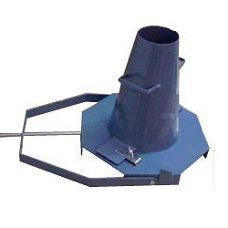
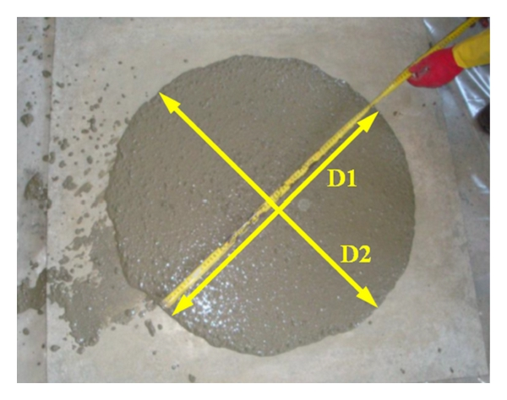
Contd.
Source: http://www.hindawi.com/journals/je/2013/912983/fig5/

Slide 18
J-Ring Test
It determines the passing ability of SCC.
It consist of ring of reinforcement bars that will fit around the slump cone.
Slump cone is fitted with concrete and lifted up as in slump cone test.
The acceptable difference in height between inside and outside should be between 0 and 10 mm.

Slide 19
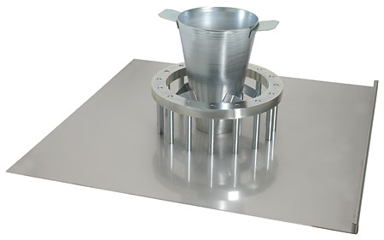
Contd.
Source: http://www.joostdevree.nl/shtmls/j_ring_test.shtml

Slide 20
Curing
Top surface dry quickly because of the increased quantity of paste, the low water/fines ratio and the lack of bleed water at the surface.
To avoid this Initial curing should therefore commence as soon as practicable after placing and finishing in order to minimize the risk of surface crusting and shrinkage cracks caused by early age moisture evaporation.

Slide 21
Complexities involved in SCC
Higher paste volume results in greater shrinkage and creep.
Higher strength achievement leads to reduces the workability to unacceptable level
Lateral Formwork pressure
Limit of flow distance of the concrete

Slide 22
Application
Two anchorages of Akashi-Kaikyo (Straits) Bridge, Japan. The volume of the cast concrete in the two anchorages amounted to 290,000 m3
The highest use of SCC in India was done at Delhi metro project. About 10000 m3 of SCC has been Used.
At Kaiga nuclear power plant, SCC of Characteristic strength 30 MPa was used.

Slide 23
Contd.
The Burj Khalifa is the tallest building in the world. SCC was used throughout the building and was pumped 166 stories above the ground.
The Trump Tower in Chicago, Illinois was a major user of SCC. It is a 92-story reinforced concrete project that required 3500 m³of SCC to be cast-in-place continuously for 22 hours to construct the mat foundation that supports the finished structure. The mix had a 7-day compressive strength of 68 MPa and a 28-day strength of 82 MPa . This single pour is the largest ever recorded to date in North America using SCC

Slide 24
Conclusion
We can reduce the in-place cost and maker a safer working environment for the workers.
SCC can be effectively placed in most congested areas and also where normal methods of vibration are not possible.
Further research are required to interpret influence on the hardened properties of SCC more precisely.
The cost of SCC is 10-15 % higher than the conventional concrete.

Slide 25
References
Okamura et al. “Self-compacting concrete,” Journal of Advanced Concrete Technology, vol. 1, no. 1, pp. 5–15,2003
SK Singh “Self Compacting Concrete - A Paradigm Shift”, Journal of New Building Materials & Construction World, Vol. 15, No. 3, pp 164-180,September , 2009.
The European Guidelines for Self Compacting Concrete, May 2005
Eric P. Koehler et al. Aggregate in Self Consolidating Concrete, ICAR Project 108, March 2007
KHALEEL, O.R. et al. The Effect of Coarse Aggregate on Fresh and Hardened Properties of Self-Compacting Concrete (SCC), Elsevier, pp 805-813, 2011

Slide 26
Contd.
Filho et al. Hardened properties of self-compacting concrete — A statistical approach, Elsevier, Construction and Building Materials, pp 1608-1615, 2010
Schindler, K Anton et al. Properties of self-consolidating concrete for precast members, ACI Materials Journal, V. 104, No. 1, 2007
Specification and Guidelines for Self-Compacting Concrete, EFNARC, 2002
Ouchi et al. APPLICATIONS OF SELF-COMPACTING CONCRETE IN JAPAN, EUROPE AND THE UNITED STATES, ISHPC, 2003
R. Loser, A. Leemann, Shrinkage and restrained shrinkage cracking of self-compacting concrete compared to conventionally vibrated concrete, Materials and Structures, 2008

