Slide 1
A
PROJECT REPORT
ON
CIVIL ENGINEERING DEPARTMENT
SAVITABEN DAHYABHAI PATEL POLYTECHNIC
VISNAGAR-MEHSANA HIGHWAY, At-GADHA, Po-PILUDARA,
Ta & Dist : MEHSANA, Pin-384315
EARTHQUAKE RETROFITTING OF BUILDING

Slide 2
A
PROJECT REPORT
PREPARED BY :
ENROLLMENT NO NAME
096690306003 PATEL ANAND B.
096690306005 SOLANKI JAYESH D.
096690306034 PATEL CHIRAG K.
096690306066 SUTHAR JANAK D.

Slide 3
SEISMIC RETROFITTING
240 million houses stock according to 2000 census
85 –90% houses are masonry houses
Stone masonry, Block masonry, Brick masonry
No standardized procedure/ no code
Differs from structure to structure
Depends upon seismic zone
Structural Engineering expert
Structural drawings/ soil data

Slide 4
CONCERN ABOUT EARTHQUAKE
SAFETY
Houses not designed to resist earthquakes
People don't know what to do ?
Whether their houses are earthquake safe ?
How strong they are ?
How to make them earthquake safe ?
Buildings can be upgraded by minor interventions –Seismic Retrofitting
What level of Seismic Retrofitting ?

Slide 5
SEISMIC EVALUATION OF
BUILDINGS
Earthquake intensity
Structural configuration and components
Structural condition
Geological condition
Foundation capability
Non-structural components

Slide 6
DIFFICULTIES IN SEISMIC
EVALUATION
Difficulty in estimating the earthquake parameters, intensity.
Influence of site condition –microzonation.
Difficulty in estimation of insitu strength of materials.
Analytical methods are either unreliable or too complex.

Slide 7
EVALUATION OF A BUILDING
Before the retrofitting –to identify the deficiency
After the retrofitting –to estimate the adequacy and effectiveness

Slide 8
SEISMIC SAFETY OF EXISING
BUILDINGS
Detailed layout (plan and elevation)
Detail of foundation and soil
Structural drawings
Detail of codes used/ design calculations
Vulnerability assessment
If found deficient -retrofitting is done

Slide 9
VULNERABILITY ASSESSMENT
Natural frequencies of vibration of the structure
Frequency content of ground motion
Type of local soil and type of foundation
Strength of building material used
Care taken in its detailing for energy absorption
Care taken in construction

Slide 10
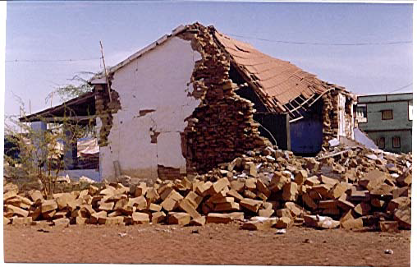
Damage to a traditional house

Slide 11
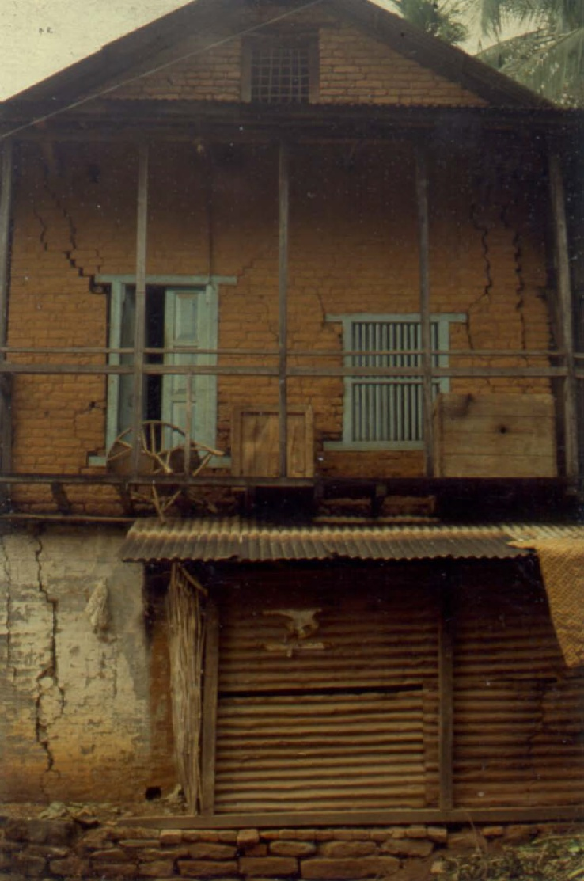
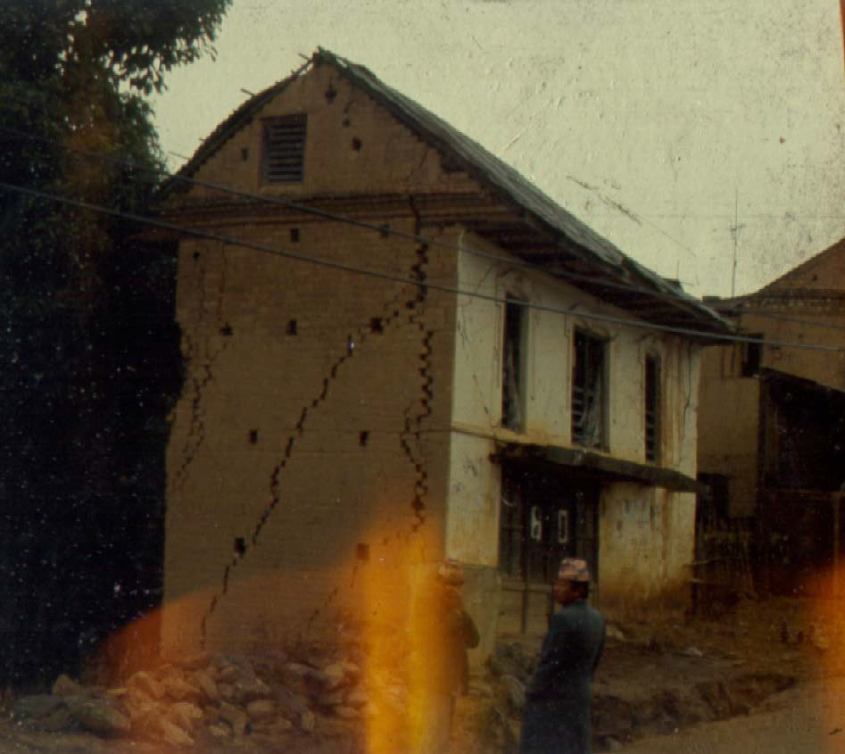
MASONRY BUILDINGS
Damage on masonry buildings start from corner separation

Slide 12
CAUSES OF UNSAFE BUILDINGS
Number of unsafe buildings is alarming
Non-engineered buildings
Faulty original design –lack of lateral resisting elements: frames, shear walls
Changes in Codal practices
Inadequate detailing of reinforcement
Extensions, Alterations and Encroachment
Increase in load due to usage
Poor and deficient construction
Lack of regular maintenance
Degradation of building material/ Corrosion

Slide 13
PRINCIPLE OF SEISMIC SAFETY
OF MASONRY BUILDINGS
Integral box action
Integrity of various components Roof to wall
Wall to wall at corners
Wall to foundation
Limit on openings

Slide 14
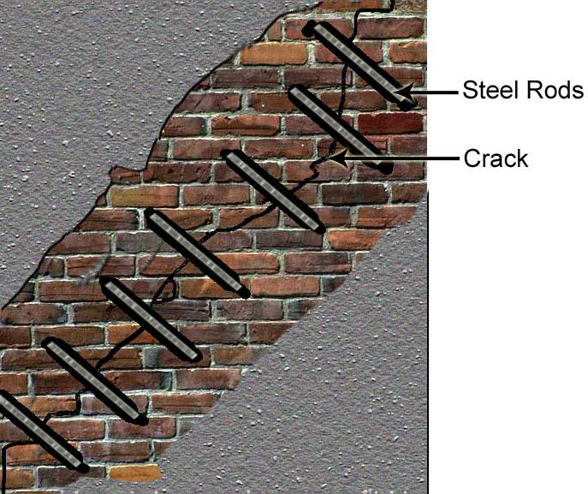
STITCHING OF CRACKS

Slide 15
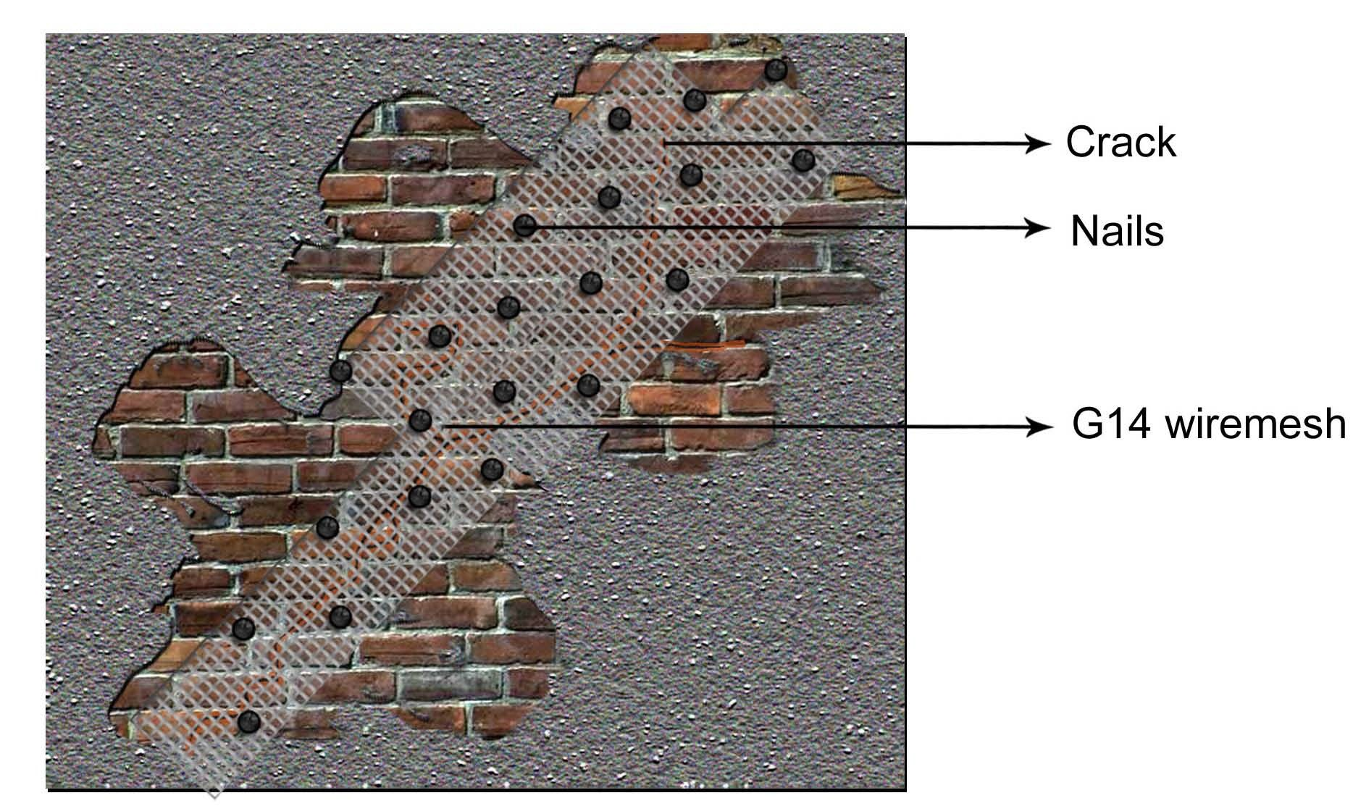
REPAIR OF DAMAGED MEMBERS

Slide 16
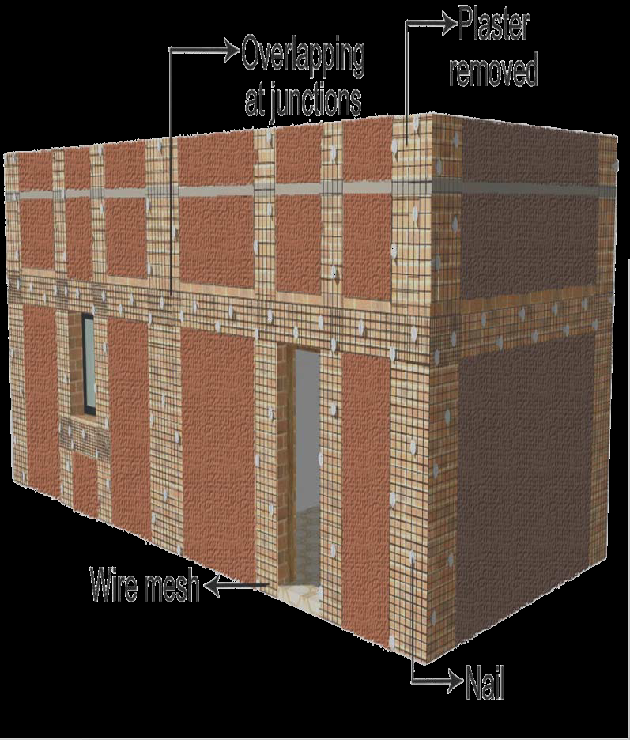
INTEGRAL BOX ACTION THROUGH SPLINT AND BANDAGE

Slide 17
PRINCIPLE OF SEISMIC SAFETY OF
MASONRY BUILDINGS
Integral box action
Integrity of various components Roof to wall
Wall to wall at corners
Wall to foundation
Limit on openings

Slide 18
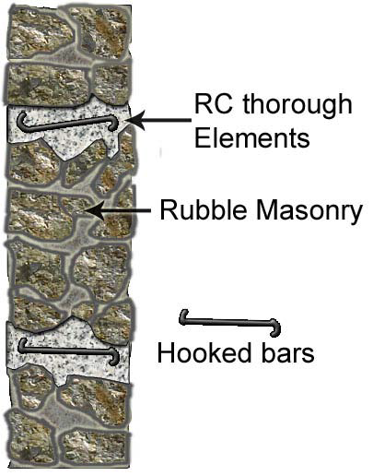
WALL INTEGRITY USING THROUGH ELEMENTS

Slide 19
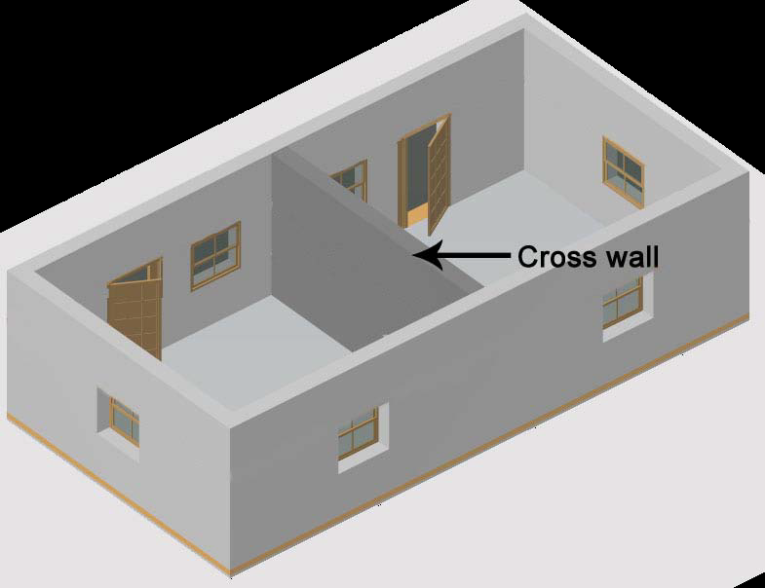
STRENGTHENING BY CROSS WALLS

Slide 20
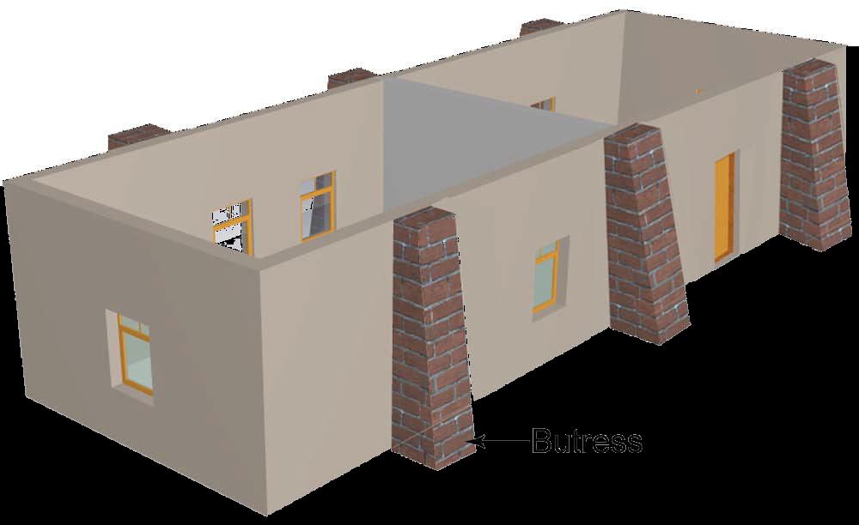
STRENGTHENING BY BUTTRESSES

Slide 21
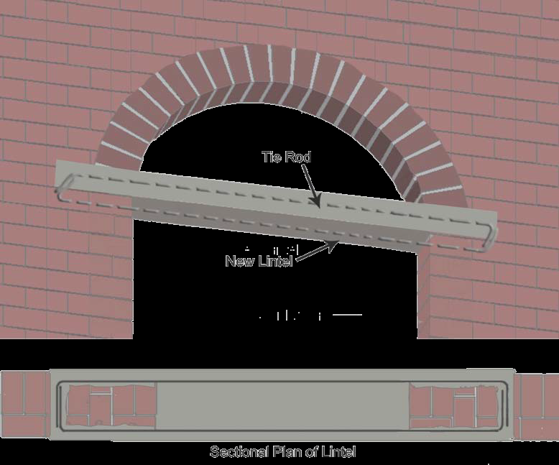
STRENGTHENING OF ARCHES

Slide 22
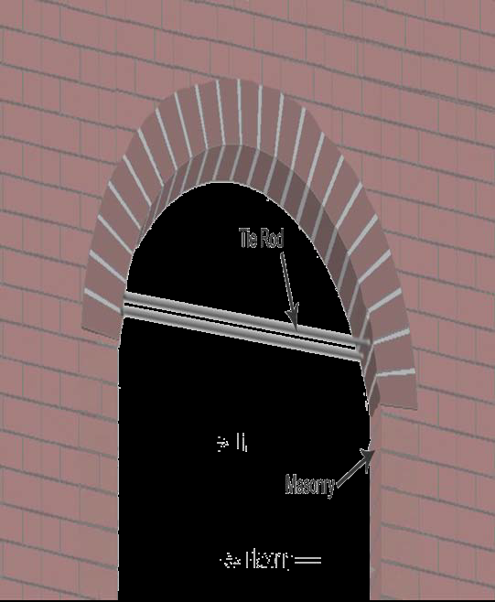
STRENGTHENING OF ARCHES

Slide 23
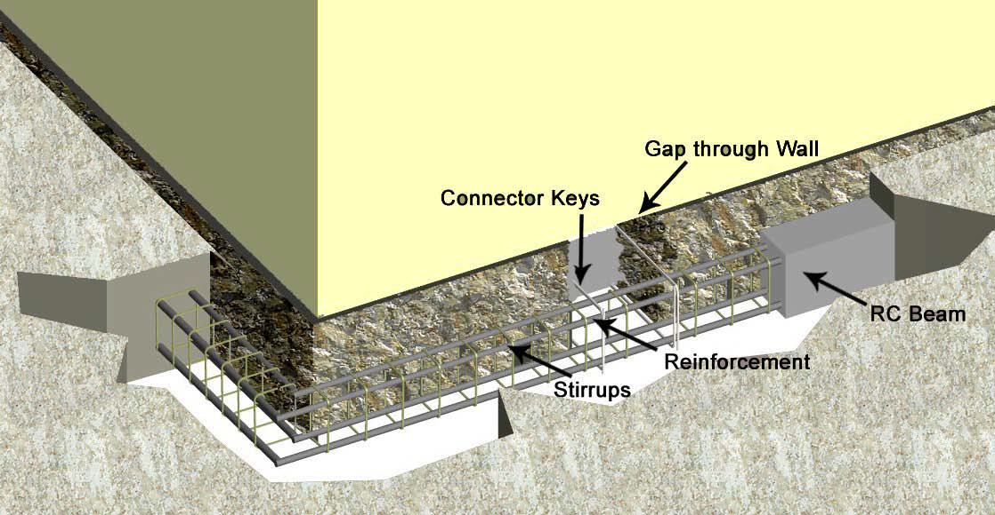
STRENGTHENING OF FOUNDATIONS

Slide 24
LESSONS FROM KACHCHH EQ.
Many buildings with soft storey collapsed due to failure of columns at joints in soft storey
The failure occurred due toLack of strength & stiffness of soft storey
strong beam-weak column behaviour of moment resisting frame
lack of ductility due to poor detailing

Slide 25
REMOVAL OF IRREGULARITY
Soft storey
Floating columns
In-plane and out-of-plane irregularity
Asymmetric configuration

Slide 26
STRENGTHENING OF STRUCTURE
Strengthening Existing MembersReinforcedConcrete Jacketing, Overlay & UnderlaySteel Plate Bonding and Jacketing, Steel section caging; FRP Plate Bonding and Jacketing
Adding New MembersShear wallsFramesBracingsButtresses

Slide 27
MATERIALS FOR RETROFITTING
Conventional cast-in-place concrete
High-strength concrete using shrinkage
compensating admixture
Ferro-cement
Shotcrete (gunite)
Polymer concrete

Slide 28
MATERIALS FOR RETROFITTING
Resins
Resin concrete
Grouts
Gluing metal sheets on concrete
Welding of new reinforcement
Gluing fibre-reinforced plastic (FRP) sheets on concrete
Composite reinforcing bars

Slide 29
ADVANCE COMPOSITE MATERIALS
Fibre reinforced composite
Latest technique in structural réhabilitation
ACS comprises of uni-directional or bi-directional woven reinforcing fabric saturated with specially formulated epoxy matrix

Slide 30
ADVANCE COMPOSITE SYSTEM
Quick and easy application procedure results in time and cost saving
Flexibility of application makes it suitable for application on member with any shape or profile
Causes no destruction or disturbance to existing concrete
It can be used in space constrained areas
No heavy machinery or equipment is required

Slide 31
ADVANCE COMPOSITE SYSTEM
It is light weight and easy to install causing no distress to the member being strengthened
It increases the strength and ductility; enhances axial, shear, flexural and tensile capacities
No appreciable increase in member size or dead load
It does not corrode and inhibits further corrosion

Slide 32
RETROFITTING OF EXISTING
BUILDINGS
Increasing the size of ground storey columns by jacketing
Addition of RC walls at ground floor
Steel bracings at ground storey
Use of energy dissipating devices such as yielding bracing or viscous dampers

Slide 33
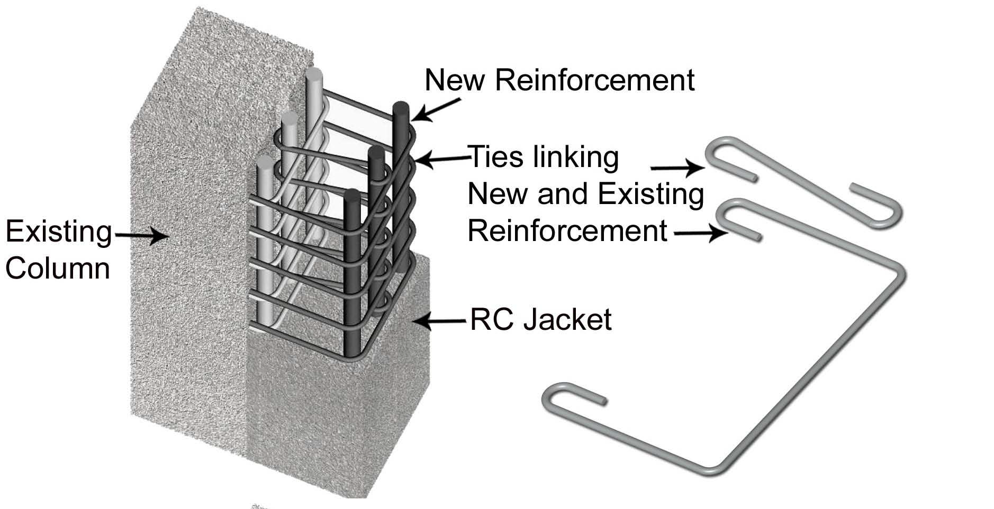
RC JACKETING

Slide 34
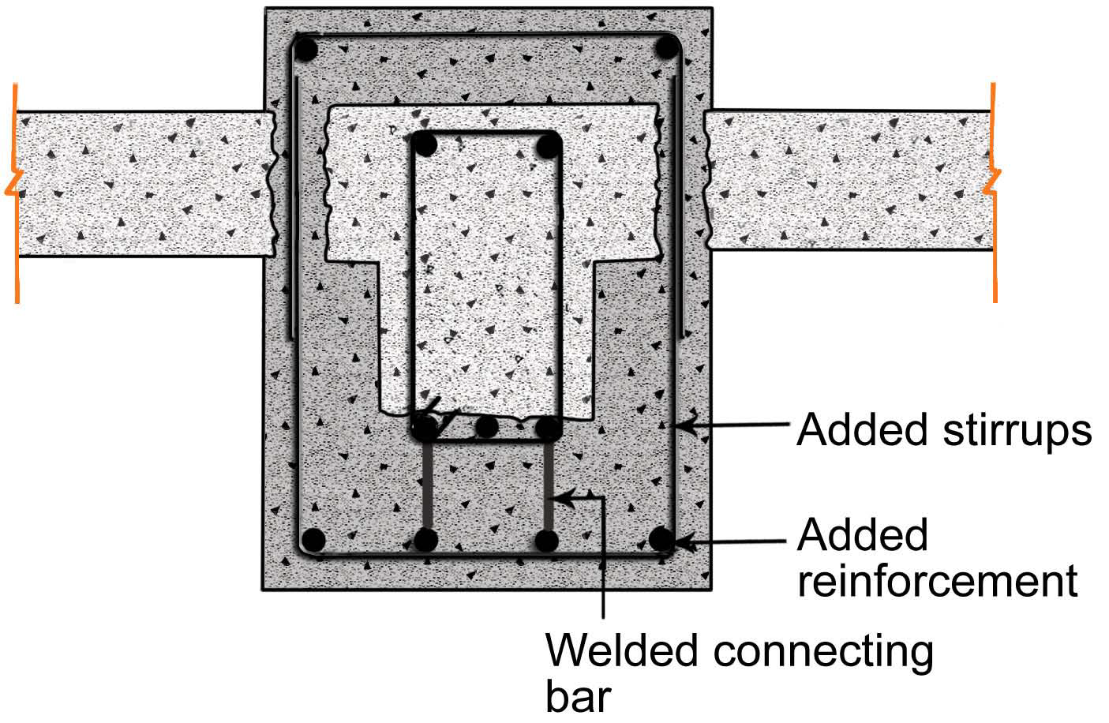
RC JACKETING

Slide 35
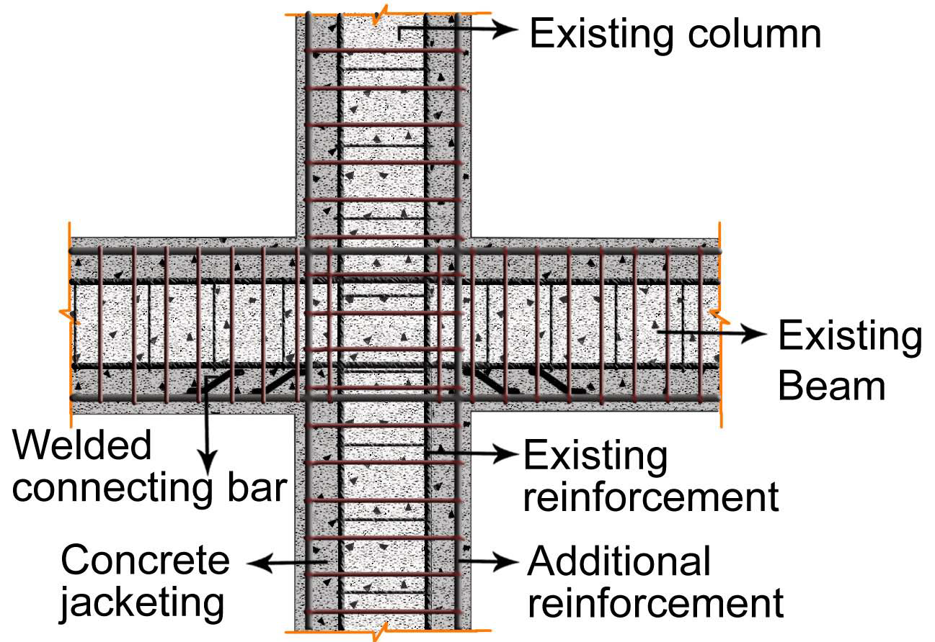
RC JACKETING

Slide 36
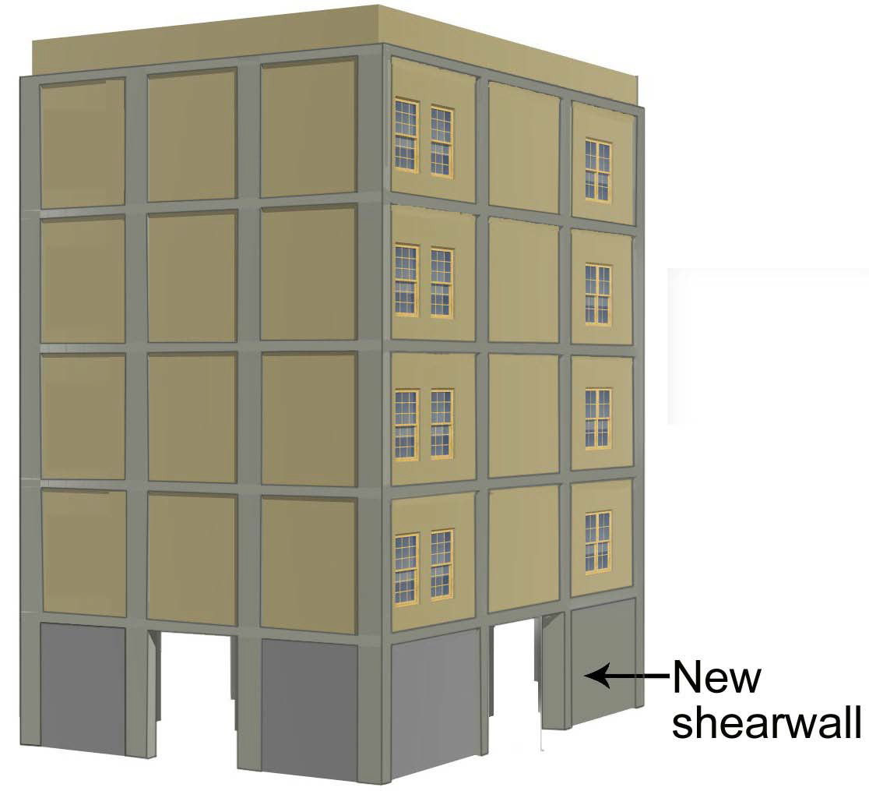
SHEAR WALLS IN SOFT STOREY

Slide 37
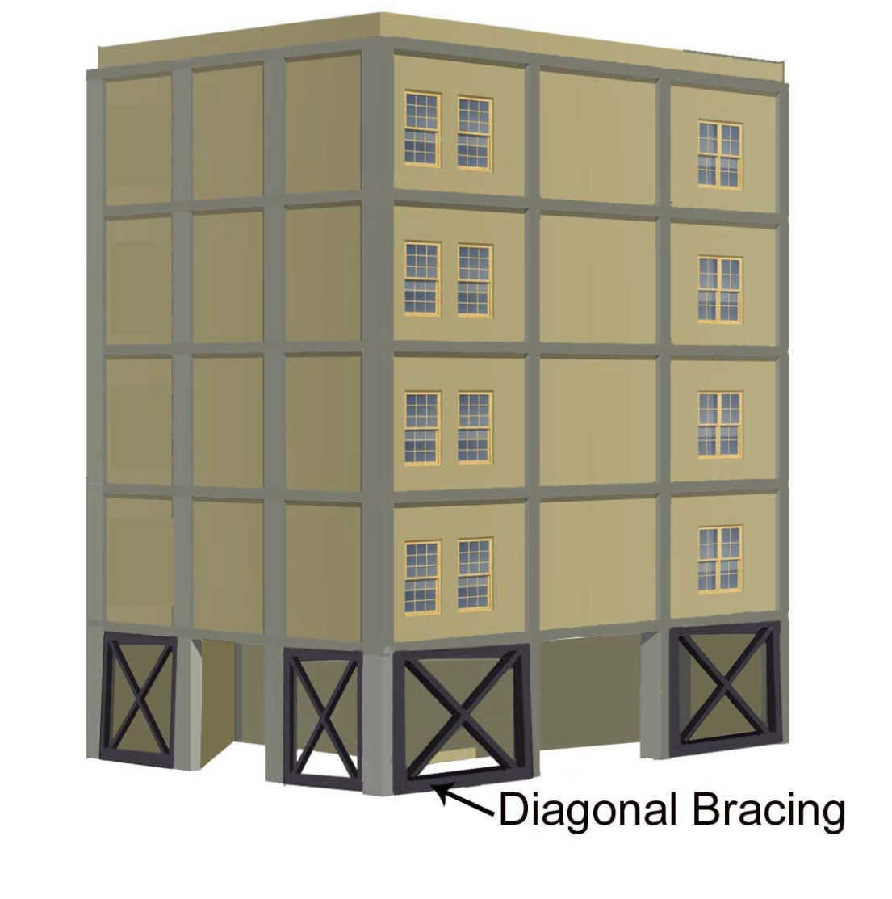
STEEL BRACING IN SOFT STOREY

Slide 38
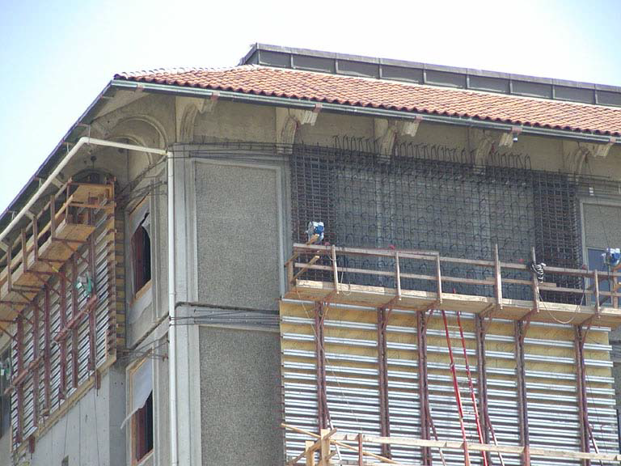
SHUTTERING FOR SHEAR WALLS

Slide 39
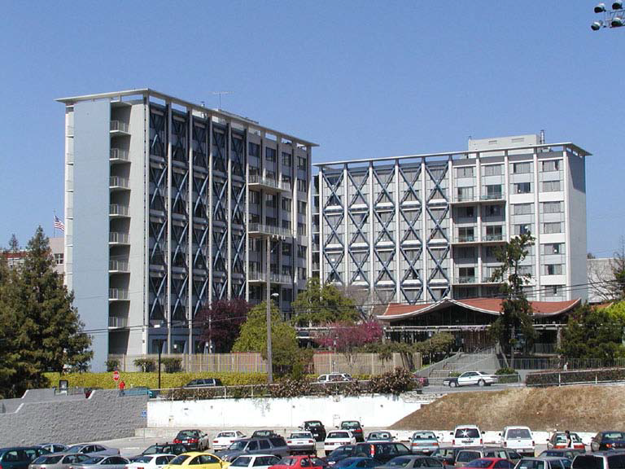
ADDING STEEL BRACING

Slide 40
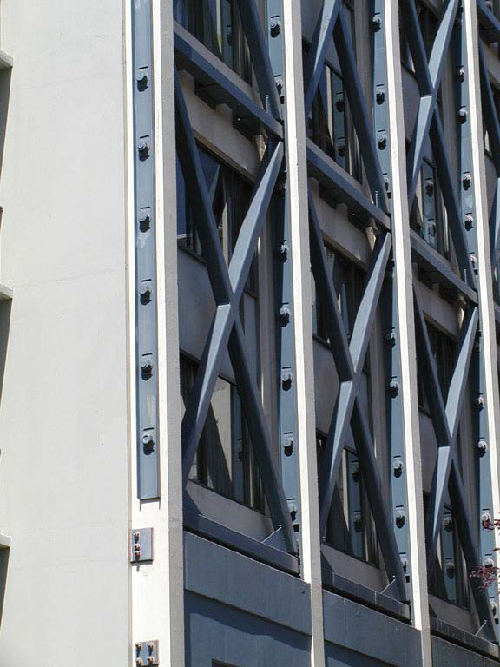
CONNECTION WITH EXISTING
MEMBERS

Slide 41
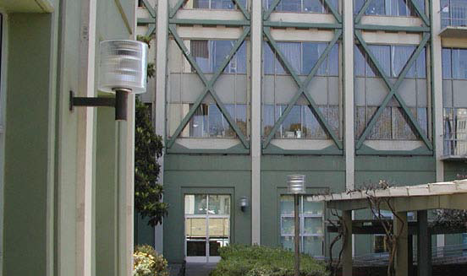
STEEL SHEAR WALLS

Slide 42
DESIGN OF SOFT GROUND
STOREY BUILDINGS
Option 1:
Detailed non-linear dynamic analysis to
ensure the deflection of the ground
storey columns to be within safe limits
Option 2:
Increased lateral stiffness of the ground
storey to avoid soft storey effect

Slide 43
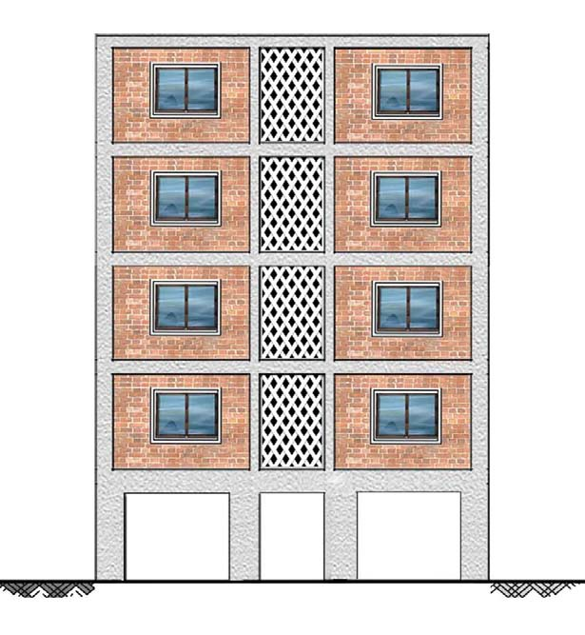
INCREASED BEAM-COLUMN SIZE
The size of the ground storey beams and columns is increased to have the stiffness of the ground storey comparable with upper storeys

Slide 44
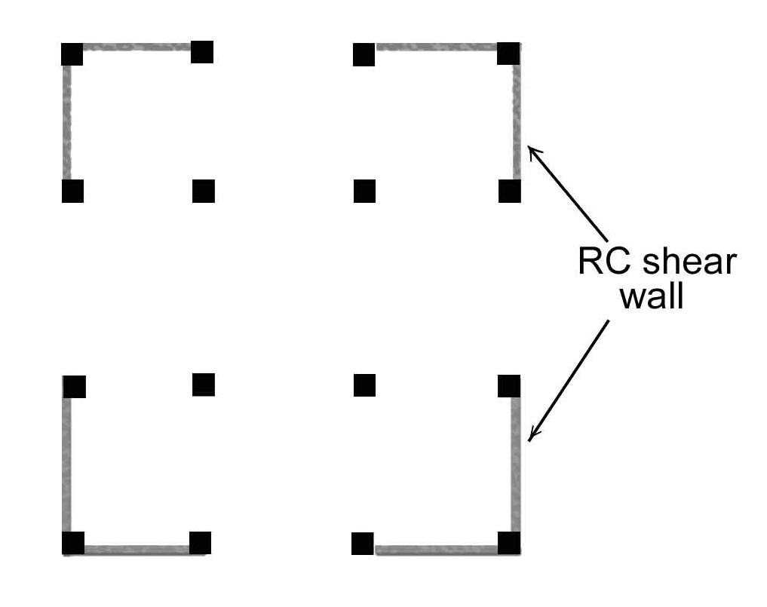
SHEAR WALLS AT GROUND STOREY
The ground storey should be provided with shear walls to increase the stiffness at ground storey

Slide 45
EARTHQUAKE DEMAND REDUCTION
THE RESPONSE OF THE STRUCTURE IS
MODIFIED TO REDUCE THE EARTHQUAKE
FORCES AND DISPLACEMENTS
STRATEGIES ARE:
1. REDUCTION OF MASS
2. BASE ISOLATION
3. ENERGY DISSIPATION

Slide 46
BASE ISOLATION
Generally required for large masonry buildings, excavations are made around the foundations of the building and the building (in piecemeal fashion) is separated from the foundations
Steel or reinforced concrete beams replace the connections to the foundations, while under these, layered rubber and metal isolating pads replace the material removed, these in turn are attached below to new or existing foundations.
These allow the ground to move while the building, restrained by its inertial mass, remains relatively static.

Slide 47
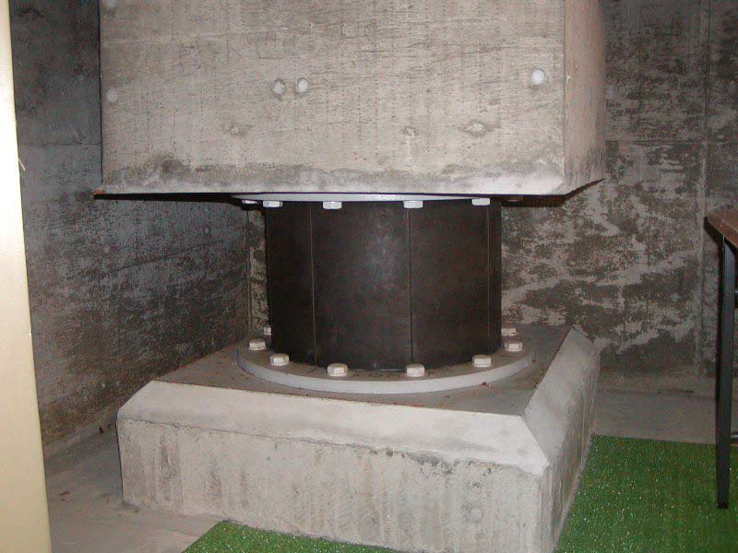
Base Isolation Devices
Lead rubber bearing

Slide 48
ENERGY DISSIPATION SYSTEM
Directly Increases The Structure Damping
Large relative displacements are required for effective damping.
More effective in frame structures with large window openings, than in shear wall buildings.
Sometimes braced frames are required for mounting.

Slide 49
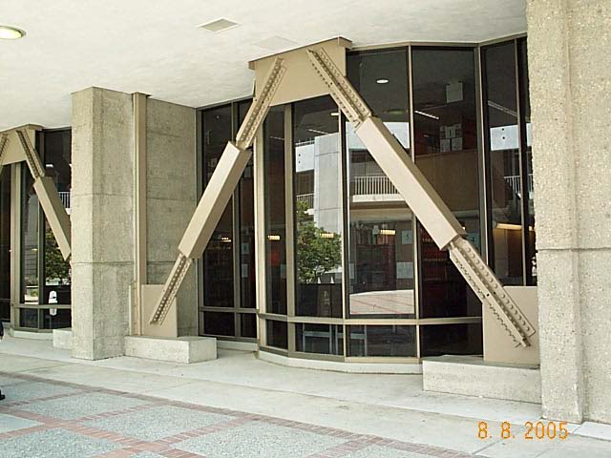
SPECIAL BRACES

Slide 50
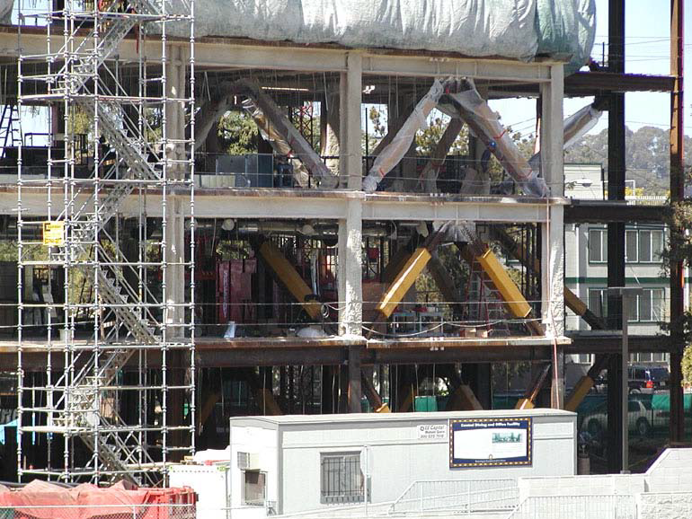
ENERGY DISSIPATING UNITS

Slide 51
CONCLUSIONS
Large Number Seismically Deficient Buildings -Quick Assessment Method
Upgradationof existing buildings is huge job and should be taken up on buildings’ importance basis
Government alone cannot do it
Techniques of retrofitting and strengthening should be applied
Techo-financing -tax exemption incentives

Slide 52
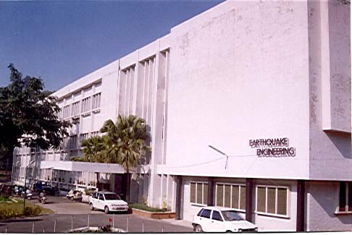
Thank You for your patient hearing

