Slide 1
AERATED AUTOCLAVED CONCRETE
Prepared by Ankit Patel
SD 1110

Slide 2
Applications
Residential Constructions
Commercial Constructions
Institutional Constructions
Hotels and Hospitals
Multi-storied Constructions
Industrial Constructions

Slide 3
Manufacturing process
Raw materials
lime
fine sand
Gypsum
Water
Cement
Aluminum powder

Slide 4
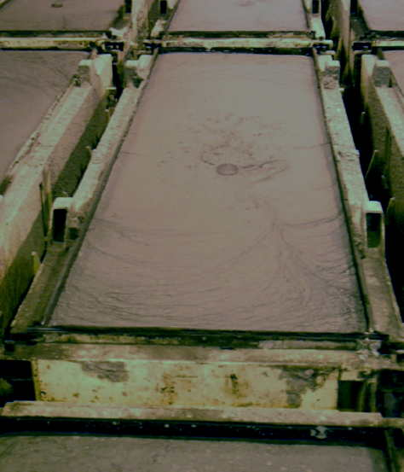

Slide 5
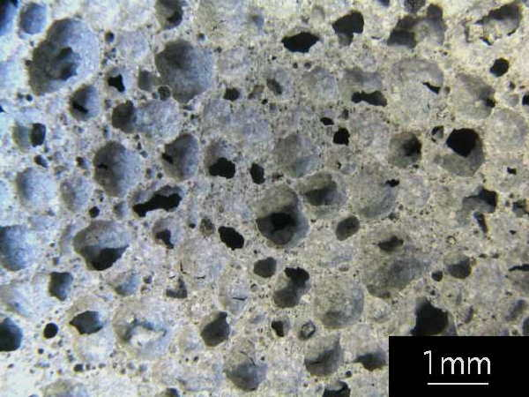

Slide 9
Benefits
Faster assembly
Material available through out the year
Cutting , chasing , nailing , etc. easily possible
Enhance the seismic resistance of the building
Ideal for multi-storied buildings, add-on floor and extensions using FSI/TDR

Slide 10
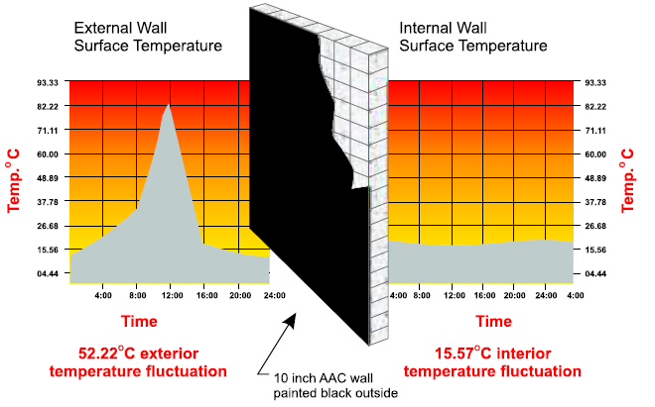
Properties of AAC
best thermal insulation

Slide 11
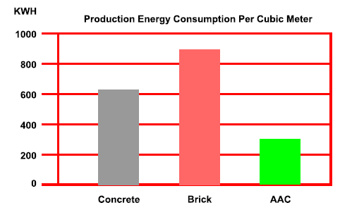
lowest energy consumption

Slide 12
fire-resistance – life saver – property saver

Slide 13
environmentally friendly, non-toxic
excellent sound absorption, ideal for the hotel industry
no waste of raw materials
Helps in earthquake resistance

Slide 14
Available in different size and shape

Slide 15
Compressive strength

Slide 16
Other properties
low weight results in easy handling and
rapid laying by the mason
Pest Resistant
Water resistance
Speed construction
does not rot, warp and rust

Slide 17
Comparison of AAC Block and Red Bricks
Sr.No | Parameters | AAC Blocks | Bricks
1 | Saving in steel | 15-20% | No saving in steel
2 | Quality | Uniform Quality due to mass production in the factory | Non-Uniform Quality
3 | Compressive strength | 30-35 Kg/cm2 | 20-25 Kg/cm2
4 | Cement Consumption | Less consumption of Mortar due to flat surfaces Column & Beam size reduced and so less Concrete Required | More consumption of Cement due to uneven surfaces NO saving in Concrete

Slide 18
5 | Labor Required | Less labors required | More labors required
6 | Sizes available | Available in sizes of 3", 4", 5", 6" 8",9" thickness | Available in 4", 6", 8" & 9" thickness
7 | Carpet area | More Carpet area is available in same built-up area due to less widths of walling | Less carpet area available due to more width of walling
8 | Construction time | Speedy construction due to its big size | Slow constructions due to small size
9 | Chemical Composition | Fly ash used app. 60 % which reacts with binders(Lime & Cement) to form AAC which is an inert material | Soil is used which contains many inorganic impurities like sulphates etc which results in efflorescence
10 | Energy saving | 30 % (app.) i.e. Air-condition Load both heating and cooling will come down. | No Saving

Slide 19
11 | Additional Properties | 1. Light weight ( Density 650 Kg/m3).
 |  | 2.Highly insulating ( K value: 0.16 W/(mK). Therefore saves 25% cost of installation and also recurring cost of Electrical charges. | 0.81W/(mK)
 |  | 3.Highly Fire -resistant and incombustible (4 Hrs for 150mm AAC Block | 2 Hrs
 |  | 4.Sound Absorption : Absorbency of airborne sound for 4" is 39-40 db. Helps to cut off sounds. Less sound pollution

Slide 20
AAC MORTAR

Slide 21
Benefits
It is eco friendly (biodegradable, inert, does not leach out, does not contribute to global warming)
It does not cause shrinkage (no expansion joints)
It is durable & economical
Needs no curing with water, easy to repair
Ready to use –RTU, wet mix jointing adhesive
Water Resistant , Time Saving

Slide 22
Walling is ready for rendering/plastering in 72 hrs depending on climatic conditions.
Non Hazardous , Excellent Bonding.
No Wastage–Keeps Site Clean
Crack Resistant , Reusable
No Supervision Required For Material procurement & Preparation

Slide 23
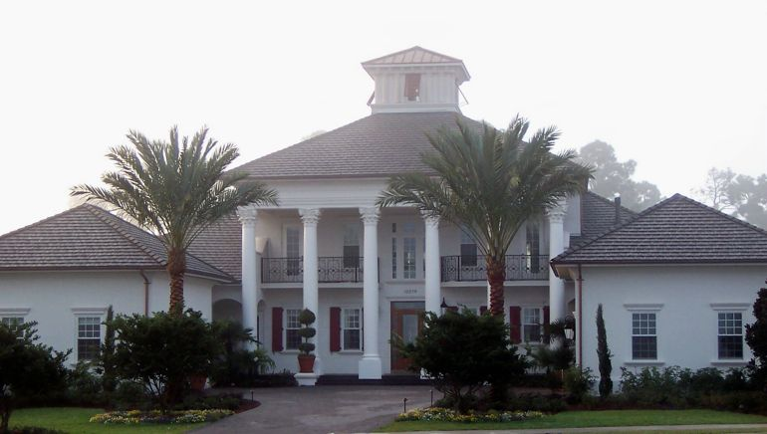
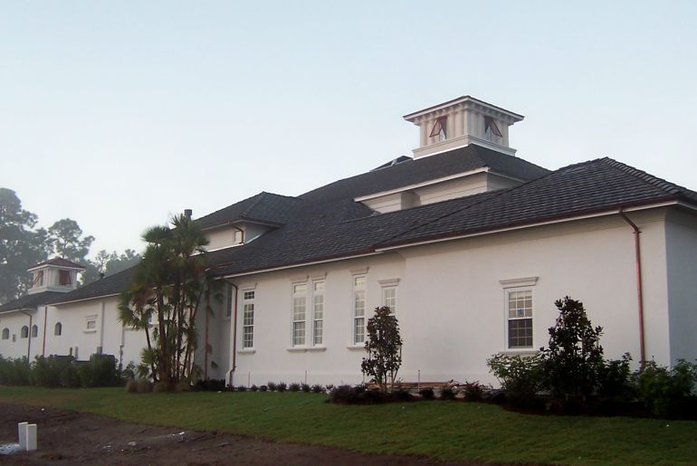

Slide 24
Conclusion
Due to its relatively low consumption of readily available raw materials, excellent durability, energy efficiency, relative cost effectiveness, and ability to be recycled, AAC is well deserving of its “green” designation.

Slide 25
Manufacturer and seller in India
optima cube inframaterials Surat
Bansal building material Surat
Mohit industry Surat
Lakshila technology Surat
Bhoomi agencies Maharashtra
Brick wall construction Hyderabad
Siporex Pune

Slide 26
Thank you

