Slide 1
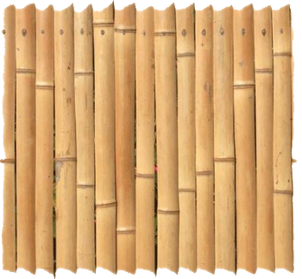
BAMBOO AS CONSTRUCTION MATERIAL
PRESENTED BY:-
UNADKAT VISHAL K.
CODE NO.:-SD -2010
CEPT UNIVERSITY

Slide 2
CONTENTS
INTRODUCTION
USE OF BAMBOO IN CONSTRUCTION
ADVANTAGES OF BAMBOO
BASIC PROPERTIES OF BAMBOO
STRESS-STRAIN BEHAVIOUR OF BAMBOO WITH CONCRETE
SOME PART OF DESIGN
CASE STUDIES
CONCLUSION
REFERENCES

Slide 3
INTRODUCTION

Slide 4
INTRODUCTION TO BAMBOO
Bamboo is a woody grass. It is the fastest-growing woody plant in the world. Some species of bamboo grow so fast you can almost see them grow.
Bamboos are some of the fastest growing plants in the world. They are capable of growing 60 cm or more per day. However, the growth rate is dependent on local soil and climatic conditions.
Bamboo are found in diverse climates, from cold mountains to hot tropical regions. They occur across East Asia, through to Northern Australia, and west to India and the Himalayas.

Slide 5
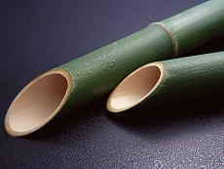
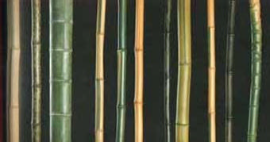
In bamboo, the inter nodal regions of the stem are hollow and the vascular bundles in the cross section are scattered throughout the stem instead of in a cylindrical arrangement.

Slide 6
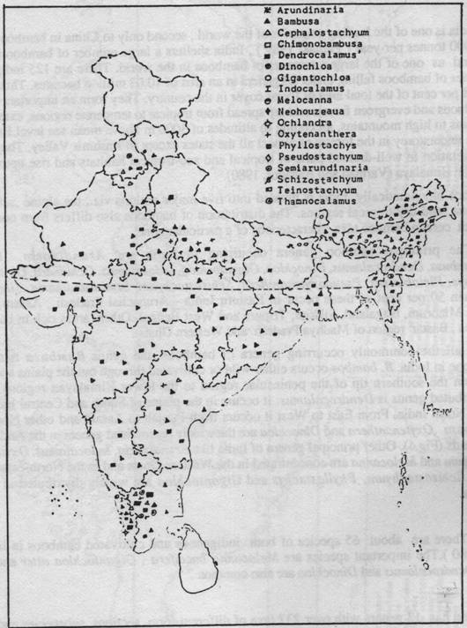
BAMBOO RESOURCES IN INDIA
MAJOR BAMBOO GROWING
REGIONS / STATES
AREA Gross
( % ) Share
North East 28.0 66
Madhya Pradesh 20.3 12
Maharashtra 9.9 5
Orissa 8.7 7
Andhra Pradesh 7.4 2
Karnataka 5.5 3
Other States 20.2 5
(Kerala, UP,
Jharkhand,
West Bengal)
India is home to almost 45 % of world's bamboo forests
4.5 M tons annually produced from 8.96 m ha.

Slide 7
ADVANTAGES OF USING BAMBOO

Slide 8
ADVANTAGES
Low-cost and environment friendly.
Light weight compared to steel.
Shock absorbing and thus earthquake resistant.
It uses less fossil fuel to manufacture.
Bamboo can prevent pollution by absorbing large amounts of nitrogen from waste water and reducing the amount of carbon dioxide in the air.
Its abundance in tropical and subtropical regions makes it an economically advantageous material.

Slide 9
USE OF BAMBOO IN CONSTRUCTION

Slide 10
USE OF BAMBOO IN CONSTRUCTION
Scaffolding
Reinforcement
Roofing
Walling
Doors & Windows

Slide 11
BASIC PROPERTIES OF BAMBOO

Slide 12
TENSIL STRESS AND UNIT WEIGHT
The common tensile stress in steel reinforcement is 160 N/mm² and in bamboo 370 N/mm².
The mass per volume of steel is 7850 kg/m³ and of bamboo is about 500-600 kg/m³.
Evidently bamboo will be cheaper because the price of bamboo per weight will be less than half that of steel.

Slide 13
MODULUS OF ELASTICITY
The cellulose fibers in bamboo act as reinforcement similar to reinforcing steel bars in concrete. The distribution of these fibers increases from the inside to the outside.
The E-modulus for cellulose is 70 000 N/mm² and about 50% of the cross-section of the fiber is cellulose; the E of the fiber is 35 000 N/mm².
In most bamboos, fibers constitute about 60% on the outside and 10% on the inside.

Slide 14
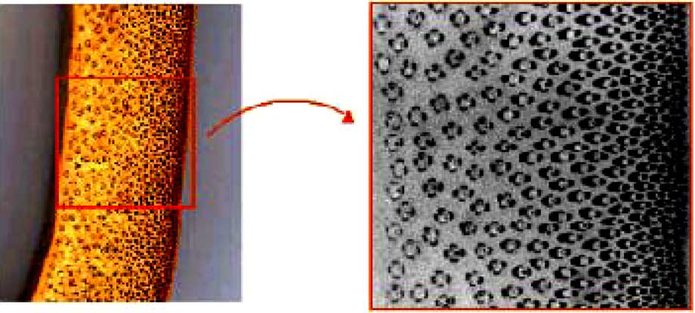
The density of the fibers in the cross-section of a bamboo shell varies along its thickness.
This presents a functionally gradient material, evolved according to the state of stress distribution in its natural environment.
The fibers are concentrated in regions closer to the outer skin. This is consistent with the state of stress distribution when the Culm is subjected to wind forces

Slide 15
DURABILTY
Bamboo with low humidity is less prone to mould attacks especially when humidity content is less than 15%.
Physical and mechanical properties of bamboo increase with a decrease in its humidity content.
Bamboo to be treated with a preservative needs to be dry to facilitate penetration. Bamboo can be dried in air, green house, and oven or by fire.

Slide 16
The durability of bamboo depends strongly on the preservative treatment methods in accordance with basic requirements, its chemical composition should not have any effect on the bamboo fiber and once injected it must not be washed out by rain or humidity.
Many steel and concrete structures built in the past 30years reveal serious deterioration caused mainly by the corrosion of the steel reinforcement.

Slide 17
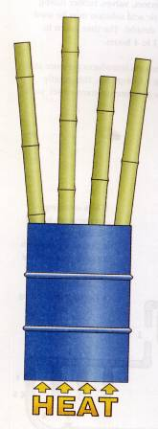
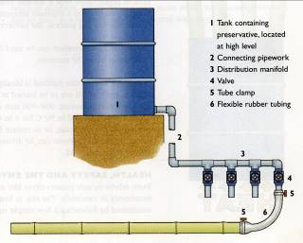
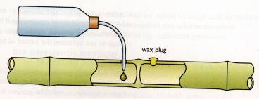
Process of Preservation
IS 401:2001 Code of Practice for Preservation of Timber
1. Surface application ( brushing, dipping)
3. Boucheire Process
5. Inter Nodal Injection
4. Diffusion Process
2. Hot & Cold Method

Slide 18
Preservatives Recommended
Coal Tar Creosote
Copper – chrome - arsenic compositions
Acid- cupric – chromate composition
Copper – chrome- born composition
Copper zinc – napthanate Abietates

Slide 19
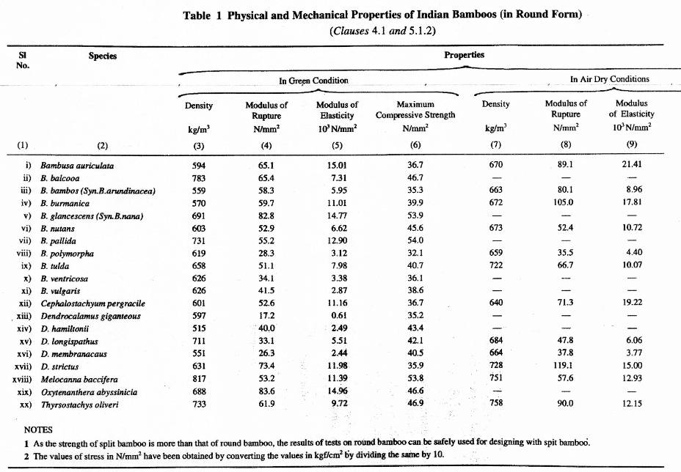
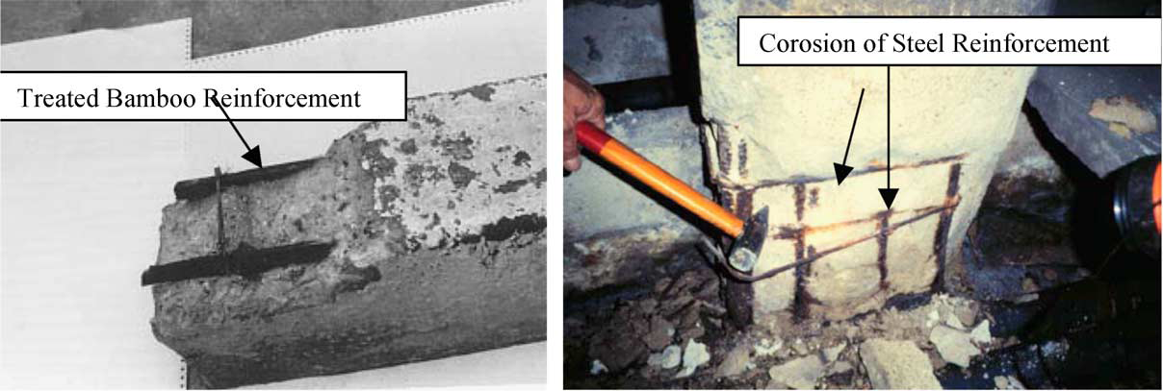
A steel reinforced concrete column after 10 service years and first bamboo reinforced concrete beam tested and compared.
The bamboo reinforced beam after testing has been exposed to open air.
It can be observed that the bamboo segment of the beam reinforcement, treated against insects as well as for bonding with concrete, is still in satisfactory condition after 15 years.

Slide 20
EARTHQUAKE RESISTANCE

Slide 21
EARTHQUAKE RESISTANCE
As said earlier, bamboo is a perfect material for earthquakes it is lightweight, and the hollow form gives much stiffness.
But some can ask how to assess whether a bamboo house would survive an earthquake of a given intensity? But for that A dynamic test on a full-scale house is extremely expensive.
So that At the National Bamboo Project of Costa Rica, only typical walls were tested, using a static test. The wall was fixed on a steel frame and using a hydraulic jack, a horizontal force was applied at an upper corner and in the plane of the wall.

Slide 22
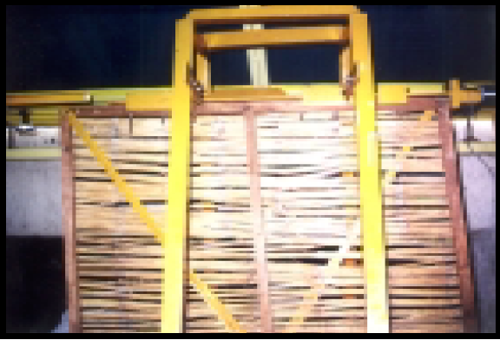
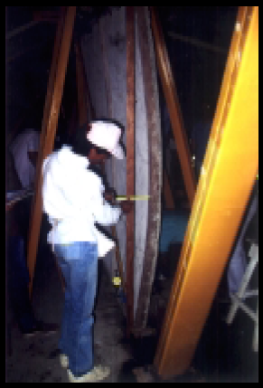

Slide 23
A panel made of split bamboo. The hydraulic jack, which applies horizontal force, can be seen at the top right corner of the frame.
This jack simulates the effect of earthquake. Different walls have been tested: with and without diagonal, with and without mortar, etc. The results were more than satisfactory.
The deformation being measured at the lower end of a panel with plaster.
The deformation was 120 mm, without any visual damage to the plaster and the panel.
From this reading the bamboo housing system was assessed as earthquake-resistant.
The real proof came in April 1991, when about 20 bamboo houses survived quite near to the epicenter of a 7.5 Magnitude earthquake.

Slide 24
SEISMIC REINFORCEMENT
The most important factor for the improved seismic performance of adobe construction is to provide reinforcement for the walls.
Earthquake shaking will cause adobe walls to crack at the corners and to break up in large blocks.
The role of the reinforcement therefore is to keep these large pieces of adobe wall together.
A ring beam that ties the walls in a box-like structure is one of the most essential components of earthquake resistance for load bearing masonry construction.
The ring beam must be strong, continuous, and well tied to the walls, and it must receive and support the roof. The ring beam can be made of concrete or timber.

Slide 26
Vertical reinforcement helps to tie the wall to the foundation and to the ring beam and restrains out-of-plane bending and in-plane shear.
Horizontal reinforcement helps to transmit the out-of-plane forces in transverse walls to the supporting shear walls, as well as to restrain the shear stresses between adjoining walls and to minimize vertical crack.
Some building codes have incorporated these recommendations for the construction of new adobe houses, such as the Adobe Construction Regulations of the province of San Juan, Argentina, that have incorporated the use of the ring beam, and the Peruvian Adobe Code that incorporated a ring beam together with vertical and horizontal reinforcement.

Slide 27
STRESS STRAIN DISTRIBUTION

Slide 28
Stress and strain distribution in an element subjected to bending

Slide 29
In previous slide D, d and b are the total, the effective depth and the width of the bending element respectively.
Abt is the area of bamboo subjected to tension, ec and fc are compression strain and stress of the concrete, ebt and fbt are tensile strain and stress in bamboo.
In stage 1 for a small load, the stress and strain are in linear elastic range.
In stage 2 With the increase of the applied load the stress diagram in the compression zone of concrete continues to be non-linear before its ultimate strength ‘‘fcu’’ and bamboo in tension starts to break from its extreme lower layer and hence, starting the third stage.

Slide 30
In stage 3 the diagram of normal compression zone of concrete is of parabolic shape. However, for the development of formulae for the practical design a rectangular shape is adopted.
Depending on the percentage of bamboo reinforcement three cases may occur:
the case with under-reinforcement, where the failure of bamboo leads to the collapse of the bending element;
with over-reinforcement, where the collapse of the element occurs due to compression failure of concrete; and
the balanced case, where both concrete and bamboo could fail simultaneously.

Slide 31
REPLACEMENT OF MUD OR BRICK WALLS WITH BAMBOO REINFORCED CONCRETE PANEL

Slide 32
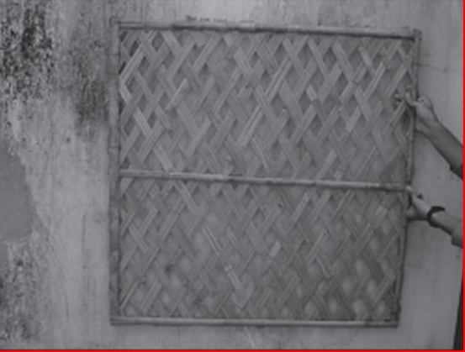
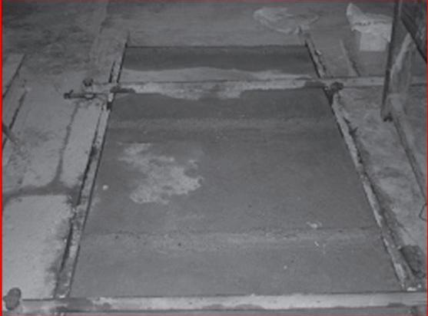
REPLACEMENT OF MUD OR BRICK WALLS WITH BAMBOO REINFORCED CONCRETE PANEL
In this case bamboo meshes are used as reinforced material in concrete. The use of bamboo mesh panels as wall makes the structure economical, shock absorbing and environment-friendly.

Slide 33
Concrete Mix Proportion
The same mix proportions which are used in case of steel reinforced slabs can be used but it is preferred to use concrete which has high early strength cement so as to reduce cracks caused by swelling of bamboo.
The concrete used in the panels is lean mixture with mix proportions of 1:2:4 of cement: fine aggregate: course aggregate and water to cement ratio of 0.4, all measured by weight.

Slide 34
Bamboo Framework
The bamboo used in the panels was allowed to dry for two to three weeks before construction of the panels, so as to remove all the moisture present in the bamboo.
Then a framework of bamboo strips is constructed by cross-linking the strips.
To avoid swelling of bamboo strips, a thin coating of asphalt is applied, as thick coating will lubricate the surface and thus weaken the bond between bamboo and concrete.
This bamboo framework can also be brought from the market as it is readily available.

Slide 35
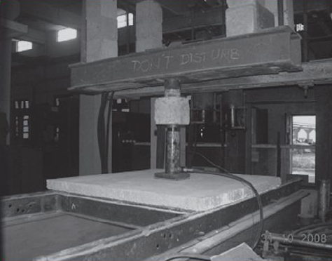
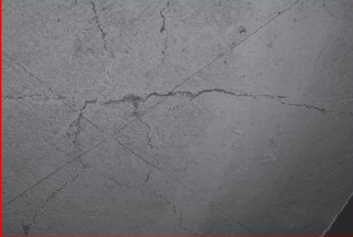
Three singly bamboo reinforced slabs were tested with the central point loading test. Also, three cubes of 150 mm × 150 mm × 150 mm and three cylinders of 150 mm × 300 mm were casted for finding out the 28 days compressive strength.
The average compressive strength of the cube and cylinder were found 19.89 N/mm² and 19.32 N/mm², respectively.

Slide 36
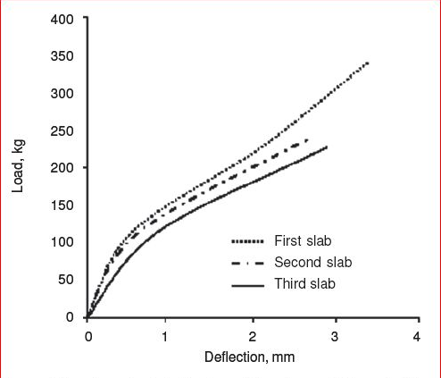
The collapse load of the first, second and third slabs were found 453 kg, 352 kg and 341 kg, respectively. It is important to note that the least count of the proving ring used was one division = 10 kg/cm².

Slide 37
COST COMPARISION

Slide 38
Study concludes that…..
The strength of bamboo concrete panels is quite higher than the mud wall and use of bamboo is highly recommended in flood prone areas.
The bamboo concrete panels are much more durable.
The initial cost of the bamboo-concrete panels is higher but the maintenance cost is lower as compared to mud walls.
The technology evolved can be effectively adopted for construction of low-cost houses with cost ranging from Rs 180 to 250/feet² depending upon the design of the house and nature of interior finish, and also upon the local conditions.

Slide 39
Construction of bamboo panels does not require much skill and can be easily done.
Mud walls get washed in case of floods which do not happen in case of bamboo reinforced concrete walls.
For regions, where the availability of steel is limited and plain concrete members are commonly being used, the use of reinforced bamboo concrete is highly recommended.
Asphalt coating on the bamboo mat and sand spraying increase the bond between concrete and bamboo.

Slide 40
SOME DESIGN PARAMETERS
CONCRETE MIX
The same mix designs can be used as would normally be used with steel reinforced concrete.
Concrete slump should be as low as workability will allow

Slide 41
SPACING OF BAMBOO
Bamboo reinforcement should not be placed less than 1-1/2 inches from the face of the concrete surface.
The clear spacing between bamboo rods or splints should not be less than the maximum size aggregate plus 1/4 inch.
Reinforcement should be evenly spaced and lashed together on short sticks placed at right angles to the main reinforcement.
Bamboo must be securely tied down before placing the concrete. It should be fixed at regular intervals of 3 to 4 feet to prevent it from floating up in the concrete during placement and vibration.

Slide 42
CHARACTERISTICS VALUE
A material property is represented by a 5 percentile property, estimated from test results, obtained as in DIS 22157 .
“Determination of physical and mechanical properties of bamboo ", with 75 % confidence that it represents the population. This is called the characteristic value. It can be obtained with this formula:

Slide 43
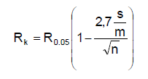
in which:
Rk = the characteristic value,
R0.05 = the 5 percentile from the test data,
m = the mean value from the test data,
s = the standard deviation from the test data,
n = the number of tests (at least 10).

Slide 44
Allowable stresses
Instead of the limit state design procedure, allowable stress design can be adopted. Allowable stresses can be derived from test results with the next formula.
sigma(all) = Rk x G x D / S
Where
sigma(all) is the allowable stress in N/mm² ,
Rk is the characteristic value,
G is the modification for the difference between laboratory quality and practice; default value 0.5,
D is the modification value for duration of load:
- 1.0 for permanent load,
- 1.25 for permanent plus temporary load,
- 1.5 for the above plus windload.
S is the factor of safety, default value 2,25.

Slide 45
SOME PHOTORAPHS OF ARRANGEMENT OF BAMBOO

Slide 46
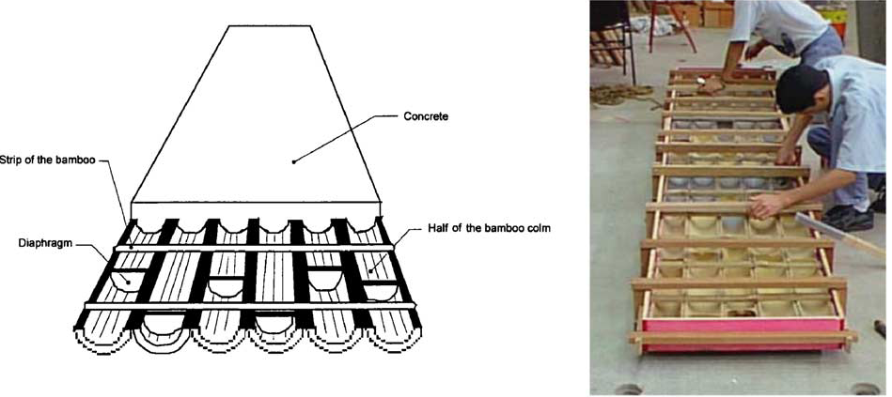

Slide 47
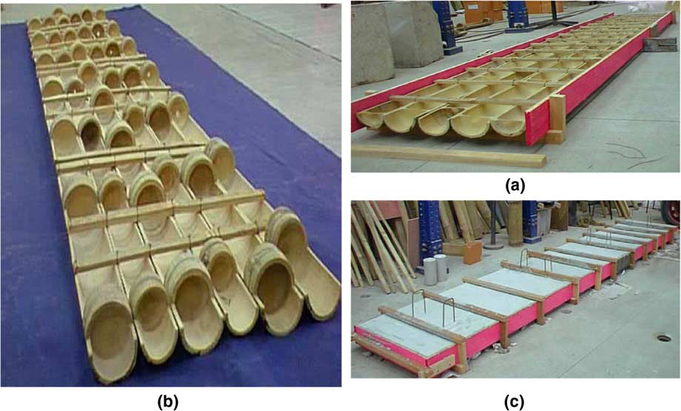

Slide 48
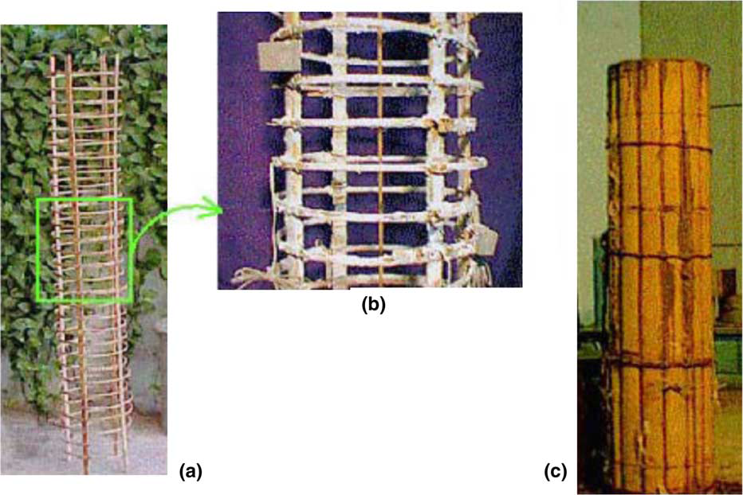

Slide 49
INDIAN STANDARDS

Slide 50
Indian Specifications for Bamboo & Bamboo Products
IS 14588 : 1999 Specification for Bamboo Mat Veneer Composite for General Purposes
IS 13958 : 1994 Specification for Bamboo Mat Board for General Purposes
IS 1902 : 1993 Code of Practice for Preservation of Bamboo and Cane for non-structural purposes
IS 10145 : 1982 Specification for Bamboo Supports for Camouflaging Equipment
IS 9096 : 1979 Code of Practice for Preservation of Bamboo and Cane for Structural purposes
IS 8242 :1976 Method of Tests for Split Bamboo
IS 8295 :1976 Specification for Bamboo Chicks ; Part 1 Fine, Part 2 Coarse
IS 7344 : 1974 Specification for Bamboo Tent Pole
IS 6874 : 1973 Method of Tests for Round Bamboo
IS 15476 : 2004 Specification for Bamboo Mat Corrugated Sheets
IS 9096:2006 Code of Practice for preservation of bamboo for structural purpose

Slide 51
APPLICATION OF BAMBOO IN VARIOUS PROJECTS

Slide 52
Construction of demonstration structures using bamboo materials in Mizoram and Tripura
Salient Features of the Structures
Bamboo posts
Bamboo grid ferrocement walls
Bamboo trusses and purlins
Bamboo Mat Corrugated Sheet Roofing

Slide 53
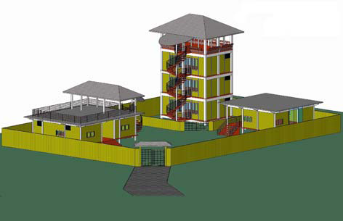
Demonstration buildings for Kerala forest Research Institute, Nilambur , Kerala
View of the complex showing three buildings different category of application- residential, office and medium rise.
All the components of the buildings are of bamboo.

Slide 54
‘Whispering Palms’ Holiday resort for Abad group of Hotels at Kumarakom.

Slide 55
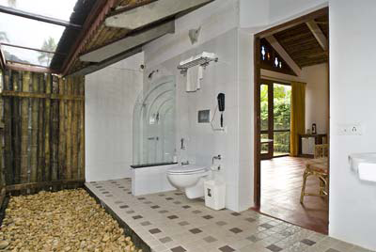

Slide 56
Premises in Cochin, Kerala

Slide 59
The structure
Covering an area of 2750 Sft, this office is probably the first and largest of its kind and an experiment where we have attempted to develop a technology for using bamboo in floors, walls and roofs in ways that meet needs.
Bamboo is used in combination with RCC (columns) ferro-cement (beams) and a limited quantity of reinforced plaster so as to arrive at an attractive functional and replicable combination of technologies.

Slide 60
DISADVANTAGES
It is not that uniform, i.e., large varieties of bamboo are found having different tensile strength.
It has tendency to absorb water and also to release water on drying.
Bamboo wood is easily infected by wood-boring insects and attracts living organisms, such as, fungi and insects because of its high content of nutrients unless treated with wood preservatives or kept very dry.
It is susceptible to catch fire as compared to steel.

Slide 61
CONCLUSION
Since bamboo is an environment friendly material it should give more importance.
Bamboo is very light in weight with compare to steel so dead load of the member can be decreased with use of it.
Bamboo is easily avail material so it is economic material and by using it we can reduced the cost of construction.
Since bamboo is very effective in seismic resistance, use of it should be safe.

Slide 62
REFERENCES
BOOKS
“Bamboo as reinforcement in structural concrete elements” by:-Khosrow Ghavami
“Design and building with bamboo” by:- Jules J.A.Jansse
REPORTS
“Bamboo Reinforced Concrete Wall as a Replacement to Brick and Mud Wall” by:- M Mishra, S Mujumdar
“Connections and slab for bamboo construction” by Guzman David, PhD candidate ,Morel Claude,Professor
”Adobe Construction” by Marcial Blondet and Gladys Villa Garcia M. Catholic University of Peru, Peru

Slide 63
THANK YOU

