Slide 1
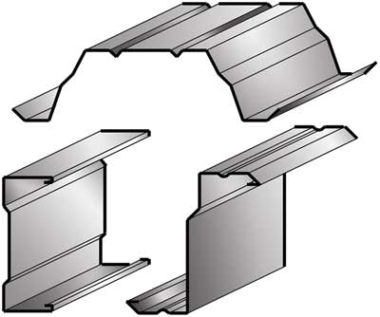
SEMINAR – 1 (Interim presentation)
Cold formed steel sections
Faculty-
V.R.Shah
Dhara Shah
Anal Shah
Prepared By-
RAVI PANCHAL(SD-1009)

Slide 2
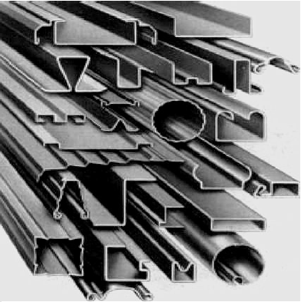
Content :- 1) Introduction 2) Forming method & it’s shape 3) Hot rolled v/s cold formed steel section(comparison) 4) Application 5) Advantages 6) Some definition & codal Provision 7) Behavior of cold form steel

Slide 3
Introduction :-
Thin sheet steel products are used in building industry and range from purlins to roof sheeting and floor decking , Generally these are available for use as basic building elements for assembly at site or as prefabricated frames or panels.
These thin steel sections are cold-formed, i.e. their manufacturing process involves forming steel sections in a cold state (i.e. without application of heat) from steel sheets of uniform thickness.
These are called as Cold Formed Steel Sections.

Slide 4
These sections are also called Light Gauge Steel Sections or Cold Rolled Steel
These are generally used for light and moderate loads and for structural members of short lengths.
Cold formed steel (CFS) members are made from structural quality sheet steel that are formed into shape either through press-braking blanks, sheared from sheets or coils, or more commonly, by roll forming the steel through a series of dies. (No heat is required )
It is thinner, lighter, easier to produce, cheaper then hot-rolled section.
Thickness of steel sheet is varied from 0.4mm to 25mm.

Slide 5
Forming method :-
The common cold rolled products are coils and sheets.
Cold rolled sheets could be made as thin as 0.3 mm. Cold-forming is a process by which the sheets (hot rolled / cold rolled) are folded in to desired section profile by a series of forming rolls in a continuous train of roller sets.
Such thin shapes are impossible to be produced by hot rolling. These cold formed sheet steels are basically low carbon steels (<0.1 % carbon).

Slide 6
There are generally three methods used in the manufacture of cold-formed
1. Cold roll forming
2. Press brake operation
3. Bending brake operation
1) Cold Roll Forming :-
The method of cold roll forming has been widely used for the production of building components such as individual structural members and some roof, floor, and wall panels and corrugated sheets.

Slide 7
2) Press Brake :-
The press brake operation may be used under the following conditions:
1. The section is of simple configuration.
2. The required quantity is less than about 300
linear ft /min (91.5 m/min).
3. The section to be produced is relatively wide [usually more than 18 in. (457mm)] such as
roof sheets and decking units.
The equipment used in the press brake operation consists essentially of a moving top beam and a stationary bottom bed on which the dies applicable to the particular required product are mounted.

Slide 8
3) Bending brake operation :-
Most shops that process heavy-gage materials use press brakes. Light-gage metal typically forms through bending machines.
In bending brake machine a workpiece placed between upper and lower dies forms through the force and pressure exerted by lowering the ram. It is a specialized type of press consisting of a long, narrow ram and bed. Manufacturers offer press brakes in a variety of sizes and capabilities
In Bending dies comprise the bulk of press-brake tooling, other tooling performs punching, countersinking, and embossing operations.

Slide 9
Some of the manufacturer are in India

Slide 10
Shapes:-
The shapes of cold-formed sections used in industrial applications are necessarily shaped to meet the specific requirement of the loading conditions and the utility.
Most common sections in building applications are C & Z sections with wide variation in their original forms to enhance the efficiency of these sections with use of lips and stiffeners.

Slide 11
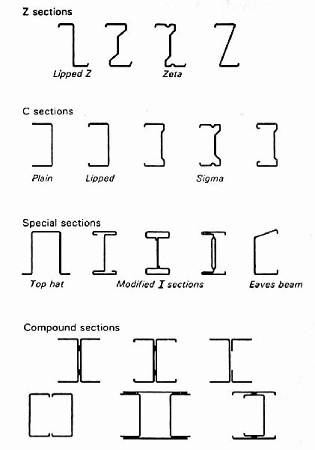

Slide 12
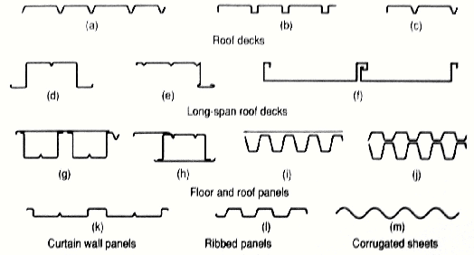

Slide 13
Comparison:-
Hot rolled section
Thicker than cold-formed sections
Local instabilities are not exhibited
Cold formed section
Thinner than hot-rolled sections
Behavior is necessarily characterized by local instabilities
No post buckling strength
Manufacturing process involves heat treatment
Local buckling is helped by post buckling strength
• Manufacturing process does not involve heat .

Slide 14
Hot rolled section
Cold formed section
Close tolerances are not possible. &
Also sections change per batch.
Cross sectional shapes are formed to close tolerances and these can be consistently repeated for as long as required.
Limited types of shapes can be produced.
Also weight limits its to Length.
Cold rolling can be employed to produce almost any desired shape to any desired length.
High strength to weight ratio as
compared to reinforced concrete but not as high as cold-formed sections.
High strength to weight ratio is achieved in cold-rolled products.

Slide 15
Application:-
1. Roof and Wall members
2. Purlins and Side railing
3. Light Steel Framing
4. Housing
5. Lintels
6. Floor Joists
7. Systems for Commercial Buildings

Slide 16
8. Roof Trusses
9. Stud-Walling - Separating Walls and Partitions
10.Space Trusses
11. Infill Walling and Over-Cladding
12. Prefabricated Modular Buildings
13. Frameless Steel Buildings
14. Storage Racking
15. Composite Decking

Slide 17
Advantages:-
Advantages of using cold-formed sections are :
1. Long span compatibility and capacity to form
shape to suit specific application.
2. Dimensional accuracy.
3. Long term durability in internal environments.
4. Freedom from long term creep and shrinkage.

Slide 18
5. Ease of construction, as members are delivered
to site cut to length and with pre-punched
holes, requiring no further fabrication.
6. Ability to be fabricated into sub-frames as wall
panels etc.
7. Robustness (sturdy), but sufficiently light for
site handling.

Slide 19
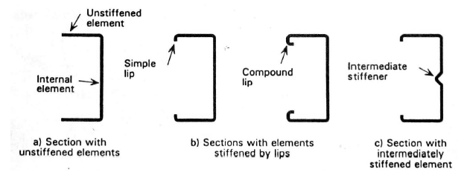
Definition & its codal Provision
1) Stiffened & Unstiffened Compression
Elements :-
An unstiffened element is one, which is supported along one longitudinal edge only with the other parallel edge being free to displace.
An element which is supported by webs along both its longitudinal edges is called a stiffened element.

Slide 20
An intermittently stiffened element is made of a very wide thin element which has been divided into two or more narrow sub elements by the introduction of intermediate stiffeners, formed during rolling.
An Element that is stiffened between webs, or between a web and a stiffened edge by means of intermediate stiffeners which are parallel to the direction of stress.
A sub-element is the portion between adjacent stiffeners or between web and intermediate stiffener or between edge and intermediate stiffener.

Slide 21
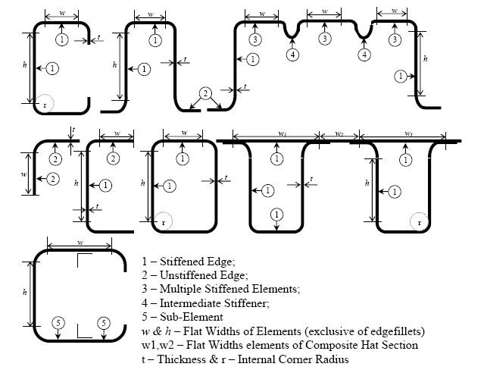

Slide 22
Behavior of cold formed steel :-
BEHAVIOUR OF THIN PLATES IN
COMPRESSION
1) Elastic Buckling
The behavior of cold-formed sections is governed by the local buckling phenomenon. Due to high width to thickness ratios, the sections undergo local deformation before yielding.
There exists post-buckling strength on account of which the sections continues to take load without failure.

Slide 23
This Local buckling is an extremely important aspect of cold formed steel sections as very thin elements used will invariably buckle before yielding.
Thinner the plate, the lower will be the load at which the buckles will form. Full compression resistance of a perfectly flat plate supported on two longitudinal edges can be developed for a w/t ratio of about 40.

Slide 25
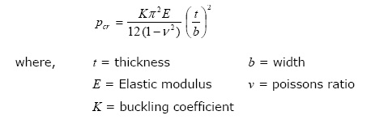
At greater widths, buckles form elastically causing a loss in overall compressive strength of plate. This is due to the inability of the more flexible central portion to resist as much compression as the outer portions.
Critical compressive stress at which elastic buckling of the plate occurs is given by

Slide 26
2) Post-Critical Behavior :-
The elastic local buckling phenomenon occurs preferentially in flat width ratio range of 30 to 60, as the elements are not purely flat and a state of non-uniform stress exists throughout the loading regime. But for the flat width ratios exceeding 60, the inplane tension stresses develop which resist further buckling, and zone of compression yielding from the longitudinal supports to covering a greater width of elements.
These post-critical effects cause an effective load-carrying capacity of wide plate relative to a value as given by above mention Equation Due to high width to thickness ratios, the sections undergo local deformation before yielding.

Slide 27
There exists post-buckling strength on account of which the sections continues to take load without failure.
3) Effective Width Concept
The effects of local buckling can be evaluated by using the concept of effective width.
Lightly stressed regions at centre are ignored, as these are least effective in resisting the applied stresses. Regions near the supports are far more effective and are taken to be fully effective.
The section behavior is modeled on the basis of the effective width (beff) sketched

Slide 29
This effective width, (beff) multiplied by the edge stress (ƒ) is the same as the mean stress across the section multiplied by the total width (b) of the compression member.
The effective width of an element under compression is dependent on the magnitude of the applied stress (Fc), the width/thickness ratio of the element and the edge support conditions

Slide 30
B) Behavior of web
The behavior of webs of cold-formed sections’ is quite important from the design and effectiveness point of view.
Webs generally are subjected to and are affected by
1) web shear
2) web bending
3) web crushing & crippling
1) Web shear:-
Slender webs normally buckle due to transfer of shear from web section incapable of transfer and fail due to shear buckling usually initiated by eccentric load not along plane of web.

Slide 31
Normally the limiting height to width ratio of web will suffice for light loads along with limiting the average shear stress to 0.6 Fy as which the shear yielding occurs.
2) Web bending :-
The webs are subjected to maximum stresses at their junction with the compression flanges. Thus, it must be noted that in very deep webs the web sections can also be affected by the local buckling phenomenon, hence reducing the net effective section of the web as well like compression flanges.
This quite differs from the normal section under compression, as the stress is varying along the depth of the web section.

Slide 32
3) Web crushing & crippling :-
Web crippling at points of concentrated loads and supports can be a critical problem in cold-formed steel structural members and sheeting for the following reasons,
In cold-formed design, it is often not practical to provide load bearing and end bearing stiffeners. This is always the case in continuous sheeting and decking spanning several support points.
The depth to thickness ratios of the webs are usually much larger.
In many cases the webs are inclined rather than vertical.

Slide 33
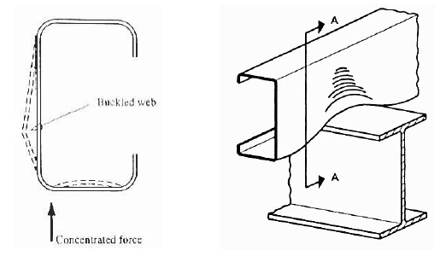
The load is generally applied to the flange, which causes the load to be eccentric to the web and causes the initial bending in the web even before crippling takes place.
The larger the corner radius the larger the
effect of web crippling.

Slide 34
3) Behavior in flexure :-
Lateral torsional buckling
Lateral buckling will not occur if the beam under loading bends only about the minor axis.
If the beam is provided with lateral restraints, capable of resisting a lateral force of 3% of the maximum force in the compression flange, the beam may be regarded as restrained and no lateral buckling will occur.
In case of cold-formed steel sections, they have low torsional stiffness as they are thin.

Slide 35
Many of the sections produced by cold-forming are generally of singly symmetric nature. Hence, the shear centre does not coincide the centroidal axis at which they are loaded.
If the section would have been loaded along the shear centre axis there would have been only flexural bending.
The thin flanges tend to buckle in bending compression and result in overall lateral buckling with twisting. This phenomenon is specifically know as flexural torsional buckling.

Slide 36
References:-
IS 801-1975 “Code of Practice for Use of Cold-Formed Light Gauge Steel Structural Members in General Building Construction”, Bureau Of Indian Standards, New Delhi.
Design of steel structure, IIT Madras,
by Prof.S.R.Satishkumar & Prof. A.R.Shanthakumar
Cold formed steel structures(design analysis & construction) ,tata Mc-graw hill publication
by-Wei-Wen Yu,(Ph.D.)

Slide 37
Thank you

