Slide 1
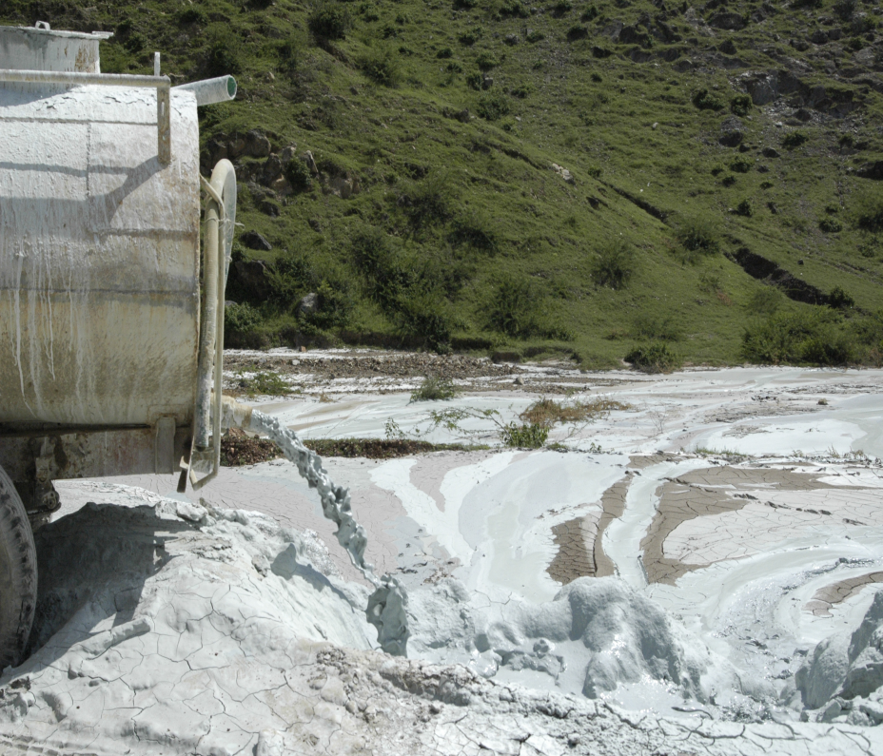
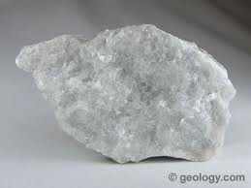
MARBLE AND QUARRY DUST AS ADDITIVES IN CONCRETE
Guided by :-
Prof. Dhara shah
Prof. Aanal shah
Prepared by:- Pankaj khunt
SD-0610
Free Powerpoint Templates

Slide 2
Introduction
Green concrete capable for sustainable development is characterized by application of industrial wastes to reduce consumption of natural resources and energy and pollution of the environment
Green concrete has nothing to do with color. It is a concept of thinking environment into concrete considering every aspect from raw materials manufacture over mixture design to structural design, construction, and service life
Green concrete is very often also cheap to produce, because, for example, waste products are used as a partial substitute for cement, charges for the disposal of waste are avoided, energy consumption in production is lower, and durability is greater.

Slide 3
Why marble dust and quarry rock?
Natural sand in many parts of the country is not graded properly and has excessive silt on other hand quarry rock dust does not contain silt or organic impurities and can be produced to meet desired gradation and fineness as per requirement.
Marble sludge powder can be used as filler and helps to reduce the total voids content in concrete
This contributes to improve the strength of concrete
Marble sludge powder and quarry rock dust improved pozzolanic reaction, micro-aggregate filling, and concrete durability

Slide 4
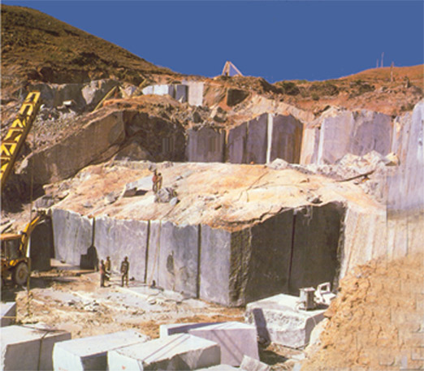
Green Marble Mining at our Mines

Slide 5
Characterization of waste
Physical characteristics of marble sludge powder, quarry rock dust and river sand.
Chemical characteristics of marble sludge powder, quarry rock dust, river sand and Portland cement
Durability studies
Resistance to sulphate attack
Permeability

Slide 6
Physical characteristics of marble sludge powder, quarry rock dust and river sand

Slide 7
Chemical characteristics of marble sludge powder, quarry rock dust, river sand and Portland cement

Slide 8
Heavy metal leachability of the waste
Toxicity characteristic leaching procedure (TCLP)

Slide 9
TEST PROCEDURE

Slide 10
Raw materials and test methods
Cement :-
Ordinary Portland Cement (43 Grade) with 28 percent normal consistency with specific surface 3300 cm2/g conforming to IS: 8112-1989 [8] was used.
Marble sludge powder :-
Marble sludge powder was obtained in wet form directly taken from deposits of marble factories.
Quarry rock dust :-
The quarry rock dust was obtained from local crusher at Kariapatti, Virudunagar District. The specific gravity of the quarry rock dust is 2.677. Moisture content and bulk density of waste are less than the sand properties.

Slide 11
Fine aggregate :-
Medium size sand from Madurai Vaigai river with a modulus of fineness = 2.20; Specific gravity 2.677, normal grading with the silt content 0.8%.
Course aggregate :-
Crushed stone from Madurai district with a size of 5-20 mm and normal continuous grading was used. The content of flaky and elongated particles is <3%, the crushing index ≤6% and the specific gravity 2.738.
Water :-
A tap water available in the concrete laboratory was used in manufacturing the concrete. The qualities of water samples are uniform and potable.

Slide 12
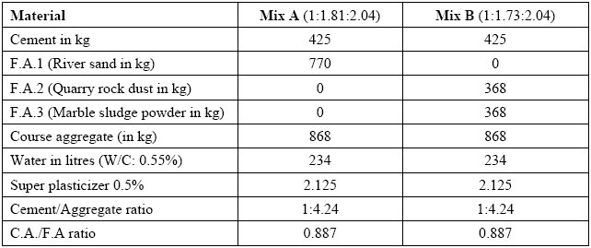
Mix proportion

Slide 13
Slump, slump flow value and V- funnel time

Slide 14
Hardened mixture properties

Slide 15
Durability studies
Durability of concrete in terms of
Resistance to Sulphate attack
Permeability
Water absorption

Slide 16
Resistance to sulphate attack in term of Percentage of weight loss
The marble powder can reduce the content of calcium aluminate in cementitious material, leading to increase of sulphate resistance of concrete.

Slide 17
Permeability of concrete specimen
Due to the pozzolanic and filling effects of the marble powder and quarry rock dust, there is more cementitious material formed with dense structure, therefore, it is easy to prepare a high impermeable concrete.

Slide 18
Conclusions
The chemical compositions of quarry rock dust and marble sludge powder such as Fe2O3, MnO, Na2O,MgO, K2O, Al2O3, CaO, and SiO2 are comparable with that of cement.
The replacement of fine aggregate with 50% marble sludge powder and 50% Quarry rock dust (Green concrete) gives an excellent result in strength aspect and quality aspect.
Green concrete induced higher workability and it satisfy the self compacting concrete performance which is the slump flow is 657mm without affecting the strength of concrete.
Test results show that these industrial wastes are capable of improving hardened concrete performance.

Slide 19
Green concrete enhancing fresh concrete behavior and can be used in architectural concrete mixtures containing white cement.
Permeability test results clearly demonstrate that the permeability of green concrete is less compared to that of conventional concrete.
The water absorption of green concrete is slightly higher than conventional concrete.
The durability of green concrete under sulphate is higher to that of conventional concrete.

Slide 20
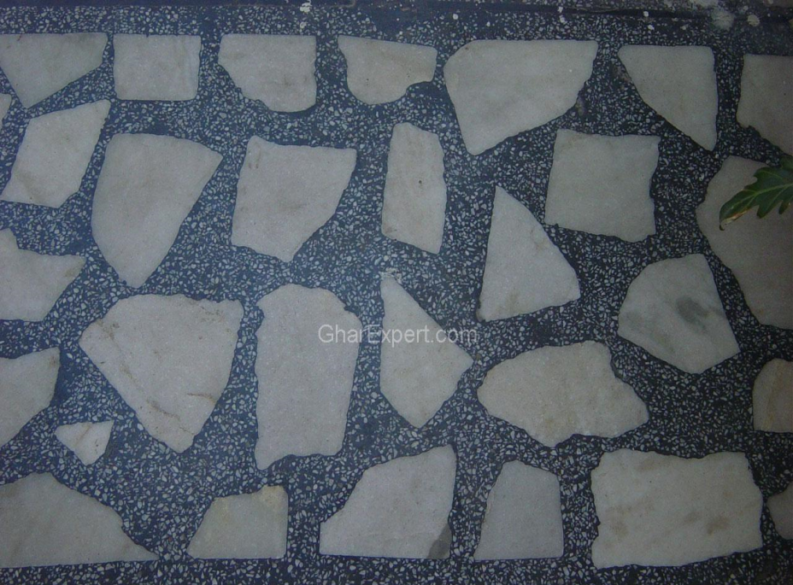
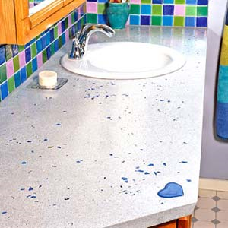
Architectural effect

Slide 21
REFERENCES
ARPN Journal of Engineering and Applied Sciences, vol. 4, no. 4, june 2009 issn 1819-6608
Chloride Penetration Study on Self-Compacting Green Concrete Using Crusher Rock Dust and Marble Sludge Powder as Fine Aggregate, M. shahul hameed , A.S.S. sekar , V.saraswathi.
Recyclable materials in concrete technology: sustainability and durability ,G. Moriconi ,Department of Materials and Environment Engineering and Physics, Università Politecnica delle Marche, Ancona, Italy

Slide 22
Properties of self-levelling concrete made with industrial wastes.Francesco Colangelo , Milena Marroccoli and Raffaele Cioffi Department of Environmental Engineering and Physics University of Basilicata, Italy
5. http://flyashbricksinfo.com/construction/green-concrete containing-quarry-rock-dust-and-marble-sludge-powder-as fine aggregate.html
Magazines
Concrete international

