Slide 1
A SEMINAR ON NANOTECHNOLOGY IN CONSTRUCTION & CARBON NANO TUBE
PRESENTED BY:
BOKIL APURV S.
SD 0210

Slide 2
CONTENTS
INTRODUCTION
WHAT IS CARBON NANOTUBES?
TYPES OF CARBON NANOTUBS AND RELATED STRUCTURES
PROPERTIES OF CARBON NANOTUBES
SYNTHESIS OF CARBON NANOTUBES
APPLICATION OF CARBON NANOTUBES
APPLICATION OF CARBON NANOTUBES IN CIVIL ENGINEERING
CONCLUSION
REFERENCES

Slide 3
INTRODUCTION

Slide 4
Nanotechnology is one of the active areas that encompass number of disciplines of including civil engineering and construction materials.
“Nanotechnology is an enabling technology that allows us to develop materials with improved or totally new properties”
The concept of nanotechnology comprises a range of techniques that allow researchers to probe the behavior of matter at length scales between 1 and 100 nm or 10⁻⁹m.
Two nano sized particles that stand out in application of construction material are: 1)titanium dioxide
2)carbon nanotubes (CNT’S)

Slide 5
CARBON NANOTUBES

Slide 6
CARBON NANOTUBES
Stronger than steel and lighter than a feather, carbon nanotubes have the potential to revolutionize just about everything.
The world's strongest known substance is graphene, a one-atom-thick sheet of carbon atoms arranged hexagonally. When layers of it are piled one on top of another, the result is ordinary pencil graphite that shears apart like a tiny stack of paper. But take a graphene layer and roll it into a tube and it forms a fiber theoretically 100 times stronger than steel and six times lighter: A CARBON NANOTUBE

Slide 7
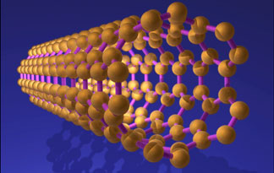
Not surprisingly, carbon nanotubes (CNTs) have garnered much attention for their strength, which comes from the double bonds that hold their carbon atoms together.
Each tube has the potential to be over one million times longer than its diameter (50 thousand times slimmer than a human hair)
Carbon nanotubes (CNTs) are allotropes of carbon with a cylindrical nanostructure.

Slide 8
These cylindrical carbon molecules have novel properties that make them potentially useful in many applications in nanotechnology, electronics, optics and other fields of materials science, as well as potential uses in architectural fields.
The process of making CNTs is difficult and expensive.
It involves vaporizing graphite at high temperature and having it reform on metal as the tiny tubes.
"Their length is also a limiting factor," Arnold said. Although theoretically one CNT could stretch for miles, the longest ones made so far are only 1 to 2 centimeters. "That's pretty good, considering they're only one nanometer in diameter," he noted.
The tubes will have to be longer and cheaper before they start having a major impact beyond the laboratory.

Slide 9
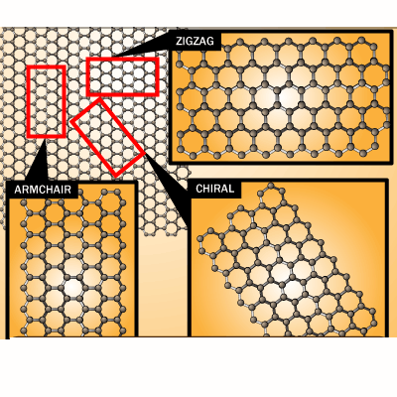
If u roll a sheet of carbon atoms into a tube, it creates a carbon nanotube.
Depending on direction the sheet is rolled into different pattern emerges.
With right arrangement of carbon atoms. Carbon nanotube hundred times stronger then steel and six times lighter.

Slide 10
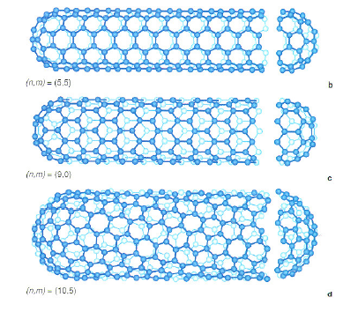
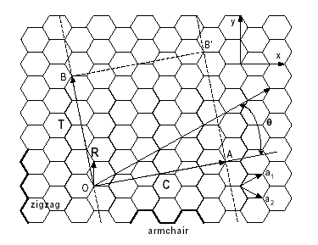

Slide 11
TYPES OF CNT’s AND RELATED STRUCTURES:

Slide 12
SINGLE WALLED
The (n,m) nanotube naming scheme can be thought of as a vector (C_{h}) in an infinite graphene sheet that describes how to "roll up" the graphene sheet to make the nanotube. T denotes the tube axis, and a₁ and a₂ are the unit vectors of graphene in real space.
Most single-walled nanotubes (SWNT) have a diameter of close to 1 nanometer, tube length that can be many millions of times longer.
The structure of a SWNT can be conceptualized by wrapping a one-atom-thick layer of graphite called graphene into a seamless cylinder.

Slide 13
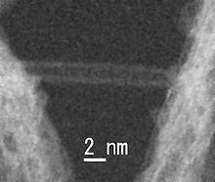
The way the graphene sheet is wrapped is represented by a pair of indices (n,m) called the chiral vector. The integer’s n and m denote the number of unit vectors along two directions in the honeycomb crystal lattice of graphene.
If m = 0, the nanotubes are called "zigzag". If n = m, the nanotubes are called "armchair". Otherwise, they are called "chiral".
Transmission electron microscopy image showing a single-walled nanotube

Slide 14
MULTI WALLED
Multi-walled nanotubes (MWNT) consist of multiple rolled layers (concentric tubes) of graphene.
There are two models which can be used to describe the structures of multi-walled nanotubes.
In the Russian Doll model, sheets of graphite are arranged in concentric cylinders, single-walled nanotube (SWNT) within a larger single-walled nanotube.
In the Parchment model, a single sheet of graphite is rolled in around itself, resembling a scroll of parchment or a rolled newspaper.
The interlayer distance in multi-walled nanotubes is close to the distance between graphene layers in graphite, approximately 3.4 Å.

Slide 15
A nanotorus is theoretically described as carbon nanotube bent into a torus (doughnut shape).
Nanotorus are predicted to have many unique properties, Properties such as magnetic moment, thermal stability, etc. vary widely depending on radius of the torus and radius of the tube.
NANOTORUS

Slide 16
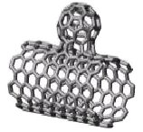
NANOBUD
Carbon nanobuds are a newly created material combining two previously discovered allotropes of carbon: carbon nanotubes and fullerenes.
In this new material, fullerene-like "buds" are covalently bonded to the outer sidewalls of the underlying carbon nanotube.
This hybrid material has useful properties of both fullerenes and carbon nanotubes.
In particular, they have been found to be exceptionally good field emitters.

Slide 17
CUP STACKED CARBON NANOTUBES
Cup stacked carbon nanotubes exhibit semiconducting behaviors due to the stacking microstructure of graphene layers
EXTREME CARBON NANOTUBES
The observation of the longest carbon nanotubes (18.5 cm long) was reported in 2009.
They were grown on Si substrates using improved chemical vapor deposition (CVD) method and represent electrically uniform arrays of single-walled carbon nanotubes.
The shortest carbon nanotubes is the organic compound cycloparaphenylene which was synthesized in the early 2009.

Slide 18
The thinnest carbon nanotube is armchair (2,2) CNT with a diameter of 3 Å. This nanotube was grown inside a multi-walled carbon nanotube.
Assigning of carbon nanotube type was done by combination of high-resolution transmission electron microscopy (HRTEM), Raman spectroscopy.

Slide 19
Properties of Carbon Allotropes
Allotrope
hardness
tensile strength
conducts heat
conducts electricity
Coal
+
+
+
no
Graphite
++
++
+++++
+++++
Diamond
+++++
Not known
+++
no
Buckyballs
+++++
++++
+
+
Carbon Nanotubes
++++++
+++++
+++++
++++++

Slide 20
SYNTHESIS OF CARBON NANOTUBES

Slide 21
SYNTHESIS OF CARBON NANOTUBES
Techniques have been developed to produce nanotubes in sizeable quantities, including : - ARC DISCHARGE
- LASER ABLATION
- CHEMICAL VAPOUR DEPOSTION (CVD)
Most of these processes take place in vacuum or with process gases.
CVD growth of CNTs can occur in vacuum or at atmospheric pressure.
Large quantities of nanotubes can be synthesized by these methods; advances in catalysis and continuous growth processes are making CNTs more commercially viable.

Slide 22
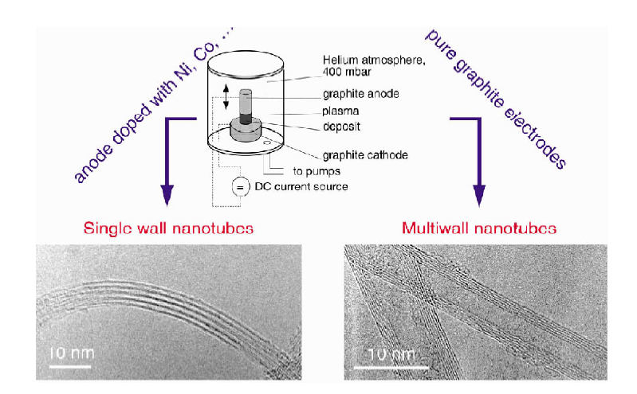
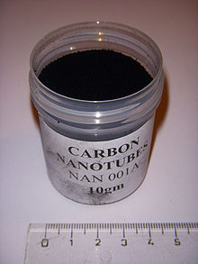
ARC DISCHARGE
Powder of carbon nanotube

Slide 23
Nanotubes were observed in 1991 in the carbon soot of graphite electrodes during an arc discharge, by using a current of 100 amps that was intended to produce fullerenes.
However the first macroscopic production of carbon nanotubes was made in 1992 by two researchers at NEC's Fundamental Research Laboratory.
During this process, the carbon contained in the negative electrode sublimates because of the high discharge temperatures. Because nanotubes were initially discovered using this technique.
The yield for this method is up to 30 percent by weight and it produces both single- and multi-walled nanotubes with lengths of up to 50 micrometers.

Slide 24
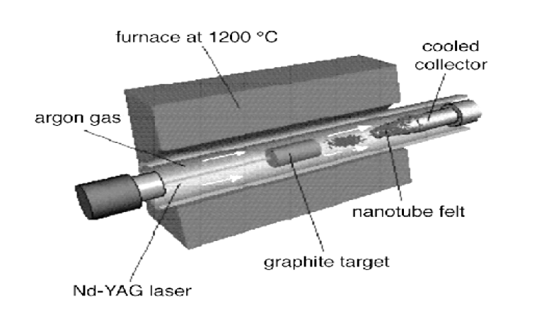
LASER ABLATION

Slide 25
In the laser ablation process, a pulsed laser vaporizes a graphite target in a high-temperature reactor while an inert gas is bled into the chamber.
Nanotubes develop on the cooler surfaces of the reactor as the vaporized carbon condenses. A water-cooled surface may be included in the system to collect the nanotubes.
This process was developed by Dr. Richard Smalley and co-workers at Rice University, were blasting metals with a laser to produce various metal molecules. When existence of nanotubes they replaced the metals with graphite to create multi-walled carbon nanotubes.
The laser ablation method yields around 70% and produces primarily single-walled carbon nanotubes with a controllable diameter determined by the reaction temperature.

Slide 26
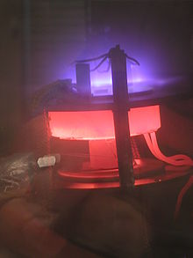
CHEMICAL VAPOR DEPOSITION (CVD)
Nanotubes being grown by plasma enhanced chemical vapor deposition

Slide 27
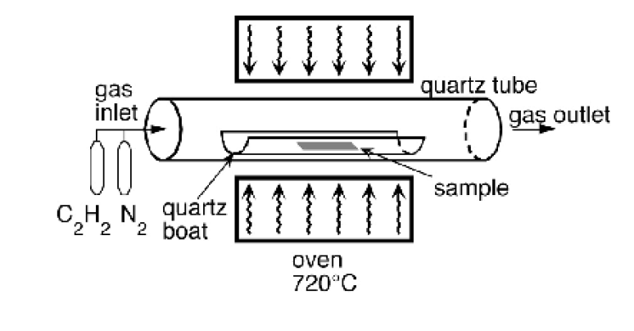
a substrate is prepared with a layer of metal catalyst particles, most commonly nickel, cobalt, iron, or a combination.
The diameters of the nanotubes that are to be grown are related to the size of the metal particles. This can be controlled by patterned (or masked) deposition of the metal.

Slide 28
The substrate is heated to approximately 700°C.
To initiate the growth of nanotubes, two gases are bled into the reactor: a process gas (such as ammonia, nitrogen or hydrogen) and a carbon-containing gas (such as acetylene, ethylene, ethanol or methane).
Nanotubes grow at the sites of the metal catalyst; the carbon-containing gas is broken apart at the surface of the catalyst particle, and the carbon is transported to the edges of the particle, where it forms the nanotubes. This mechanism is still being studied.

Slide 29
Of the various means for nanotube synthesis, CVD shows the most promise for industrial-scale deposition, because of its price/unit ratio, and because CVD is capable of growing nanotubes directly on a desired substrate, whereas the nanotubes must be collected in the other growth techniques. The growth sites are controllable by careful deposition of the catalyst.

Slide 30
APPLICATION OF CARBON NANOTUBES

Slide 31
APPLICATION OF CARBON NANOTUBES:
Space elevator
Faster computer chips
Better solar cells
Cancer treatment
Better thinner TV’s
Better capacitors that replaces batteries
Flexible displays
Bone healing
Body armor
Faster flywheels

Slide 32
SPACE ELEVATOR
Sending a payload into space by rocket is expensive ($10,000 per pound) and dangerous.
Some folks are proposing a very tall elevator that would stretch from the ground to beyond Earth's atmosphere. Making it a reality requires a long, strong cable to a counterweight in geosynchronous orbit, maintaining a fixed position about 22,000 miles above the earth.
CNTs are the only known material up to the task. Among other things, a successful space elevator could create means for safe disposal of nuclear waste, and give life to a space tourism industry.

Slide 33
FASTER COMPUTER CHIPS
The processing speed of a computer chip depends on the number of transistors it has.
Today, typical desktop processors using silicon transistors have less than half a billion.
Computer chips using CNTs could blow those numbers away.
Their small size -- just one nanometer wide -- means many billions of CNT transistors could be packed onto a single processing chip, making for smaller, faster computers and electronics.

Slide 34
SOLAR CELLS
Semiconducting materials, when altered with certain impurities, are used in solar cells.
When struck by sunlight, these materials converts the sunlight directly into electricity by photovoltaic effect.
Most of today's solar cells use silicon semiconductors, but that could change. Because they're so tiny, billions of CNTs could be tightly packed onto solar cells and release far more electricity per square inch than silicon.

Slide 35
CANCER TREATMENT
By treating CNTs with certain proteins, scientists are developing a method to bind them specifically to cancerous cells.
Once attached, the CNTs, which are excellent conductors of heat, could be exposed to infrared light shone through the patient's skin.
The light would heat the CNTs to a temperature high enough to destroy the cancer cells while leaving surrounding tissue undamaged.
While more research must be done, this method could offer a way to treat certain cancers without harming healthy tissue.

Slide 36
BETTER CAPACITORS THAT REPLACES BATTERIES
Instead of storing electricity chemically like a battery, capacitors hold it physically by building a charge on a material called a dielectric.
The dielectric's surface area determines how much charge it can hold. CNTs have extraordinarily high surface areas, and using them as the dielectric could increase the storage ability of capacitors to be on par with modern batteries.
Capacitors don't have these problems. CNT capacitors might one day be used in instantly rechargeable laptops and electric cars.

Slide 37
FLEXIBLE DISPLAY
The dream of fold-up TVs and computer screens that can fit inside people's pockets has, up until now, been stifled by rigid silicon semiconductors.
But CNTs, in addition to being very flexible, compare favorably to silicon in terms of performance. Researchers at Purdue and the University of Illinois-Urbana-Champaign are developing carbon nanotube flexible displays which one day could be used for things like electronic newspapers and roll-up handheld devices.

Slide 38
BODY ARMOR
Researchers at Cambridge University have figured out how to spin many tiny carbon nanotubes together to create fibers that have the strength of Kevlar, a composite material used in bullet-proof vests.
With new techniques rapidly emerging to make longer CNTs, spun fibers using the longer CNTs will soon surpass Kevlar in strength. As CNT prices drop, spun CNT fibers could be the material of choice for better, lighter body armor.

Slide 39
APPLICATION OF CARBON NANOTUBES IN CIVIL ENGINEERING

Slide 40
APPLICATION OF CARBON NANOTUBES IN CIVIL ENGINEERING
Carbon Nanotubes as Reinforcing Materials in Composites
The majority of research on CNT composites has instead focused on polymer matrices, with ceramics and metals also being considered for this role.
Results showing significant improvements in fracture toughness, hardness and strength in both ceramic and polymer matrices.

Slide 41
Traditional reinforcing mechanisms such as crack bridging, fiber pull out and crack deflection have been identified in, with additional, nanoscale reinforcement mechanisms also being seen.
Key factors that have contributed to these improvements include the process of distributing the CNT in the matrix material and the degree of bonding between the reinforcement and the matrix..

Slide 42
Experimental Approach
Commercial single walled carbon nanotubes were dispersed by sonication (vibration by ultrasound) in isoproponal.
By some of the weight of CNT/cement ratio was then added to the beaker containing the CNT while maintaining continuous sonication. After four hours, the sonication was stopped and the isoproponal was allowed to desiccate.
The resulting cement/carbon nanotube cake was then broken apart and ground using a hand mortar.
This treatment produced cement particles coated with bundles of carbon nanotubes.

Slide 43
Carbon nanotube bundles distributed on unhydrated cement powder

Slide 44
Samples were then prepared at a variety of water/cement ratios. Mixes with water/cement (w/c) ratios of 0.8 and 0.5 were prepared.
samples with 0.4 w/c ratios were prepared with the addition of varying amounts of super plasticizer, rather than with the use of water alone.
A variety of tests were conducted on the hydrated samples, including scanning electron microscope (SEM) examination of fracture surfaces and ground powder, Vickers hardness testing, thermal analysis etc.
Sl. No. | Water/cement ratio | Super plasticizer Content | Time of Hydration for Measurements (days)
1 | 0.8 | None | 1, 2, 3, 4, 8, 16, 22
2 | 0.5 | None | 1, 2, 3, 4, 7, 14, 21
3 | 0.4 | 10 g/L | 1, 2, 3, 7, 14, 21, 28

Slide 45
RESULTS

Slide 46
Figure shows a typical image of a fracture surface. It shows a crack crossing the centre of the fracture surface.
The width of the white bars themselves is 50 nm.
Some of the regions where carbon nanotubes bridge the large crack are indicated by the black arrows, while the white areas on the image are regions where carbon nanotubes are exposed on the fracture surface after fiber pull out. Only bundles of carbon nanotubes can be imaged, not individual tubes.

Slide 47
Figure shows an image from the powdered material. Here bundles of pulled out CNT can be clearly seen. In this case the small hydrated cement particles indicated by the black arrows are being held to the larger background particle by the CNT bundles.

Slide 48
Figure shows a second example of crack bridging, with a narrow crack being crossed by a number of nanotubes.
The close up image in Figure shows typical behavior of the CNT across a crack, with the majority of the bundles being pulled in approximately the same direction as the crack parts.
The bundles that appear to lie in a different direction were found upon imaging to be partially above the fracture surface, suggesting that they represent bundles that have experienced fiber pull-out, rather than remaining attached to both sides of the crack.

Slide 49
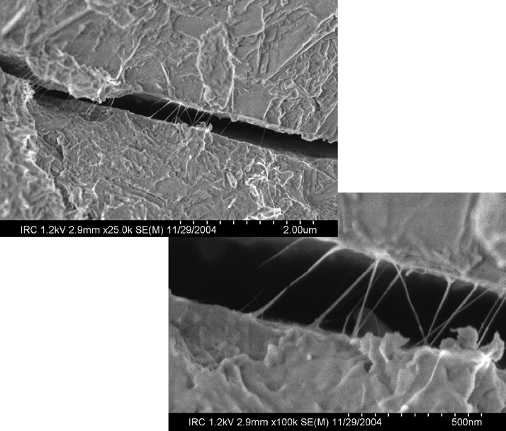

Slide 50
Carbon Nanotubes as Reinforcing Materials in Composites because of their extremely high strength and toughness .
Applications of carbon nanotubes in the construction industry:
there are at least three broad areas of research that will lead to product intended specifically for the construction industry:
CNT composites made with existing construction materials
CNT ropes for use as structural components
CNT heat transfer systems.

Slide 51
CONCLUSION
While considerable work remains to be done to prove the utility of cement/carbon nanotube composite materials, the nature of the cement hydration process means that multiple, nanotechnology based routes to stronger and tougher concretes are likely to be found.
These new materials will allow existing structural designs to be produced with reduced material volumes, but they may also allow for entirely new structural designs and concepts. Research is needed to explore these possibilities. Nanotechnology has developed quickly as a discipline because of strong synergies between theoreticians and experimentalists. A similar synergy is needed between material researchers and structural engineers to apply nanotechnology to the construction industry.

Slide 52
REFERENCES
www.mrs.org/publications/bulletin
Nanoforum.org
Salvetat, J.-P., et. al. 1999. , Mechanical Properties of Carbon Nanotubes, Applied. Physics A.

