Slide 1
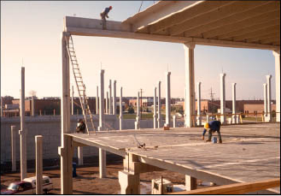
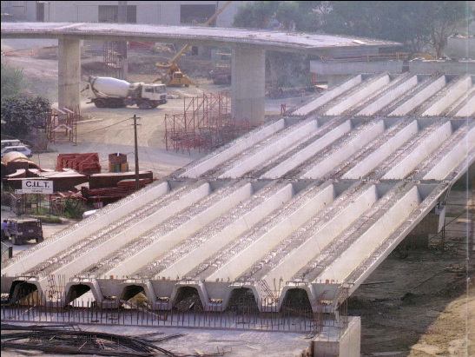
PRECAST CONSTRUCTION
Prepared by:
PARTH S. PATEL
SD1510

Slide 2
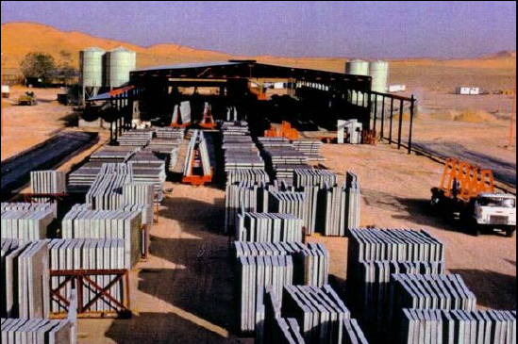
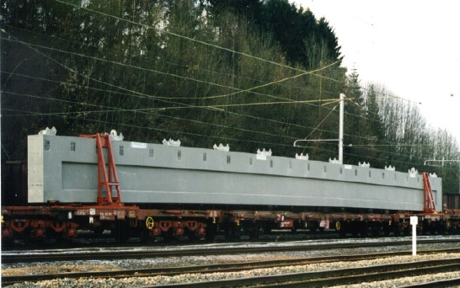
INTRODUCTION
Precast Concrete is a construction product produced by casting concrete in a reusable mold or "form" which is then cured in a controlled environment, transported to the construction site and lifted into place. In contrast, standard concrete is poured into site-specific forms and cured on site.
also known as "prefabricated“
produced in plants in a location away from the construction site
These components are manufactured by industrial methods based on mass production in order to build a large number of buildings in a short time at low cost.

Slide 3
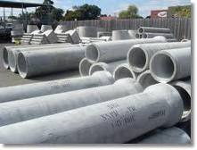
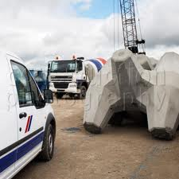
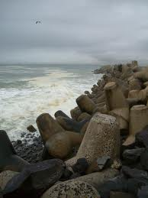
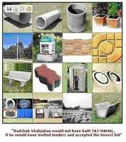
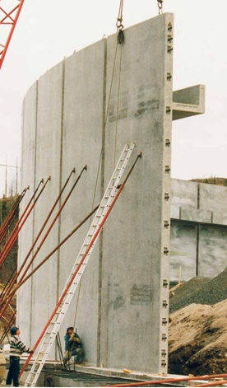
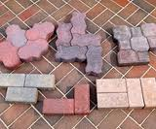
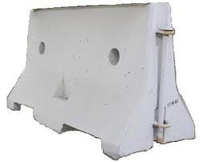
PRE-CAST CONCRETE PRODUCTS
Precast concrete building components and site amenities
Earth retaining systems
Sanitary and Storm water management products
Precast concrete transportation products
Marine Products
Pre-stressed / Structural Products

Slide 4
ADVANTAGES
Concrete is cast off site
Identical forms can used several times
Batter quality control
Control on curing
Un affected by weather , when casting
Construction in less time
Less cost
Waste materials can be used
( fly ash)
Fire resistant
Can avoid air born pollution on site
( dusting )
$$$$$

Slide 5

DISADVANTAGES
Costlier for small projects
Required skilled workers
Transportation is costly of large members for small projects.
It’s required to be design and detailed for transportation, erection.
Required different site for its production

Slide 6
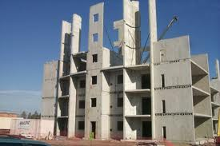
PRECAST IN BUILDING
A whole building can be construct.
Precast beams, columns, footings, floors, roofs, walls and stairs
Erection on site with care
Depending on the load-bearing structure, Precast buildings by former Soviet Union and Eastern European countries can be divided into the following categories:
· Large-panel systems
· Frame systems
· Slab-column systems

Slide 7
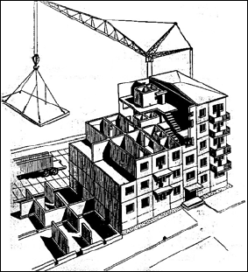
LARGE-PANEL SYSTEMS
"large-panel system“ composed of large wall and floor concrete panels connected in the vertical and horizontal.
Panels form a box-like structure .
Both vertical and horizontal panels resist gravity load.
Wall panels are usually one story high. Horizontal floor and roof panels span either as one-way or two-way slabs.
When properly joined together, these horizontal elements act as diaphragms that transfer the lateral loads to the walls.

Slide 8
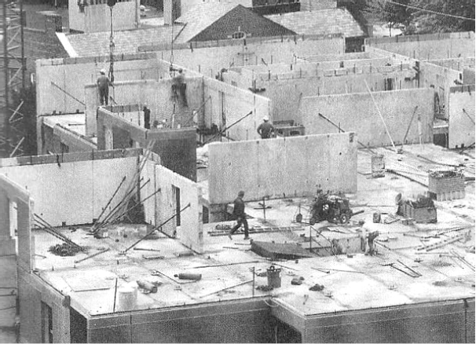
LARGE-PANEL SYSTEMS

Slide 9
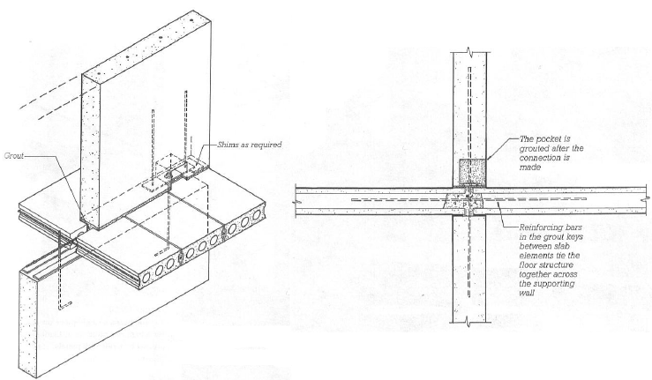
LARGE-PANEL SYSTEMS

Slide 10
FRAME SYSTEMS
Precast frames can be constructed using either linear elements or spatial beam-column sub-assemblages.
The connecting faces are at the beam-column junctions.
The beams can be seated on corbels at the columns, for ease of construction.
To aid the shear transfer from the beam to the column. The beam-column joints accomplished in this way are hinged.
However, rigid beam-column connections are used in some cases, when the continuity of longitudinal reinforcement through the beam-column joint needs to be ensured.

Slide 11
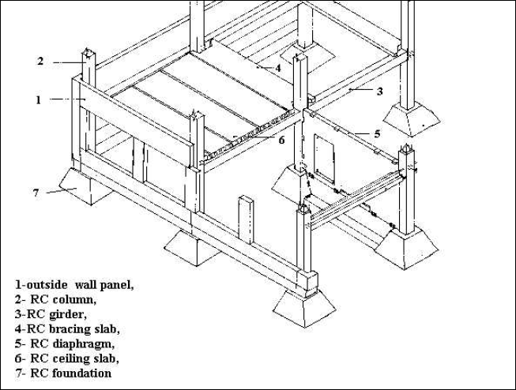
FRAME SYSTEMS

Slide 12
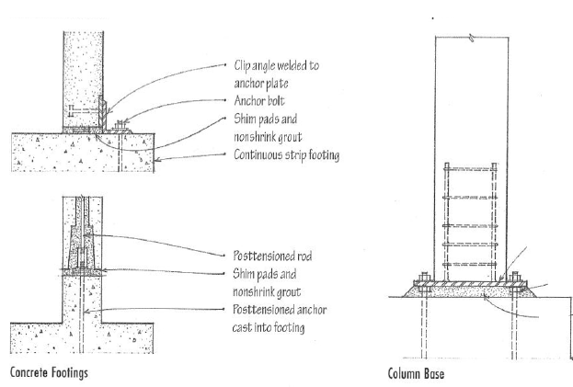
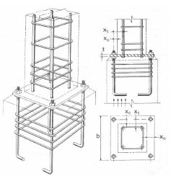
CONNECTIONS-COLUMN TO BASE

Slide 13
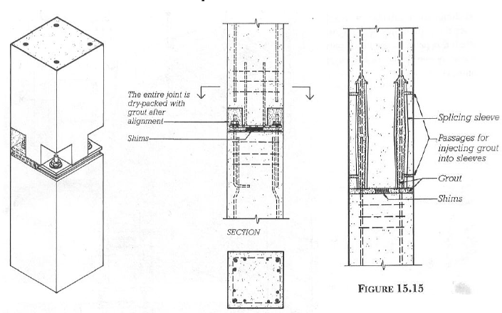
CONNECTIONS-COLUMN

Slide 14
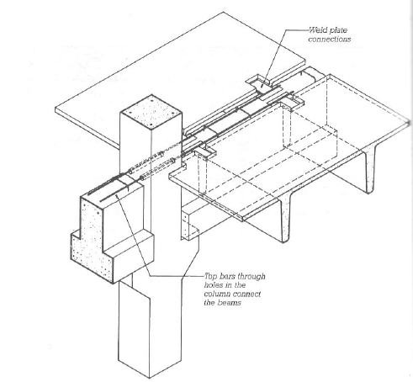
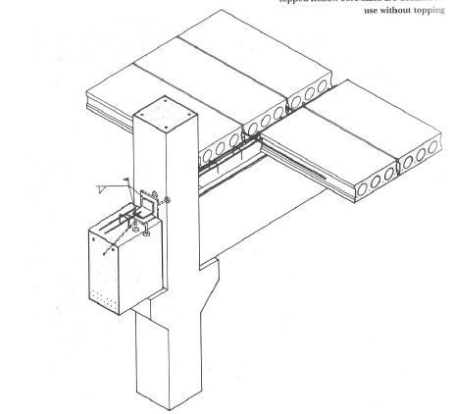
CONNECTIONS-SLAB TO BEAM

Slide 15
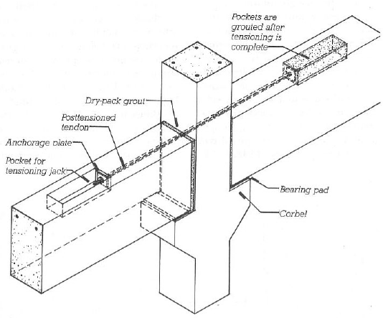
CONNECTIONS-COLUMN TO BEAM

Slide 16
SLAB-COLUMN SYSTEM WITH SHEAR WALL
These systems rely on shear walls to sustain lateral load effects, whereas the slab-column structure resists mainly gravity loads.
Pre-stressed slab-column system were introduced in the last decade of the Soviet Union (period 1980)
Reinforced concrete slabs are poured on the ground in forms.
The slab panels are lifted to the top of the column and then moved downwards to the final position. Temporary supports are used to keep the slabs in the position until the connection with the columns has been achieved.
In the connections, the steel bars (dowels) that project from the edges of the slabs are welded to the dowels of the adjacent components and transverse reinforcement bars are installed in place. The connections are then filled with concrete that is poured at the site.
Most buildings of this type have some kind of lateral load-resisting elements, mainly consisting of cast-in-place or precast shear walls

Slide 17
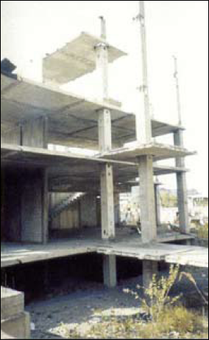
SLAB-COLUMN SYSTEM WITH SHEAR WALL

Slide 18
CARE TO TAKE DURING CASTING
Good formwork to be used
Lubricant should be applied to forms
Quality concrete to be used
Suitable method of vibration should be used
Water for Curing should be good
Steam curing can be use for mass production, if cost is available

Slide 19
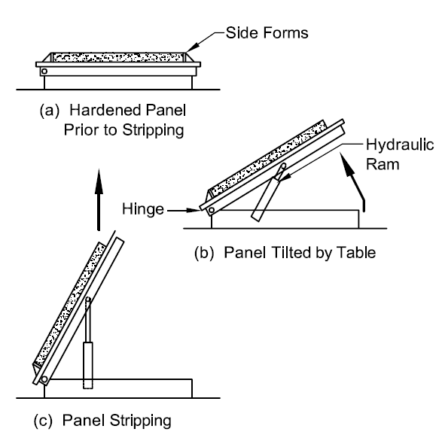
CARE TO TAKE AT PLANT
Once a piece has been fabricated, it is necessary to remove it from the mold without being damaged.
Breakaway forms should be used to allow a member to lift away from the casting bed without becoming wedged within the form
Orientation of members during storage, shipping and final in-place position is critical
Sand bed will help protect edge
Tilt tables or turning rigs are used to reduce stripping stresses
Warpage in storage may be caused by
  temperature or shrinkage differential between surfaces
  creep
The member should be oriented in the yard so that the sun does not overheat one side

Slide 20
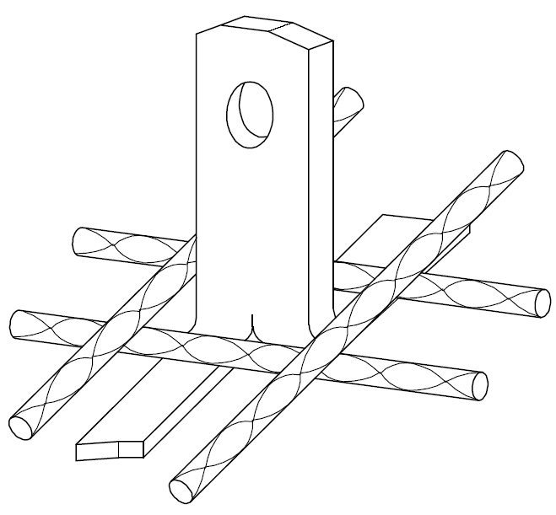
CARE TO TAKE DURING TRANSPORTATION
The loads and forces on precast and pre-stressed concrete members during production, transportation or erection will frequently require a separate analysis
Support points and orientation are usually different from members in their final position
it may be necessary to cast in extra lifting devices to facilitate these maneuvers.
The number and location of lifting devices are chosen to keep stresses within the allowable limits
special handling required by the design should be clearly shown on drawings

Slide 21
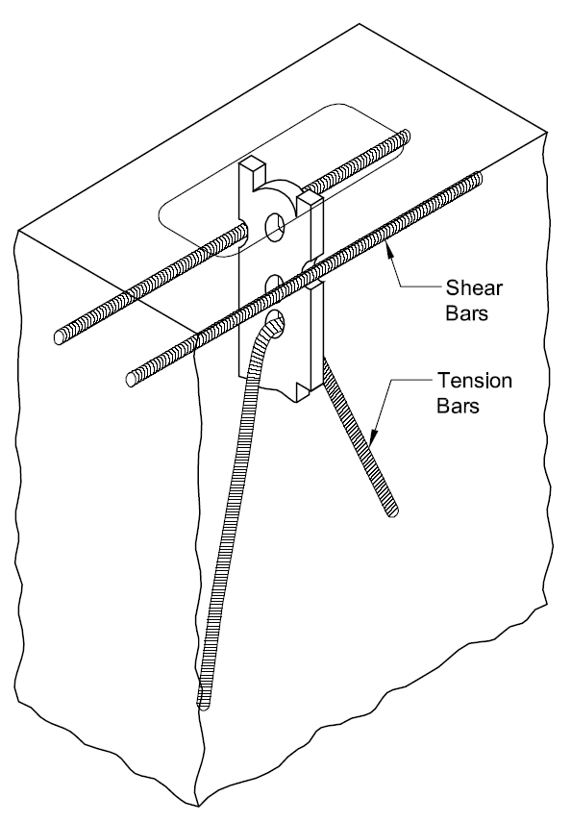
CARE TO TAKE DURING TRANSPORTATION
Lifting points must be located to keep member stresses within limits and to ensure proper alignment of the piece as it is being lifted
Members with unsymmetrical geometry or projecting sections may require supplemental lifting points to achieve even support during handling
“Come-alongs” or “chain-falls” are frequently used for these auxiliary lines
When the member has areas of small cross section or large cantilevers, it may be necessary to add a structural steel “strong back” to the piece to provide added strength
temporary loads

Slide 22
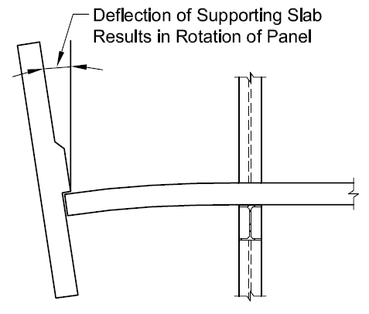
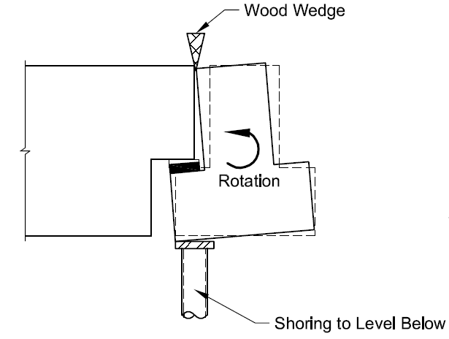
CARE TO TAKE DURING ERECTION
Columns with eccentric loads from other framing members produce side-sway which means the columns lean out of plumb
A similar condition can exist when cladding panels are erected on one
side of a multistory structure
Unbalanced loads due to partially complete erection may result in beam rotation
The erection drawings should address these Conditions
Some solutions are:
Install wood wedges between flange of tee and top of beam,
Use connection to columns that prevent rotation,
Erect tees on both sides of beam

Slide 23
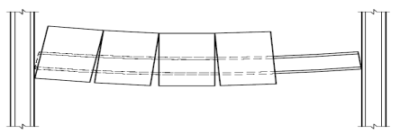
CARE TO TAKE DURING ERECTION
Rotations and deflections of framing members may be caused by cladding panels. This may result in alignment problems and require connections that allow for alignment adjustment after all panels are erected
Careful planning of the erection sequence is important

Slide 24
CARE ON SITE OF CONSTRUCTION
The project can be economical, considering the following factors:
Stability and stresses on the element during handling
Transportation size and weight regulations and equipment restrictions
Available crane capacity at both the plant and the project site.
Position of the crane must be considered, since capacity is a function of reach
Storage space, truck turning radius, and other site restrictions

Slide 25
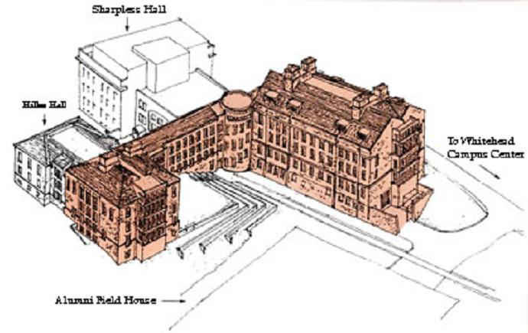
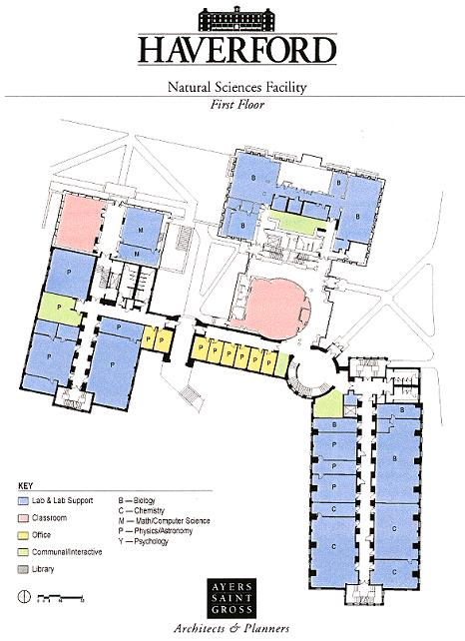
CASE STUDY
Koshland Integrated Natural Science Center
Located on the Haverford College campus
4-story laboratory facility with basement
Also contains classrooms, offices, & communal spaces
Total area 185,423 ft²
Total project cost of $42.6 Million
Construction was done in phases
The work was completed in 6 months

Slide 26
CASE STUDY
Superstructure – Precast concrete framing
Precast beams : 24”x12” spanning 21’
Precast columns : 16”x16” & 20”x20”
Foundation – (concrete masonry unit) CMU foundation/retaining walls, precast piers
Floor System – 10” precast plank with 2” topping
Façade – Stone & precast panels
Roof System – Steel framing with metal deck; precast plank
Typical story height of 13’

Slide 27
CASE STUDY
Expansion Jts. -

Slide 28
CASE STUDY

Slide 29
CASE STUDY

Slide 30
CASE STUDY

Slide 31
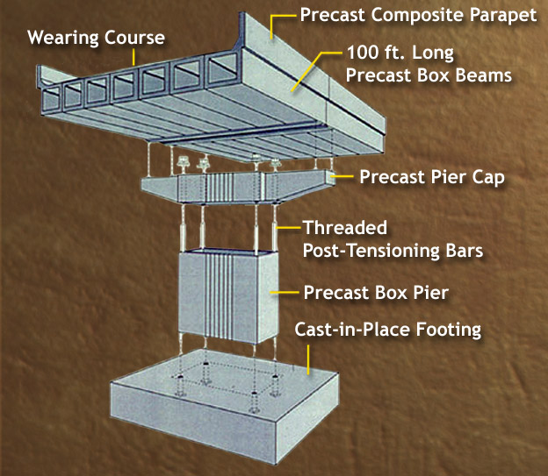
PRECAST IN BRIDGE
Bridge can also construct with precast.
Parts of a bridge, Substructures and superstructures
In India growth of precast in bridge is slow
But, Precast is growing continues very rapidly in other countries, not only for bridges in the short span range, but also for spans in excess of 45 meters.
Based on type of bridge and site condition method of construction is to be adopted.

Slide 32
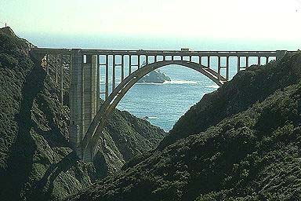

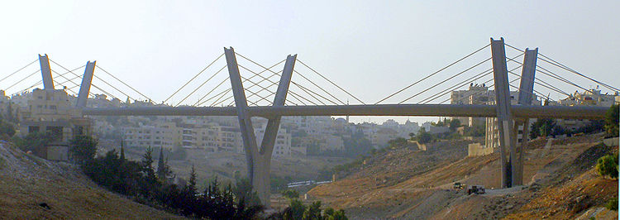
TYPES OF BRIDGES
Culvert
T-Beam deck slab bridge
Arch bridge
Cantilever bridges
Continuous bridges
Suspension bridges
Cable-stayed bridges

Slide 33
ADVANTAGES
Prestressed concrete bridges are usually lower in first cost than all other types of bridges.
With savings in maintenance, precast bridges offer maximum economy.
Every operation in the manufacturing process provides a point of inspection and control over quality
Faster construction
Formwork of the super­structure can be eliminate
Piers, Abutments and wing walls can be made of precast concrete pieces quickly assembled on the field.
Precast concrete bridges can be installed during all seasons
The durability of precast prestressed concrete bridge is good and the resulting low maintenance requirements.
No painting is needed.
Superstructure can be made as shallow as possible in order to provide maximum clearance with good structural designing
Greater fire resistance and design aesthetic is another advantage.

Slide 34
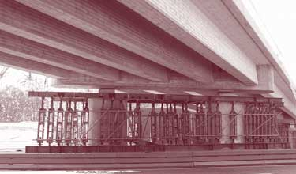
PRECAST BRIDGE CONSTRUCTION
T-Beam deck slab bridge
Simplest type of Precast bridge, most of the bridges in India are of this type
Sub- structure is cast in situ
In superstructure, Main girders are precast post tensioned, casted away from site and are transported to site.
Secondary girders and Deck slab are casted on Precast post tensioned girders on site or precast slab can be used.

Slide 35
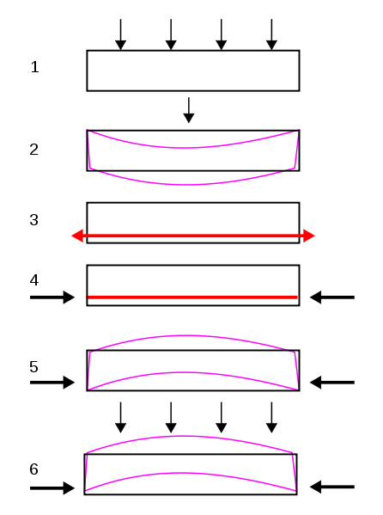
PRESTRESSED GIRDERS
Post tensioning technique is to be used in girders
In post tensioning, the concrete units are casted bye incorporating duct to house the tendons, when concrete attains sufficient strength, high-tension wires are tensioned bye means of jacks, after then the duct is grouted.
Forces are transmitted to the concrete at the end anchorage

Slide 36
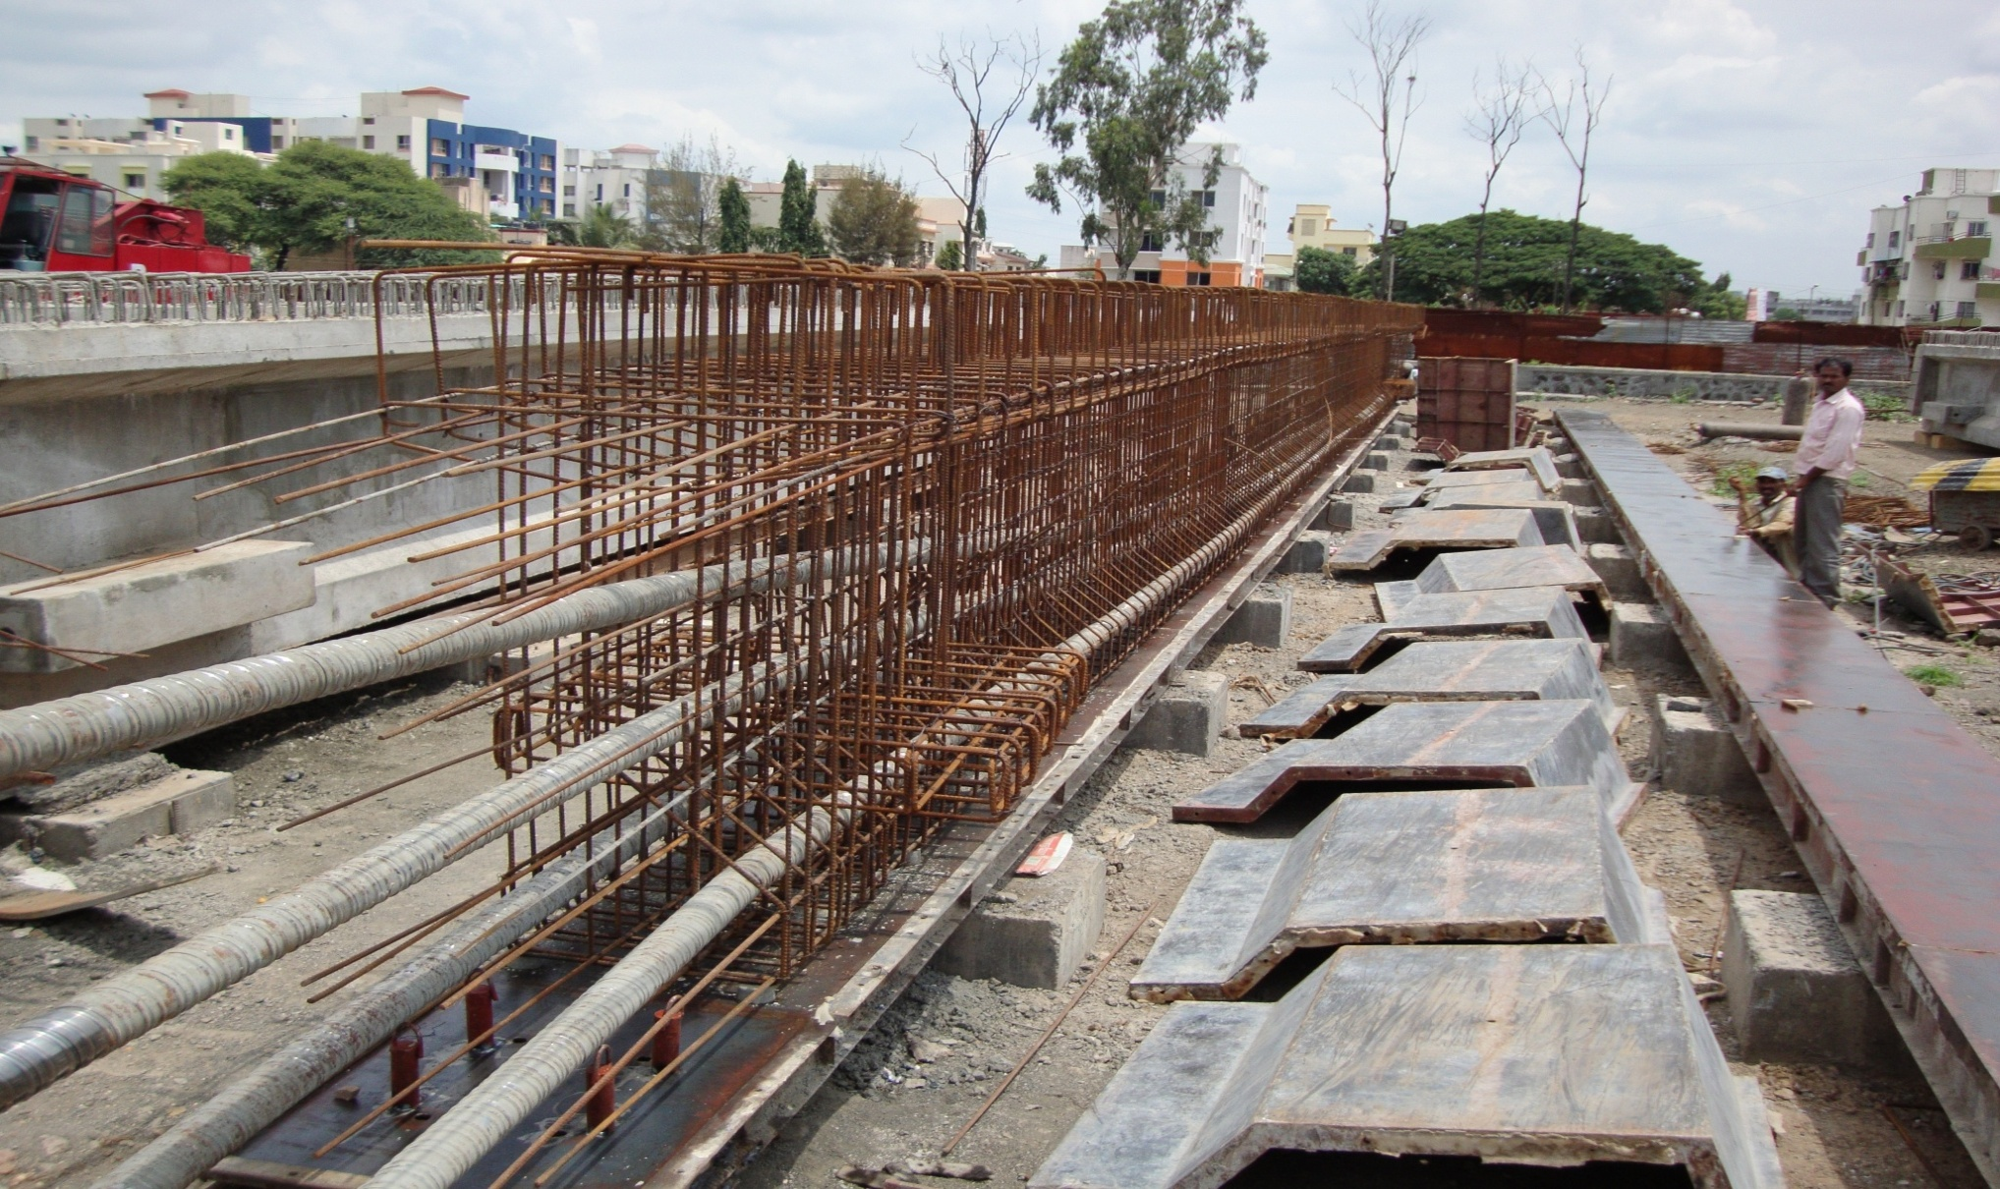
PRESTRESSED GIRDER MAKING

Slide 37
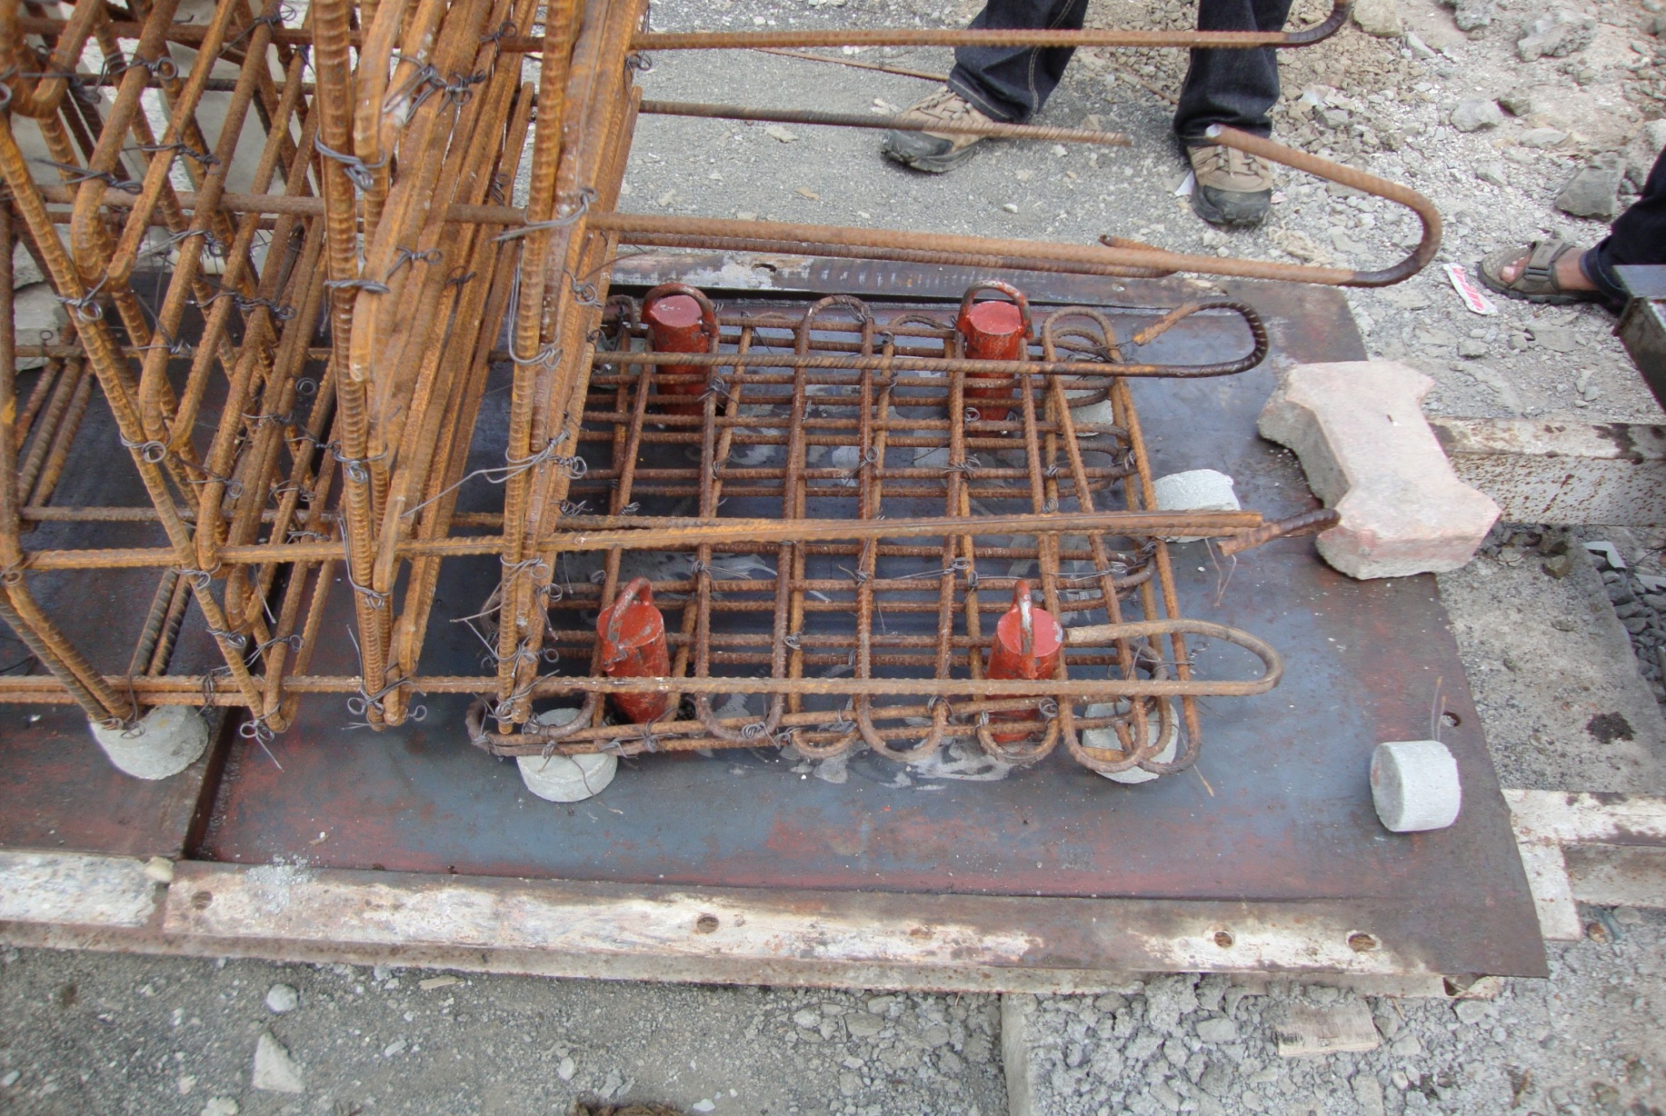
PRESTRESSED GIRDER MAKING

Slide 38
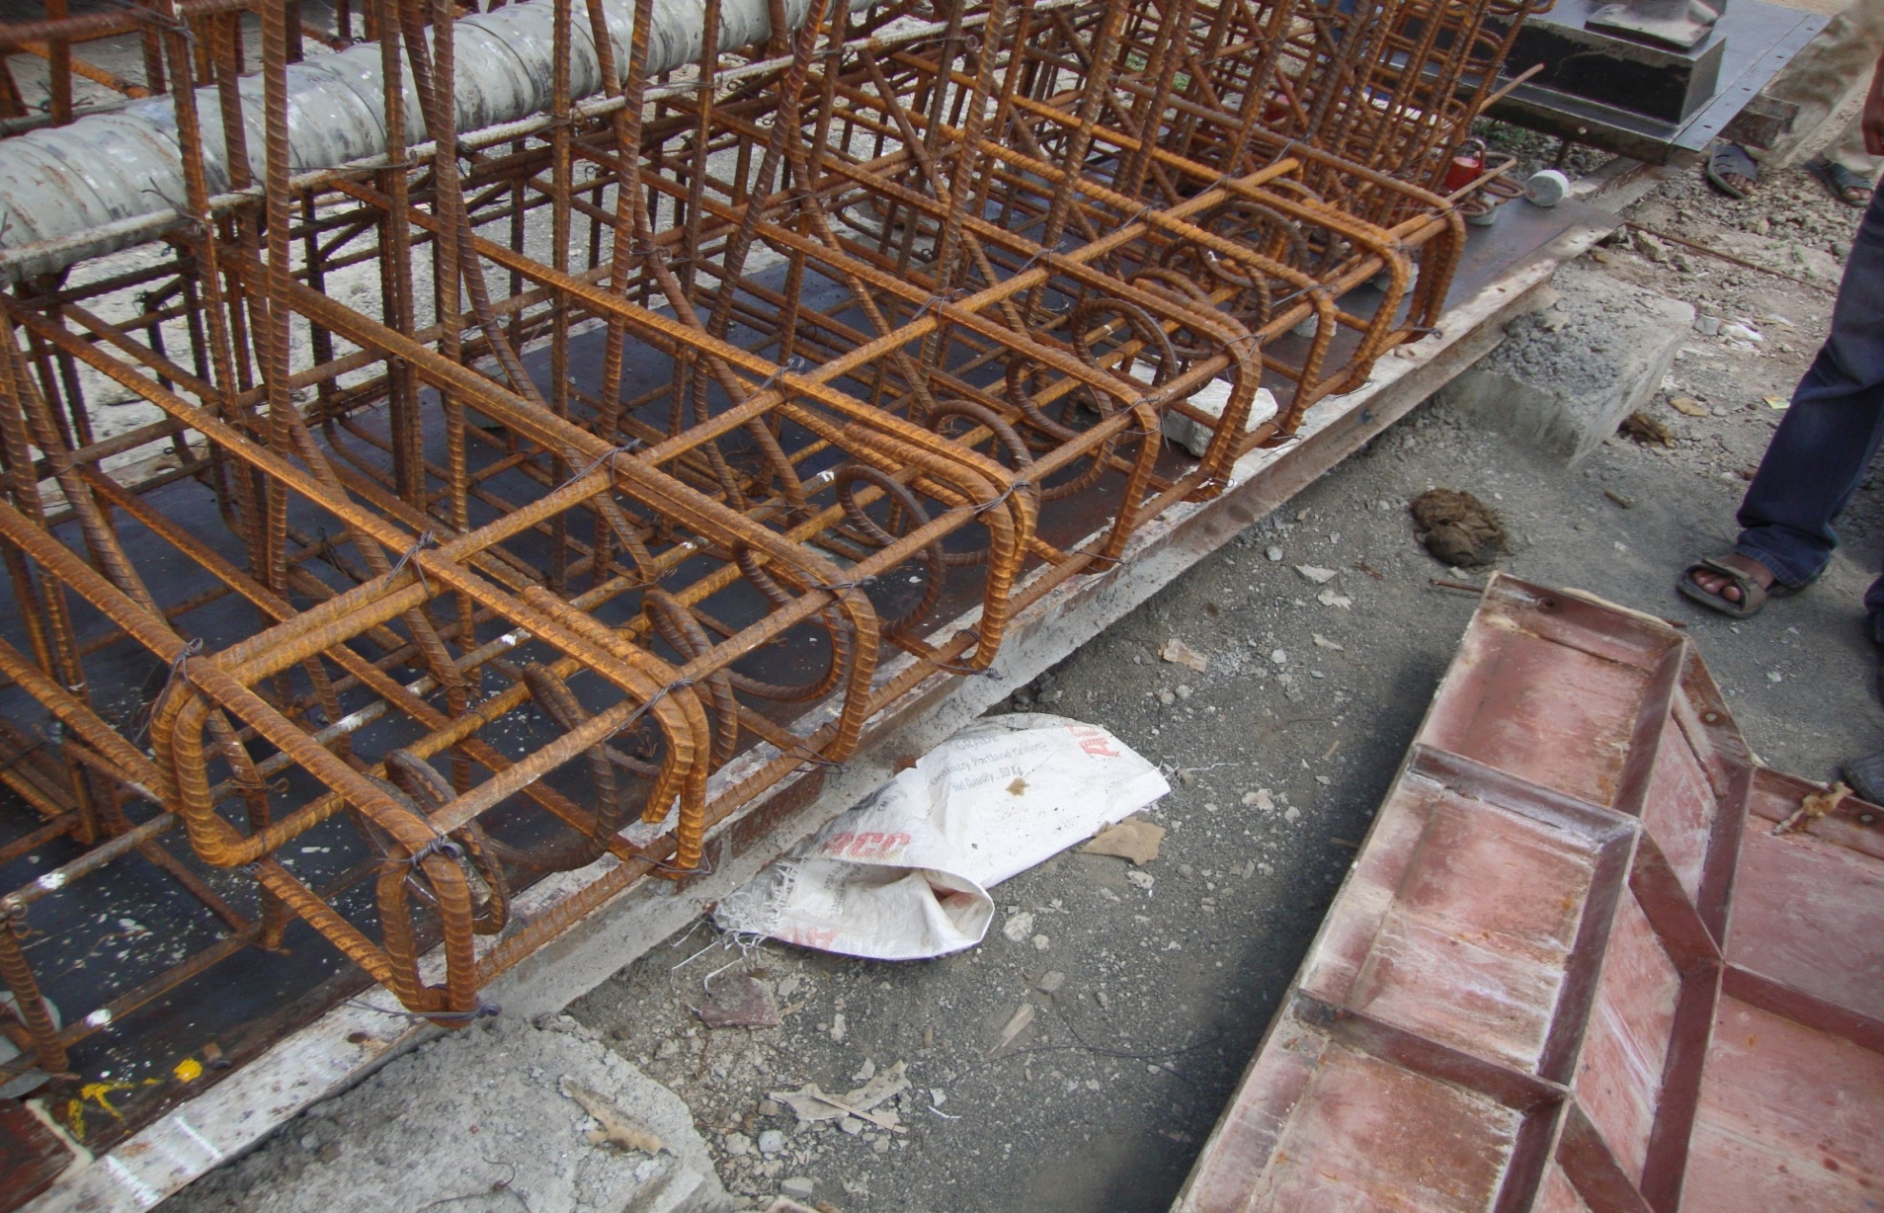
PRESTRESSED GIRDER MAKING

Slide 39
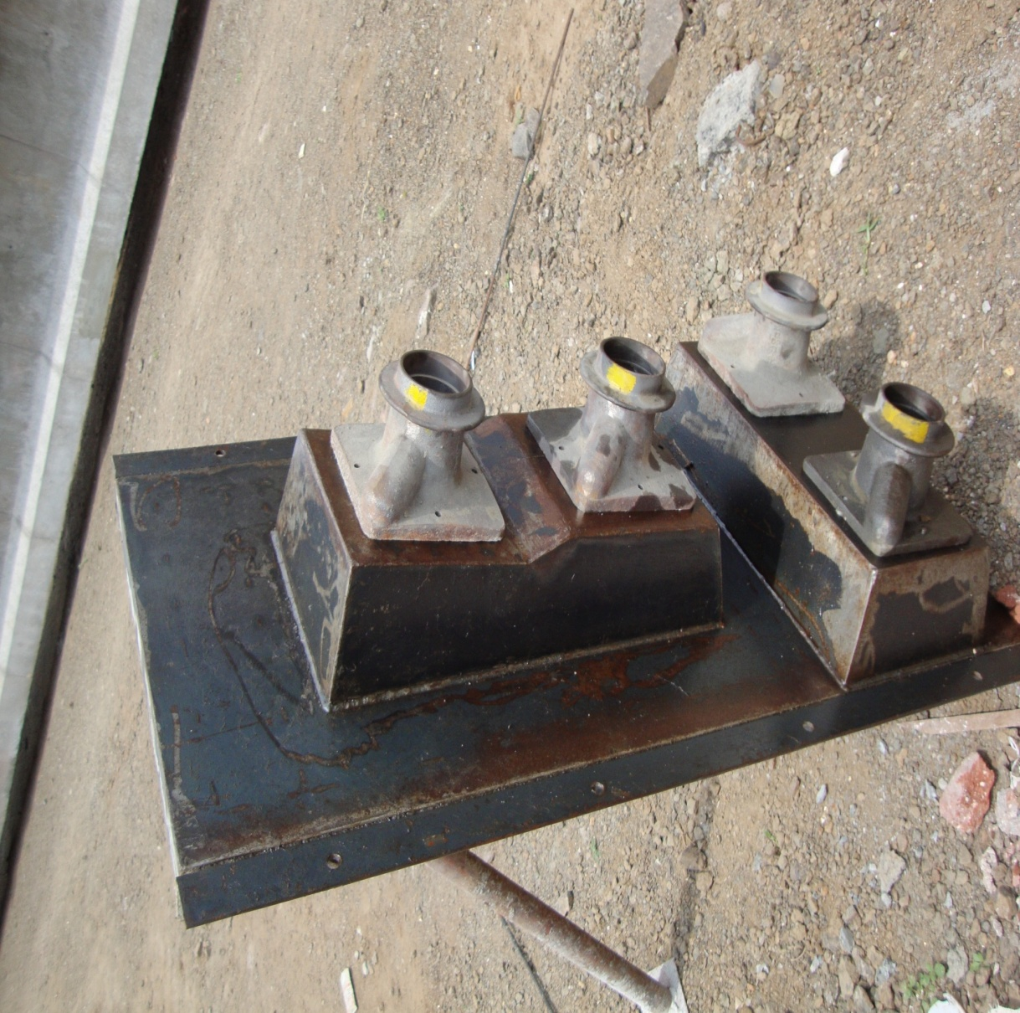
PRESTRESSED GIRDER MAKING

Slide 40
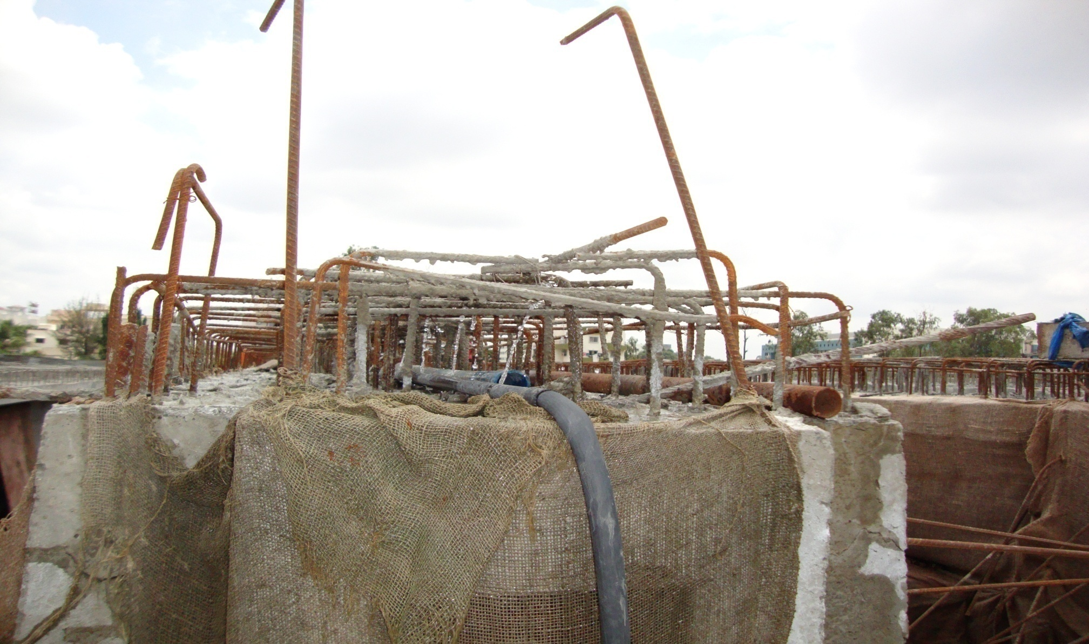
PRESTRESSED GIRDER MAKING

Slide 41
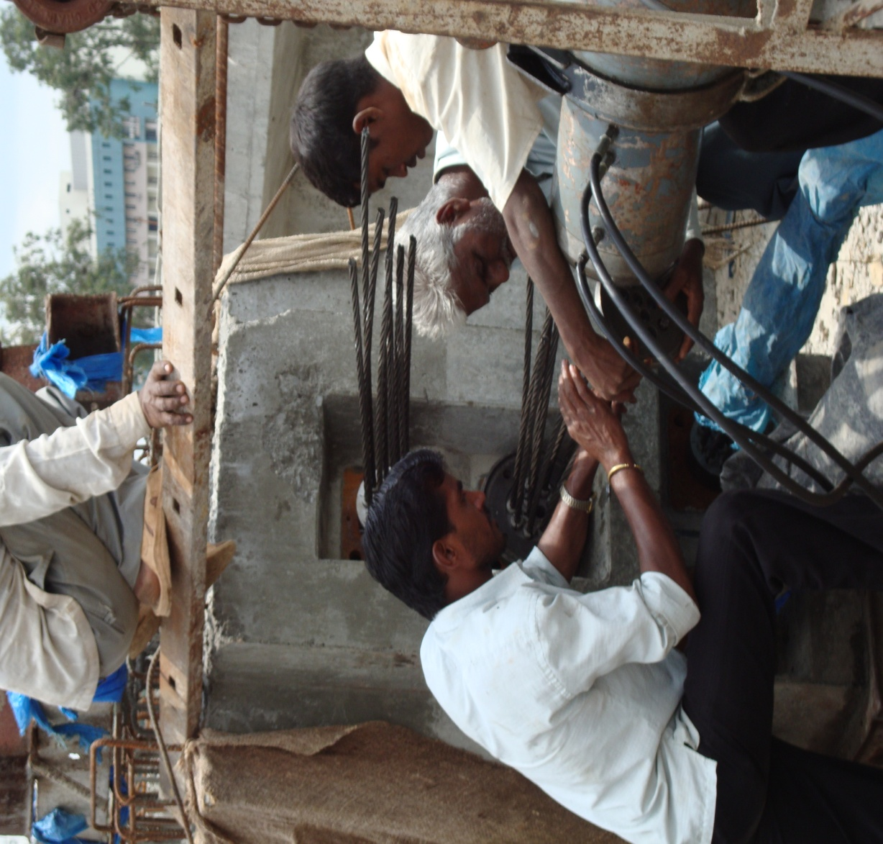
PRESTRESSED GIRDER MAKING

Slide 42
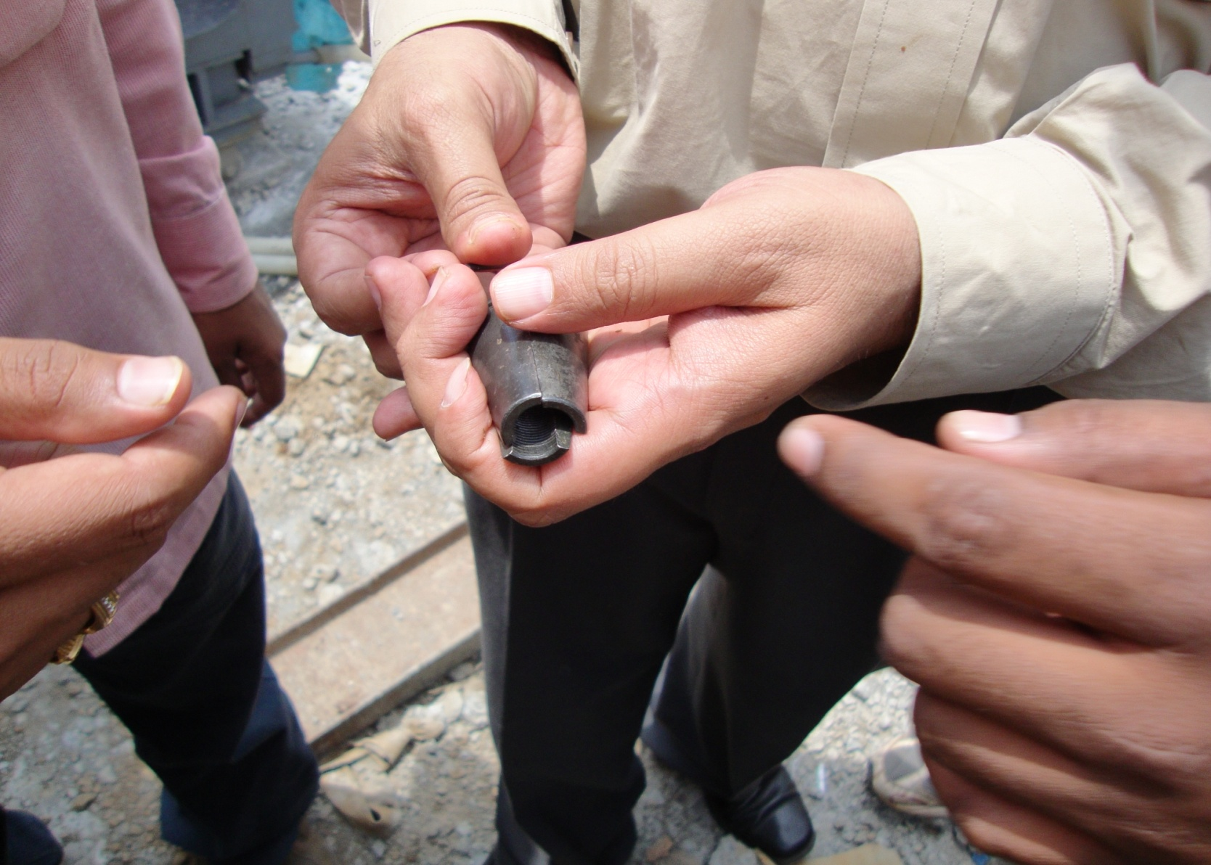
PRESTRESSED GIRDER MAKING

Slide 43
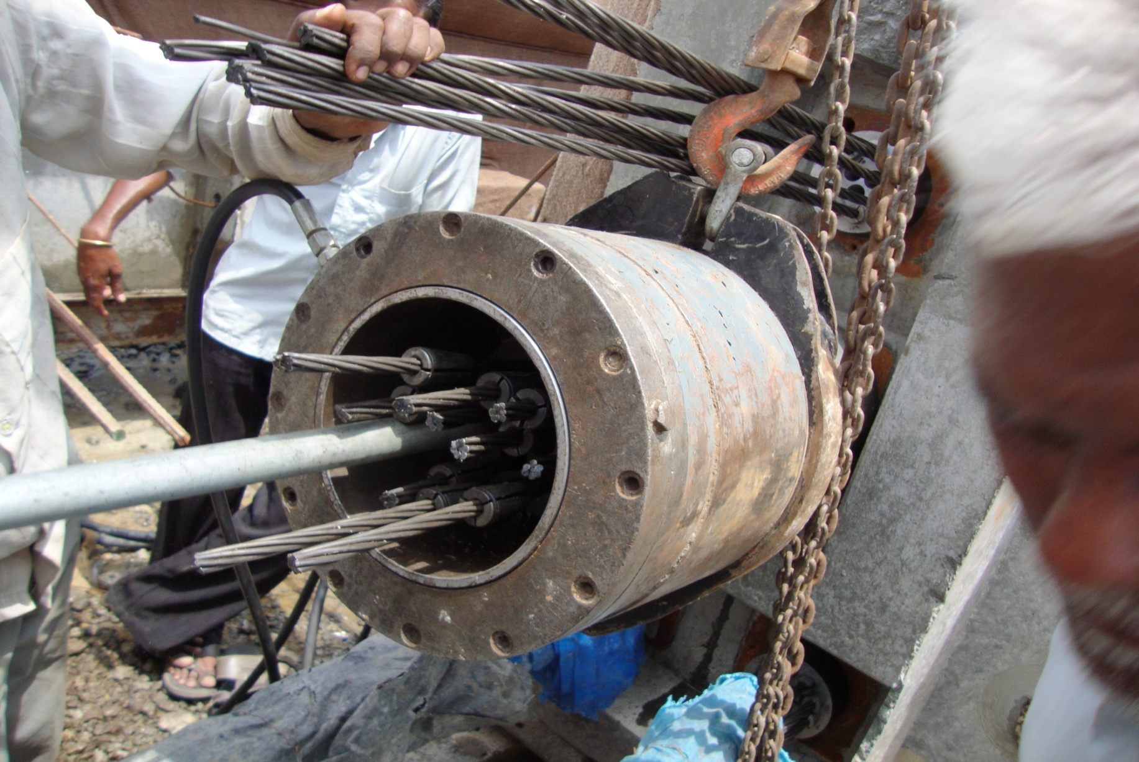
PRESTRESSED GIRDER MAKING

Slide 44
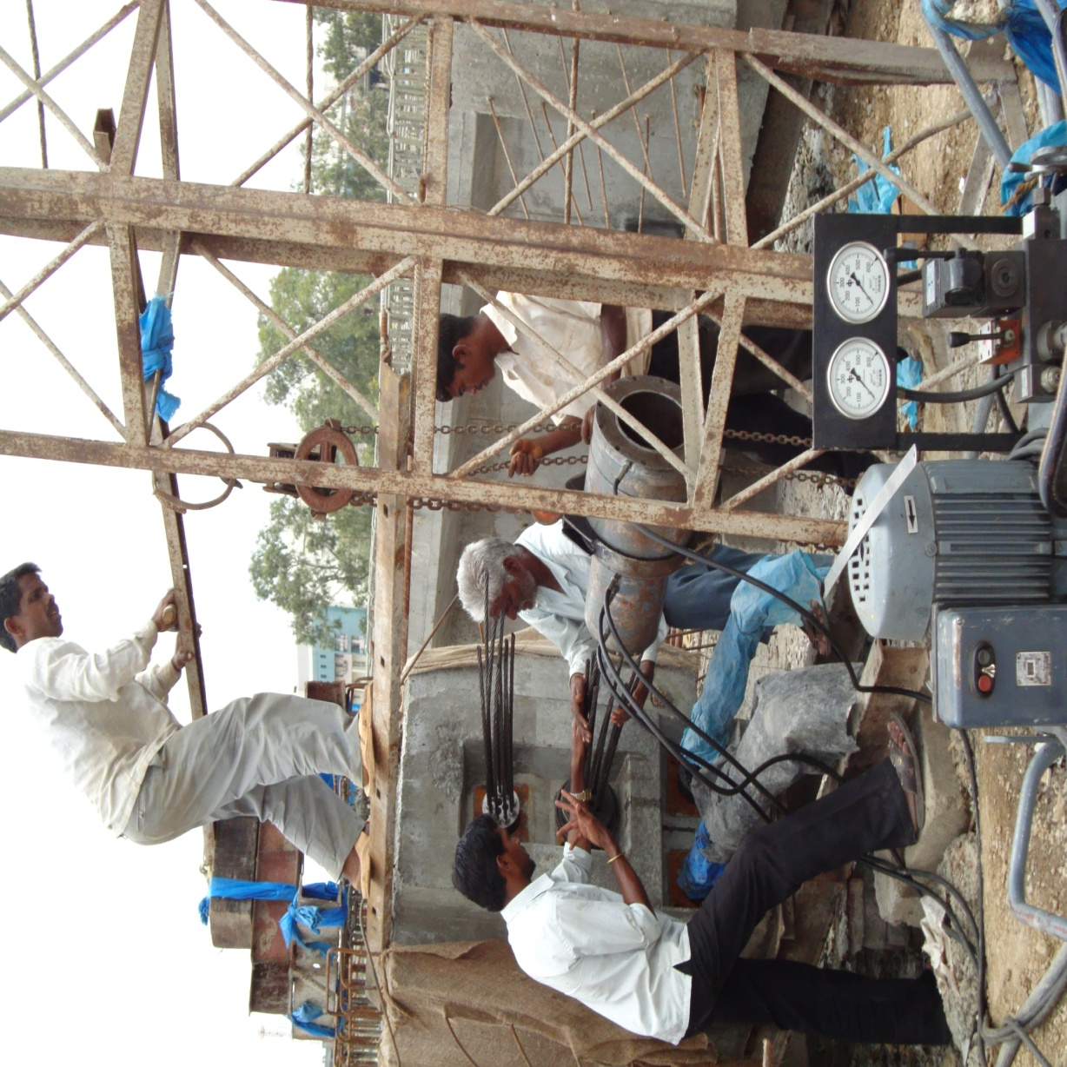
PRESTRESSED GIRDER MAKING

Slide 45
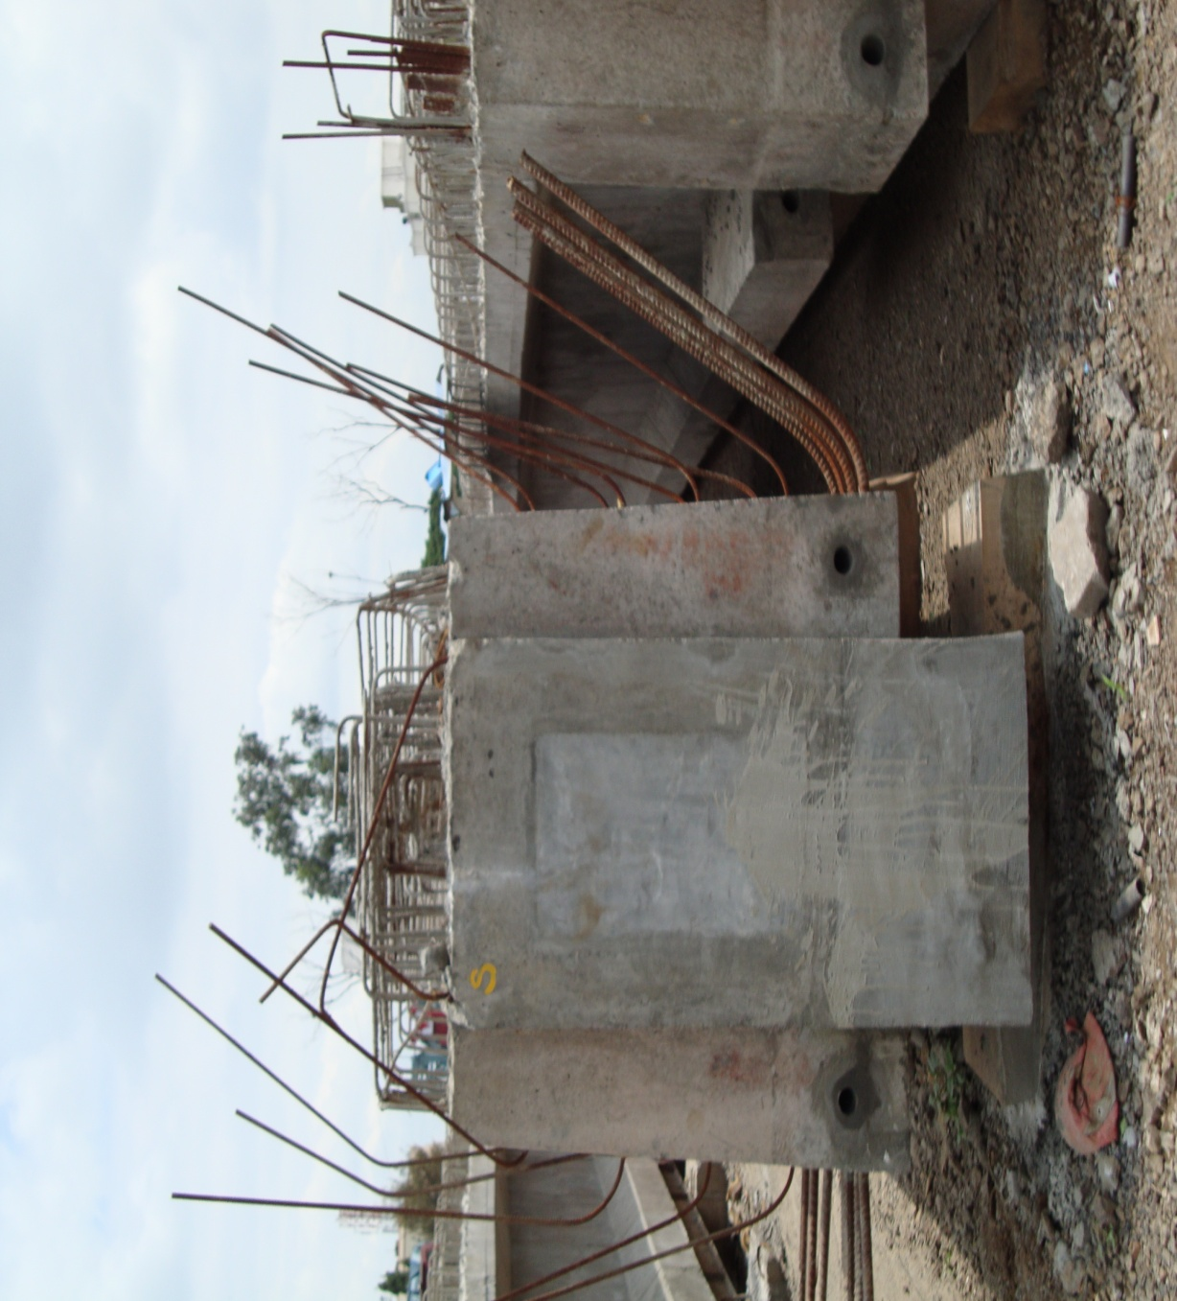
PRESTRESSED GIRDER MAKING

Slide 46
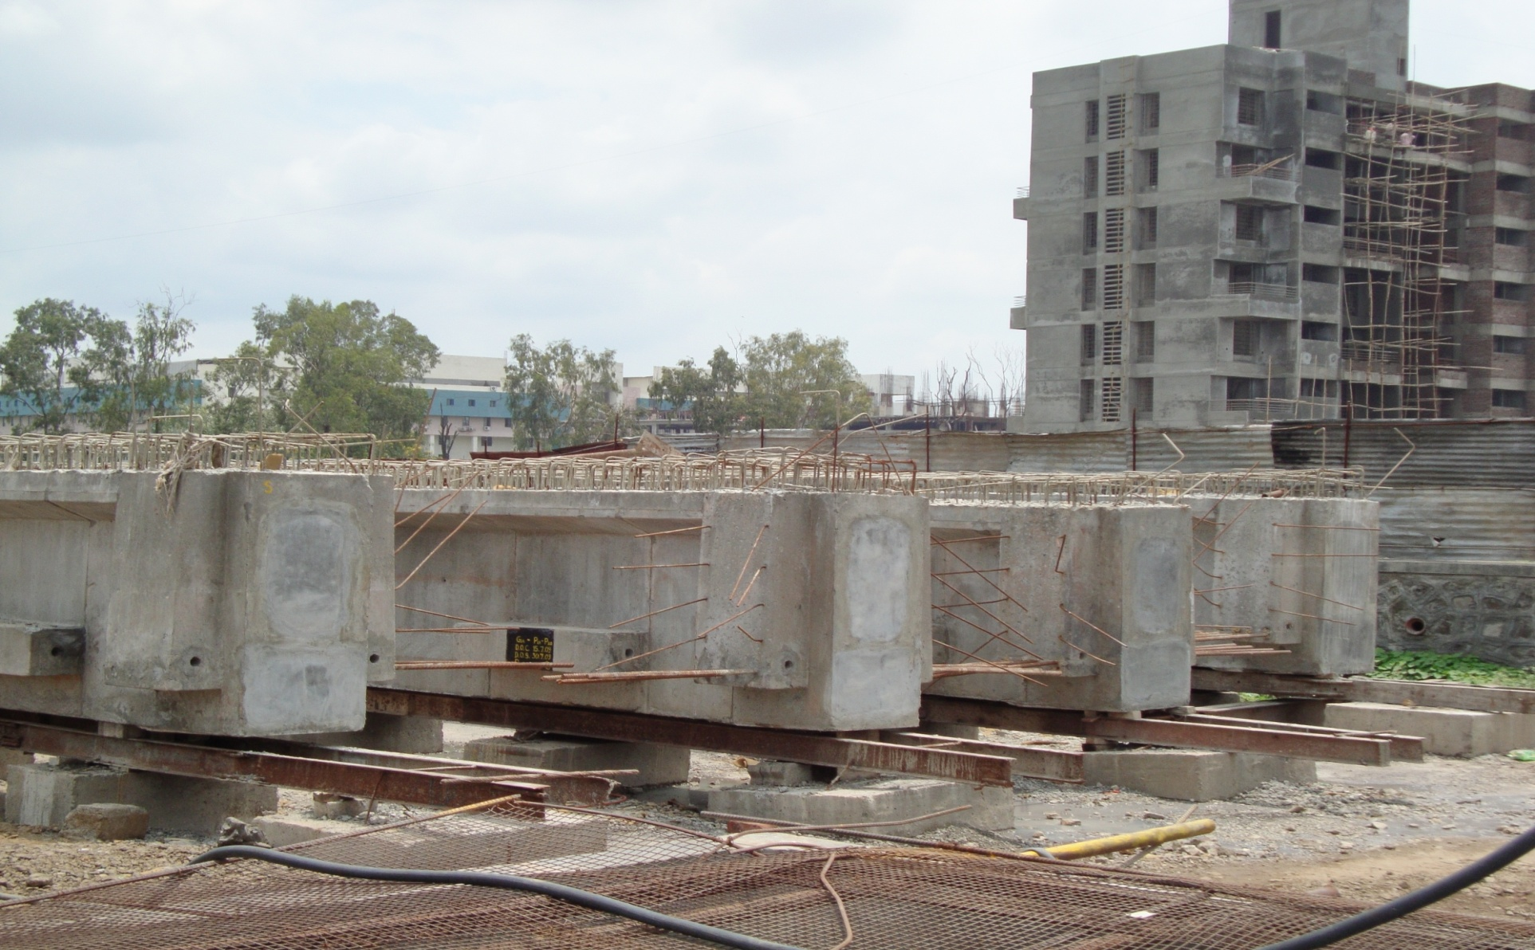
PRESTRESSED GIRDER MAKING

Slide 47
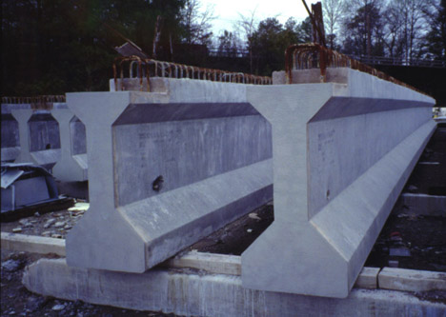
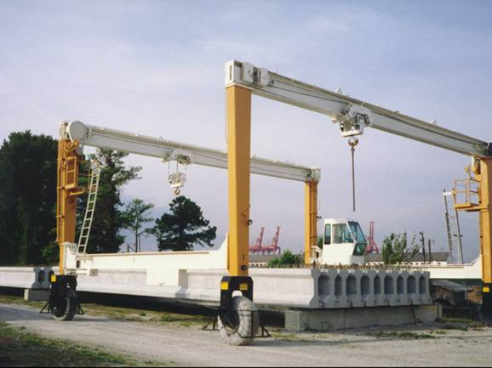
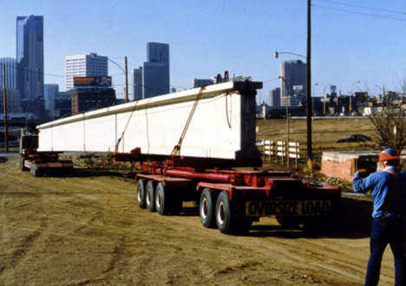

CARE TO TAKE
During designing all the loads are to considered and losses are also to be considered as per IS1343 for pre-stressed concrete.
Casting and curing is to be done properly for quality concrete. Suitable method of post tensioning is to be adopted.
Casted elements are to be stoked care fully, details should be given by designer
for storing members.
Transportation is to be done carefully to avoid damage to the precast elements.
Erection process is to be well decided and planed based on type of bridge and site condition.

Slide 48
CASE STUDY
Hangzhou Bay Bridge
Longest trans-oceanic highway bridge in the world, with a cable-stayed portion across Hangzhou bay in the eastern coastal region of China (6-lanes)
Total length of bridge is 35.67mt.
Construction of the bridge was completed on June 14, 2007.
The bridge shortened the highway travel distance between Ningbo and Shanghai from 400 km to 280 km and reduced travel time from 4 to 2.5 hours.
40 piers with large number of girders
Girder is of 70m length and 16.5m wide in plan
830 cubic meter of concrete for one girder and took 8 hours to cast one girder
Barge crane was used for erection of girders for 25 km. and for other portion special machine was built

Slide 49

HANGZHOU BAY BRIDGE

Slide 50

HANGZHOU BAY BRIDGE

Slide 51

HANGZHOU BAY BRIDGE

Slide 52

HANGZHOU BAY BRIDGE

Slide 53

HANGZHOU BAY BRIDGE

Slide 54
REFERANCES
Director - Martin P. Korn, President - Douglas ConeInitially, PCI, 1954
John Diaz & Ron Tola, Professor Parfitt – Thesis Advisor, Haverford College
Book, N. Krishna Raju, “Prestressed Concrete”, McGraw-Hill, 2008
Book, Rangwala, ”Bridge Engineering”, Charotar, 2010
Internet , “Google”,– Images
Internet, “Youtude”,- Videos

Slide 55
  THANK YOU

