Slide 1
Reactive Powder Concrete
Abbas Jamani
SD0510

Slide 2
Contents
Introduction
Composition of reactive powder concrete(RPC)
Properties of RPC
Application of RPC
Advantages & disadvantages of RPC
Case study
Conclusion
References

Slide 3
INTRODUCTION
RPC was first developed by P. Richard and M. Cheyrezy.
RPC was first produced in the early 1990’s by researchers at Bouygues laboratory in France and the world’s first RPC structure, the Sherbrooke Bridge in Canada was constructed in July 1997.

Slide 4
What is reactive powder concrete (RPC)
RPC is an ultra high strength and high ductility cementitious composite with advanced mechanical and chemical properties.
There are concretes that leads the way to the achievement of the maximum compressive strength of the order 120-150 Mpa.

Slide 5
……continue
In order to increase the compressive strength of concrete even further, the only way is to remove the coarse aggregate.
This philosophy has been employed in what is today known as Reactive Powder Concrete.
RPC is not just a simple mixture of cement, water and aggregates.
Quite often, it contains mineral components and chemical admixtures having very specific characteristics, which impart specific properties to the concrete.

Slide 6
COMPOSITION OF RPC

Slide 7
……continue
CEMENT
Their C3A content, varies from 1% up to 8%. Their soluble alkali content is very low and is comprised between 0.16% and 0.38%.
SILICA FUMES
The main quality of a silica fume is the absence of aggregates.

Slide 8
… continue
SAND
Sand should be of good hardness, readily available and low cost. Its particle size ranges from 0.15mm to 0.6 mm. The type of sand generally used is natural and crushed.
QUARTZ POWDER
Its particle size ranges from 0.005mm to 0.025mm. It should be crystalline in nature.

Slide 9
…continue
STEEL FIBRES
It should have good aspect ratio and should be able to improve ductility. Its length ranges from 13mm 25mm. It should be straight.
WATER
It should be clean from all the organic impurities as well as other dust particles. It should not be saline in nature.

Slide 10
…..continue
SUPER PLASTICIZER
A copolymer of acrylic ester (CAE), a polynaphtalene Sulfonate (PNS) and a polymelamine sulfonate (PMS) are normally employed for the purpose.
These admixtures are synthetic polymers.

Slide 11
Objectives of developing RPC
Elimination of coarse aggregate for enhancement of homogeneity .
Utilization of pozzolanic properties of silica fume.
Optimal usage of super plasticizer to reduce W/C and at the same time improves compaction .
Post- set heat treatment for enhancement of the microstructure.
Addition of small sized steel fibers to improve ductility.

Slide 12
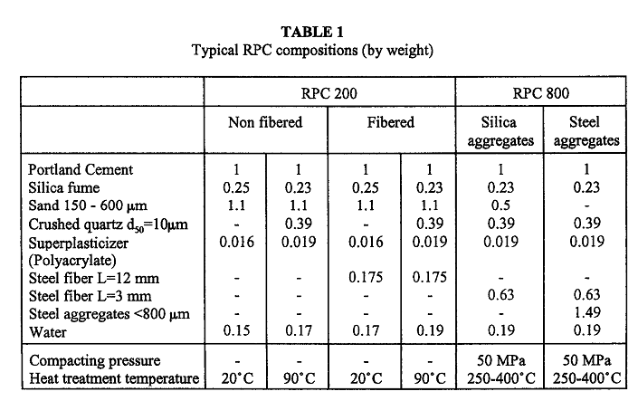
…..continue

Slide 13
……continue

Slide 14
Components with function parameters
Components
Sand
Cement
Quartz powder
Silica fume
Steel fibers
Superplasticiser
Function parameters
Give strength to aggregate
Binding material
Maximum reactivity during heat-treating
Filling the voids
Improve ductility
Reduce water binding

Slide 15
PROPERTIES
Fresh concrete properties
Compressive strength
Flexural strength
Water absorption and permeability
Chloride impermeability
Frost resistance

Slide 16
…..continue
RPC 200
Pre-setting pressurization -None
Heat-treating - 20 to 90°C
Compressive strength -170 to 230MPa
Flexural strength -30 to 60MPa
Young’s modulus -50 to 60GPa

Slide 17
…..continue
RPC 800
Pre-setting pressurization- 5OMPa
Heat-treating -250 to 400°C
Compressive strength
-using quartz sand : 490 to 680MPa
- using steel aggregate :650 to 810MPa
Flexural strength :45 to 141MPa
Young’s modulus : 65 to 75GPa

Slide 18
PROPERTIES OF RPC
COMPRESSIVE STRENGTH
  -Higher compressive strength than normal Concrete.
  -It is a factor linked with durability of material.
  -Maximum compressive strength of RPC is approximately 200MPa.

Slide 19
……continue
FLEXURAL STRENGTH
-Plane RPC possess high flexural strength than
regular concrete.
-By introducing steel fibers, RPC can achieve high
strength. The length and diameter of the fibres
have a considerable impact on the strength.

Slide 20
WATER ABSORPTION

Slide 21
RESISTANCE TO CHLORIDE ION PENETRATION
Increases when heat curing is done in concrete.
Heat cured RPC show higher value than normal cured RPC.
HOMOGENITY
Improved by eliminating all coarse aggregates.
Dry components for use in RPC is less than 600 micro meter .

Slide 22
WATER PERMEABILITY

Slide 23
7. COMPACTNESS:
Application of pressure before and during concrete setting period.
8. MICROSTRUCTURE:
Microstructure of the cement hydrate can be changed by applying heat treatment during curing.
9. MATERIAL DUCTILITY:
Material ductility can be improved through the addition of short steel fibres.

Slide 24
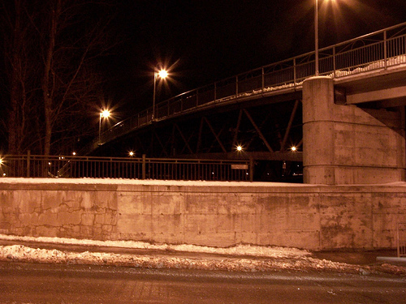
APPLICATIONS OF RPC
SHERBROOKE PEDESTRAIN BRIDGE

Slide 25
…..continue
CONTAINMENT OF NUCLEAR WASTE
-Used for isolation and containment of
nuclear wastes.
- It has been used for blocking &
stabilization of containment waste.

Slide 26
Advantages of RPC
It has the potential to structurally compete with
steel.
Superior strength combined with higher shear
capacity result in significant dead load reduction.
RPC can be used to resist all but direct primary
tensile stress.
Improved seismic performance by reducing
inertia load with lighter member .
Low &non-interconnected porosity diminishes
mass transfer, making penetration of liquid/gas non-existent.

Slide 27
Limitations of RPC
Least costly components of conventional concrete are eliminated by more expensive elements.
RPC is still in the intial stages,So long term properties are not yet known.

Slide 28
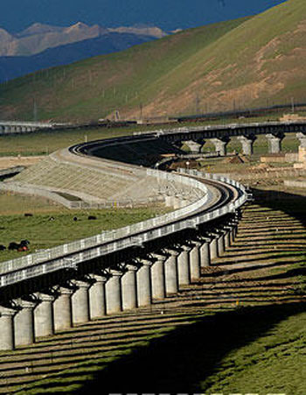
Case study
Qinghai-Tibet Railway

Slide 29
…..continue
The Qinghai-Tibet railway lies in the west area of China at an altitude of more than 4,000 meters.
The 576-km railway is being built on frozen earth.
The bad climate and sandstorms of the tundra require the concrete of the bridge to have superior mechanical properties and high durability.
By adding portland cement, silica fume, superfine fly ash, and superplasticizers, reactive powder concrete (RPC) is used in the sidewalk systems of bridges with compressive strength of 160 MPa

Slide 30
…conitnue
There are a lot of different problems with conventional concrete sidewalks such as corrosion, rust of reinforcing steel bars, and breakability of concrete slab.
The steel brackets rust in a conventional concrete sidewalk.
As a result, a conventional concrete sidewalk system requires maintenance every year.
Dead weight of the traditional sidewalk system is greater than that of the RPC sidewalk system.

Slide 31
…..continue
The sidewalk system made of RPC has such merits as small deadweight, excellent durability, low cost, and minimum maintenance.
Thus, RPC is more suitable for the sidewalk system of Qinghai-Tibet Railway than conventional concrete.

Slide 32
conclusion
The reactive powder concrete produced by routine concrete manufacture techniques has compressive strength above 160 MPa, bending strength above 20 MPa, fine frost resistance, and impermeability of chloride.
The sidewalk flat system produced by the reactive powder concrete has light deadweight, low cost, and the littler workload, which makes it suitable for bridge and its subsidiary facilities on the Qinghai-Tibet plateau.

Slide 33
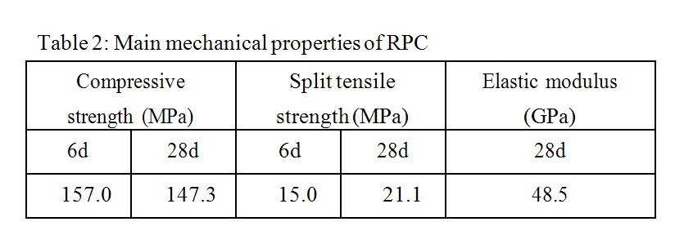
…..continue
Structural members have fine and steady quality and can satisfy the demand of practice production.

Slide 34
References
A.S Dili and Manu Santhanam.
Investigations on concrete powder concrete: 2004.
Halit Yazici.
The effect of curing conditions on compressive strength of ultra high strength concrete with high volume mineral admixtures, 2006.
Pierre Richard and Marcel Cheyrezy.
Composition of Reactive powder concretes, 1995 .
Ching- Tsung Liu and Jong- Shing Huang.
Highly flowable reactive powder mortar as a repair material, 2007

Slide 35
Thank you

