Slide 1
RECYCLED CONCRETE AGGREGATE

Slide 2
INTRODUCTION :-
One of the major challenges of our present society is the protection of environment.
Some of the important elements in this respect are the reduction of the consumption of energy and natural raw materials and consumption of waste materials.
Rapid infrastructural development such as highways, airports etc. and growing demand for housing has led to scarcity & rise in cost of construction materials.

Slide 3
INTRODUCTION (CONTD….)
Any construction activity requires several materials such as concrete, steel, brick, stone, glass, clay, mud, wood, and so on. However, the cement concrete remains the main construction material used in construction industries.
For its suitability and adaptability with respect to the changing environment, the concrete must be such that it can conserve resources, protect the environment, economize and lead to proper utilization of energy.
The utilization of recycled aggregate is particularly very essential as major part of concrete is made of aggregates.

Slide 4
INTRODUCTION (CONTD….)
Most of waste materials produced by demolished structures disposed off by dumping them as land fill.
Dumping of wastes on land is causing shortage of dumping place in urban areas.
Therefore, it is necessary to start recycling and re-use of demolition concrete waste to save environment, cost and energy.
The use of recycled aggregates from construction and demolition wastes is showing prospective application in construction as alternative to natural aggregates.

Slide 5
SOURCE OF AGGREGATE
The enormous quantities of demolished concrete are available at various construction sites.
Many old buildings, concrete pavements, bridges and other structures have overcome their age and limit of use due to structural deterioration beyond repairs and need to be demolished.
The structures, even adequate to use are under demolition because they are not serving the needs in present scenario.
Structures are turned into debris resulting from natural disasters like earthquake, cyclone and floods etc.
New construction is required for better economic growth.

Slide 6
PROCEDURE TO OBTAIN RCA
Recycled concrete aggregates (RCA) contain not only the original aggregates, but also hydrated cement paste.
Recycling of aggregate can take place either at the site from which the material is sourced using mobile crushers, or the
material may be transported to a central recycling facility where large stockpiles may be accumulated.
Recycled aggregates from these central recycling facilities undergo a number of processes to ensure higher quality.

Slide 7
PROCEDURE (CONTD….)
Various process involve, crushing, pre-sizing, sorting, screening and contaminant elimination.
Then to start with clean, quality aggregate in order to meet design criteria easily and ultimately get a quality product that will go into end use.
Further cleaning is also done to ensure the recycled concrete product is free of dirt, clay, wood, plastic and organic materials. This is done by water floatation, hand picking, air separators, and electromagnetic separators.

Slide 8
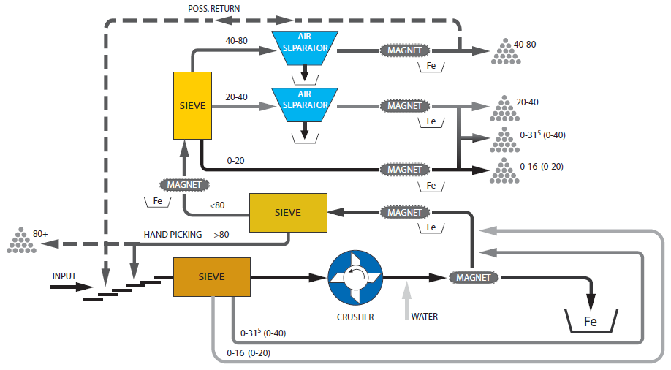
PROCEDURE (CONTD….)

Slide 9
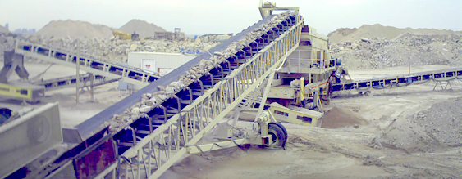
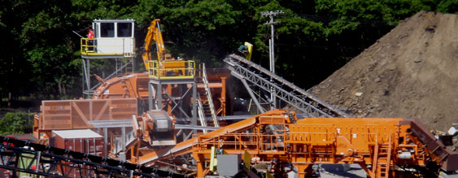
PROCEDURE (CONTD….)

Slide 10
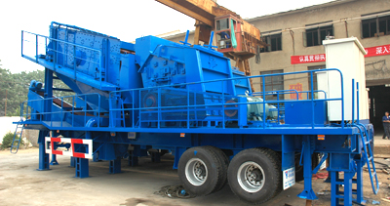
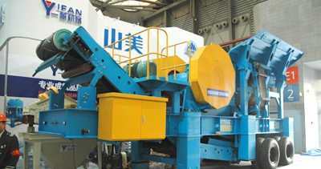
PROCEDURE (CONTD….)

Slide 11
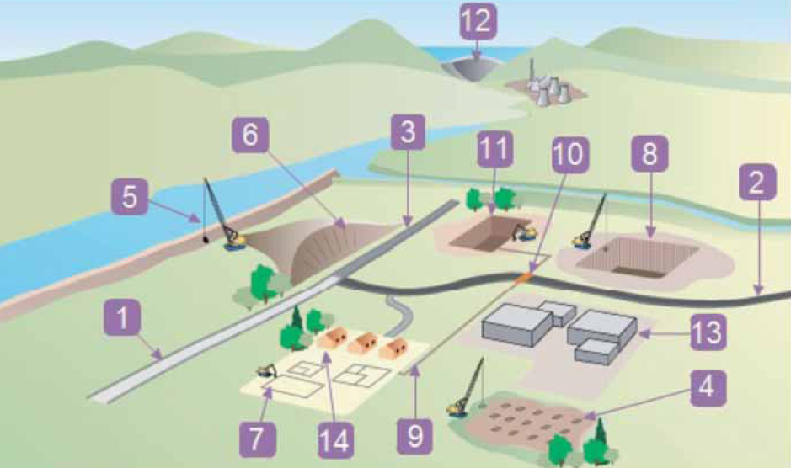
APPLICATION OF RECYCLED AGGREGATE
1, 2, 3: Roads
4: Ground Improvement
5: Earthwork Embankment
6: Earthwork Cutting
7: Shallow Foundation
8: Deep Foundation
9, 10: Utilities
11: Concrete Sub Structures
12: Concrete Structures
13: Buildings (industrial)
14: Buildings (residential)

Slide 12
PROPERTIES AND VARIOUS TESTING METHODS
Research has shown that coarse recycled aggregates can be used in concrete up to a compressive strength of 80 N/mm² and used in the range of 20 – 30% by mass of aggregates required along with natural aggregates.
As replacement amount increase, drying shrinkage and creep will increase and tensile strength and modulus of elasticity will decrease.
This is mainly because recycled aggregates provide less restraint to movement (lower elastic modulus), and because of the higher cement contents that are often used in these concretes to achieve the required strength.

Slide 13
TESTING (CONTD….)
Particle Size Distribution:
Sieve analysis is carried out as per IS 2386 for different types of crushed recycled concrete aggregates.
It is found that recycled coarse aggregate are reduced to various sizes during the process of crushing and sieving (by a sieve of 4.75mm), which gives best particle size distribution.
The particle shape analysis of recycled aggregate indicates similar particle shape of natural aggregate obtained from crushed rock.

Slide 14
TESTING (CONTD….)
Specific Gravity and Water Absorption:
The specific gravity (saturated surface dry condition) of recycled concrete aggregate was found from 2.35 to 2.58 which are lower as compared to natural aggregates.
Also, the RCA from demolished concrete consist of crushed stone aggregate with old mortar adhering to it, the water absorption ranges from 3.05% to 7.40%, which is relatively higher than that of the natural aggregates.
Bulk Density:
The bulk density of recycled aggregate is lower than that of natural aggregate which results in to higher porosity.

Slide 15
TESTING (CONTD….)
Crushing and Impact Value:
The recycled aggregate is relatively weaker than the natural aggregate against mechanical actions.
Compressive Strength:
The average compressive strengths cubes cast are determined as per IS 516 using RCA and natural aggregate at the age 1, 3, 7, 14, 28, 56 and 90 days.
The result shows that the compressive strength of RAC is lower than the conventional concrete made from similar mix proportions. The reduction in strength of RAC as compare to NAC is in order of 2- 14% and 7.5 to 16% for M-20 & M-25 concretes respectively.

Slide 16
TESTING (CONTD….)
Modulus of Elasticity:
The modulus of elasticity of RAC is lower than the natural aggregates and reduction is up to 15%.
The reason for the lower static modulus of elasticity of RCA is higher proportion of hardened cement paste.

Slide 17
TESTING (CONTD….)
Natural Aggregate Concrete (NAC): Cement, Fine aggregate and Coarse aggregate in the ratio 1:1.6:3.3.
.
Recycled Aggregate Concrete (RAC): Natural coarse aggregate was completely replaced by recycled aggregate and the mix was in the ratio 1: 1.6: 3.3.
.
NAC1: 10% fly ash (by weight of cement) was added to NAC replacing cement.
RAC1: 10% fly ash (by weight of cement) was added to RAC replacing cement.
Water –cement ratio: 0.4 by weight.
Water reducing admixture: 125ml/50 kg of binder

Slide 18
TESTING (CONTD….)
Mix Designation Compressive Strength, MPa
7-day 28-day
NAC 35.26 46.13
RAC 29.33 38.11
NAC 1 41.70 48.52
RAC 1 36.70 53.55

Slide 19
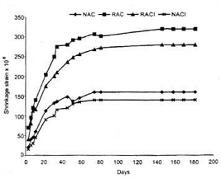
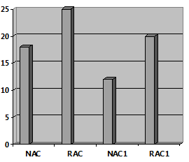
TESTING (CONTD….)
Drying Shrinkage
Water Absorption

Slide 20
Reasons for low strength test results
The weaker interfacial transition zone between aggregate and mortar, due to recycled aggregates having a coat of weak mortar already attached which raises the porosity of the concrete.
The inclusion of weak and porous aggregate particles, for example low strength bricks, glass and plaster.
Crushing and impact values also depends on source of original aggregates received from recycling of concrete.
Compressive strength depends on grade of demolished concrete, replacement ration, W/C ratio and process of recycling.

Slide 21
Obstacles in use of rca
The acceptability of recycled aggregate is impeded for structural applications due to the technical problems associated with it such as weak interfacial transition zones between cement paste and aggregate, porosity and transverse cracks within demolished concrete, high level of sulphate and chloride contents, impurity, cement remains, poor grading, and large variation in quality.
The current legislation and experience are not adequate to support and encourage recycling of construction & demolished waste in India.
Lack of awareness, guidelines, specifications, standards, data base of utilization of RCA in concrete and lack of confidence in engineers, researchers and user agencies is major cause for poor utilization of RCA in construction.

Slide 22
VALUE ENGINEERING BENIFITS
Recycled concrete aggregates reduces the need for virgin aggregates. This in turn reduces the environmental impact of the aggregate extraction process.
Produce specification sized recycled aggregates at any given location.
Avoid haul-off costs and landfill disposal fees.
Eliminate the expense of aggregate material imports and exports.
Minimize impact to community infrastructure by reducing import and export trucking.

Slide 23
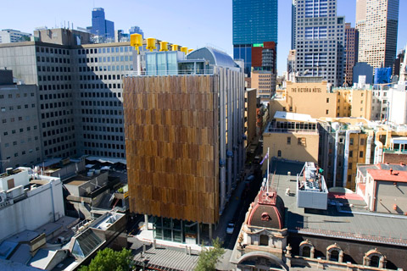
CASE STUDY: COUNCIL HOUSE 2 (CH2), MELBOURNE

Slide 24
CASE STUDY (CONTD….)
Client and Project Management: City of Melbourne
Builder: Hansen Yuncken
Architect: City of Melbourne and DesignInc Pty Ltd
Structural Engineer: Bonacci Group
Type of Building: 10 Storey Office Building
Year of Construction: 2004

Slide 25
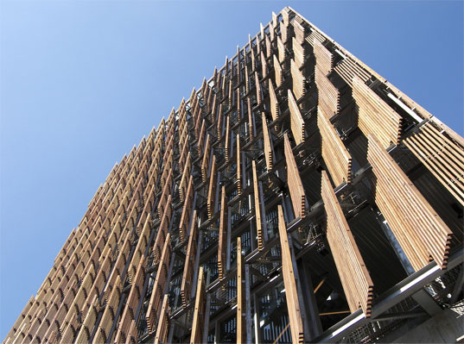
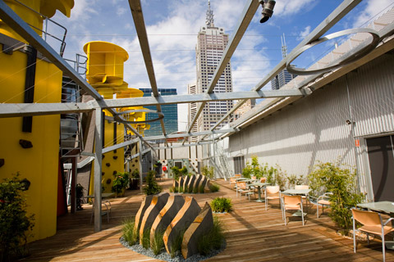
CASE STUDY (CONTD….)

Slide 26
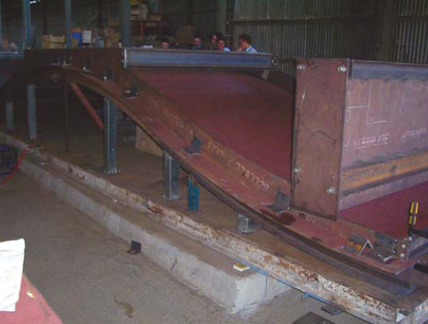
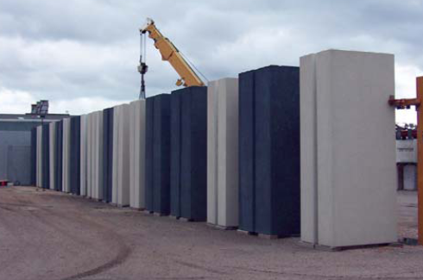
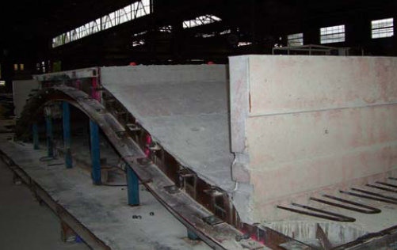
CASE STUDY (CONTD….)

Slide 27
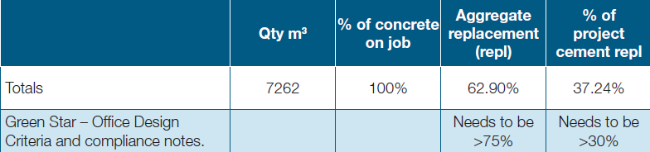
CASE STUDY (CONTD….)

Slide 28
THANK YOU

