Slide 1

SELF HEALING MATERIAL--
BACTERIAL CONCRETE
PARIN PATEL
SD-1410
GUIDED BY:
V.R. SHAH
DHARA SHAH
ANAL SHAH

Slide 2
Introduction :
Concrete is a material which is the most widely used building material in the world.
Natural processes such as weathering, faults, land subsidence, earthquakes, and human activities creates cracks in concrete structures.
Concrete expands and shrinks with changes in moisture and temperature and this tendency to shrink and expands causes cracks in concrete.

Slide 3
We do not like cracks in concrete because cracks form an open pathway to the reinforcement and can lead to durability problems like corrosion of the steel bars.
These cracks should be repaired because they can reduce the service life of structure.
In case of historical monuments cracks spoils the appearance of structure.
Remediation of already existing cracks has been subject of research for many years.

Slide 4
The various product such as structural epoxy, resins, epoxy mortar, and other synthetic mixtures are used as filling material but they are not environmentally friendly not even safe for human health.
Here are some four possible mechanisms given for self healing of concrete which are as under :
1.) Formation of material like calcite
2.) Blocking of the path by sedimentation of Particles
3.) Continued hydration of cement particles
4.) Swelling of the surrounding cement matrix.

Slide 5
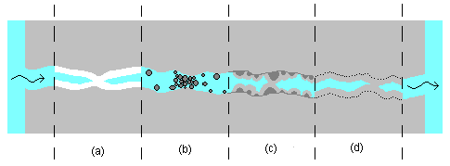
Different healing mechanisms

Slide 6
Bacterial concrete :
The "Bacterial Concrete" is a concrete which can be made by adding bacteria in the concrete that are able to constantly precipitate calcite, this phenomenon is called microbiologically induced calcite precipitation.
It is process by which living organisms form an inorganic solids.
It is same process as we people are producing teeth and bones.

Slide 7
“Bacillus Pasteruii ” is a common soil bacterium, which can continuously precipitate a new impermeable calcite layer over the surface of concrete.
Favorable condition does not exist in concrete because of its alkaline nature, pH value of concrete is very high.
In extreme alkaline environment pH of 12 in not favorable for growth of this bacteria, its optimum pH
for growth is 9, but bacteria has an ability to produce such material to maintain pH.

Slide 8
How does bacteria remediate cracks ?
As we have seen in previous slides “Bacillus pasteurii” have an ability to precipitate calcite in environment.
This process of microbiologically induced calcium carbonate precipitation is having a complex biochemical reactions.
B. Pasteurii produces urea which catalyzes to produce CO₂ and ammonia, due to the ammonia pH of concrete get increase.

Slide 9
There is a medium of nutrient urea and CaCl₂ is used to grow the bacteria and also to control the pH.
After this process in surroundings ions Ca²⁺ And
CO₃ ²⁻ precipitate as CaCO₃.
This following equations summarize the whole process:
Ca²⁺ + Cell Cell-Ca²⁺
Cl⁻ + HCO₃⁻ + NH₃ NH₄Cl + CO₃²⁻
Cell-Ca²⁺ + CO₃²⁻ Cell- CaCO₃

Slide 10
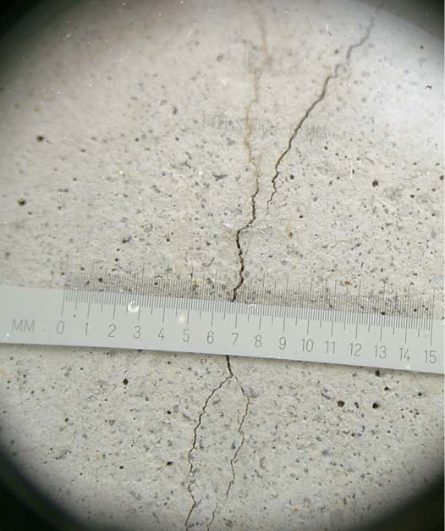
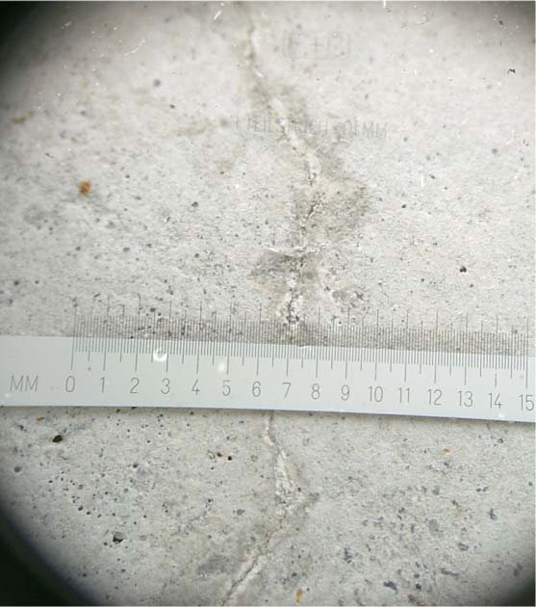
Observed crack healing in concrete

Slide 11

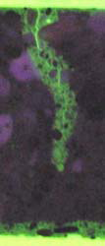
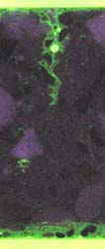

Image showing effect of healing

Slide 12
Comparison of characteristics of bacterial concrete and concrete without bacteria through some of the test results…..

Slide 13
(1) Effect of bacteria to various depth of cracks on stiffness
Beam size of 152×25.4×25.4 mm
Cured for 28 days and keep exposed to air for 3 months
Artificial cracks of depth 3.2mm and 9.5mm were cut on beam
For each depth of crack made 10 specimen among them 5-were filled with bacteria
5- without bacteria kept as it is
Tested using one point loading system

Slide 14
From the results graph of load and deflection were drawn from the slope of that curve stiffness is calculated.
In results it is obviously deeper cuts have shown lower stiffness value than shallower cuts
In beams where bacteria were provided showed more effective remediation of cracks than other without bacteria
Stiffness of beams which were having bacteria showed increase in stiffness by 24% and 14% in beams with having depth 3.2mm and 9.5mm respectively.

Slide 15
Comparison of stiffness value for different crack depths:
Stiffness
(N/mm)
Depth of crack (mm)

Slide 16
(2) Effect of bacteria to various depths of crack on compressive strength:
cube size 50.8×50.8×50.8 mm
Cured for 28 days kept exposed to air for 3 months
Cracks of depth 12.7mm, 19.05mm, 25.4mm were made
For each crack depth 10 Specimen were made among them 5- with bacteria and
5-without bacteria
Tested on compression testing machine

Slide 17
Comparison of compressive strength of cubes with various crack depth:
Compress- ive strength in(Mpa)
Depth of crack(mm)

Slide 18
Result showed increase in compressive strength of specimen with bacteria but in crack of depth 25.4mm it showed more significant result that its compressive increased by 80%

Slide 19
(3)Effects of different concentration of bacteria on compressive strength:
Same specimen were made as it was in previous experiment
Cracks of depth 3.2mm and 25.4 mm were made
Total 9 specimen were made for each crack
Added bacteria of following concentration:
4.3× 10⁸ cells/ml of water
  8.6× 10⁸ cells/ml of water
4.3× 10⁹ cells/ml of water

Slide 20
Comparison of compressive strength of concrete made with various concentration of bacteria:
Compressive strength in(Mpa)
specimens

Slide 21
In result specimen which were treated with bacteria showed higher compressive strength.
From results at concentration of 8.6× 10⁸ cells/ml found increase maximum compressive strength and this concentration is taken as optimum concentration.
Reason why higher concentration did not give higher compressive strength may be because greater population of bacteria did not have enough nutrients to share.

Slide 22
(4)Effects of different concentration of bacteria on alkali aggregate reactivity :
Size of beam- 285.75×25.4×25.4mm
20 specimen were made, among them 16 were made with different concentration of bacteria and 4 without bacteria
specimen were placed in moist cabinet for 24 hrs and cured for 7 days, and then transferred into plastic container having tap water at 80⁰ C for 24 hrs

Slide 23
Readings were taken at every 3,5,7,11 and 14 days
Reading were taken on length comparator to measure the expansion occurred due to alkali aggregate reaction
From result it showed that beam without bacteria were having more expansion as compare to other having different concentration of bacteria.
The reason in having less expansion is due to formation of calcite on the surface and in internal part of concrete.

Slide 24
Comparison of mean expansion of concrete made with and without bacteria subjected to alkali attack:
Mean expansion (%)
Age(days)

Slide 25
(5)Effects of different concentration of bacteria on sulfate attack resistance :
Same size of beams as used in previous example
Total 20 specimen were made among them 16 made with bacteria and 4 made without bacteria it were cured for 7 days.
Specimen were than placed in sodium sulfate solution
Reading using length comparator were taken at 7,14,21,28 and 56 days.

Slide 26
Comparison of mean expansion of concrete made with and without bacteria subjected to sulfate attack:
Mean expansion(%)
Immersion age (days)

Slide 27
(6)Effects of different concentration of bacteria on freeze and thaw action:
Size of beam- 285.75×76.2×76.2mm
Total 12 specimen were made having different concentration among them 9 were made with bacteria and 3 were made without bacteria, they were cured for 7 day.
For freezing and thawing effect temperature was lowered to 4.4⁰ to -17.8⁰ C and raising it from -17.8⁰ to 4.4⁰. the specimen were removed in thawing phase only.
Results were taken at every 30 cycles. In following graph results of 0 and 210 cycles are given

Slide 28
Comparison of weight change of concrete made with and without bacteria subjected freeze and thaw action:
Weight change (%)
Mix designation

Slide 29
Scanning electron microscopy investigation:
This analysis is done due to the following reasons:
To give visual documentation of extent of mineral precipitation in various region within the cement mortar
to confirm the elemental composition of the mineral precipitation
To identify microscopic evidence supporting the precipitation of bacteria in mineral precipitation

Slide 30
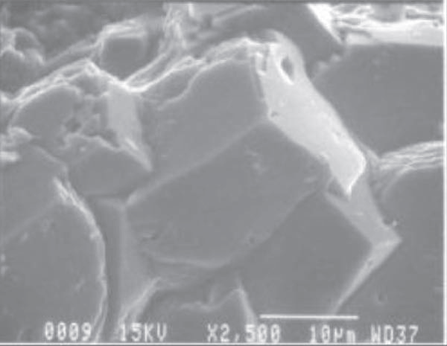
Magnified image of hexagonal shaped calcite crystal which indicates full growth of crystals:

Slide 31
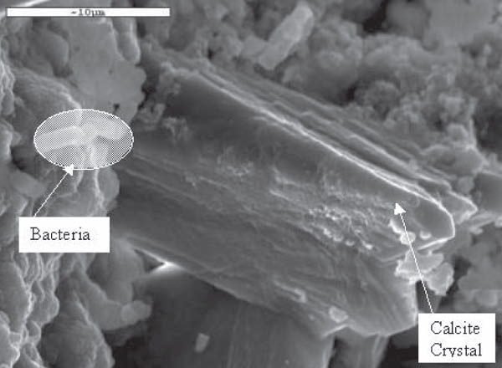
Developing calcite layer at higher magnification:

Slide 32
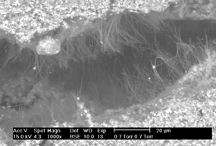
Precipitation of material in crack observed in concrete:

Slide 33
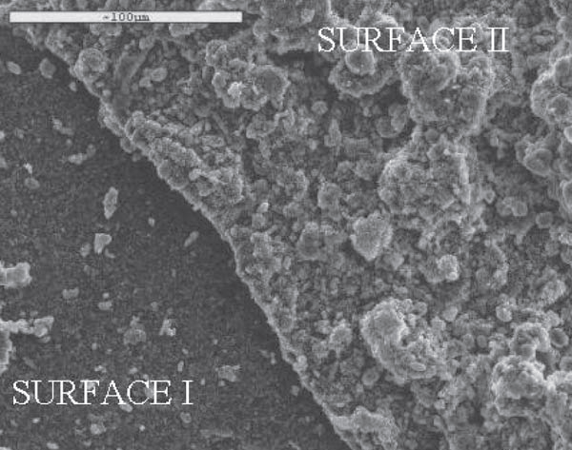
Formation of new layer (surface-2) over concrete beam:

Slide 34
Comparison of % elements in surface-1 and surface-2 :
ELEMENT | SURFACE-1 (%) | SURFACE-2 (%)
Na | 0.3 | 0.5
Mg | 0.05 | 0.6
Al | 7.1 | 0.2
Si | 25.9 | 1.0
S | 0 | 0
Cl | 0.2 | 0
K | 15.2 | 0
Ca | 8.4 | 68.8
Fe | 0.3 | 0
O | 42.5 | 29.2

Slide 35
Conclusion :
It was found that beams with micro crack remediated with bacterial concentration of 8.6× 10⁸ cells/ml of water regained 80% of its original strength.
Higher concentration reduced the regaining strength of concrete.
It was found that specimen with bacteria improved its permeability and resistance to alkaline environment, sulfate attack and freeze- thaw action.

Slide 36
Thus we can say that crack remediated with bacteria can improve the strength and durability of structure.
This all observation were done in America this results we cannot directly considered valid for our country because of difference in temperature, humidity, type of concrete, control on various parameters such as type of concrete mix, etc.
In India porosity and permeability of concrete should be studied because they are the main causes of distress in many structures.

Slide 37
If this method once studied in Indian environment then it can be used in crack remediation in many structures having more importance and containing hazardous material.
In India Nuclear Power Corporation has started working on the research of bacterial concrete for using it in nuclear power plant.

Slide 38
References:
Ramachandran, S.K., Ramakrishnan, V., and Bang, S.S., “Remediation of Concrete using Microorganisms”, ACI Materials Journal, v.98, No.1, pp. 3-9, Jan-Feb 2001.
Ramakrishnan, V., Ramesh Panchalan., and Bang, S.S., “Bacterial Concrete- A Self Remediating Biomaterial” Proceedings of 10th International Congress on the Polymers in Concrete, Hawaii, May 2001.
A Text book of concrete technology by M.S.SHETTY…
http://www.tudelft.nl/live/pagina.jsp?id=8691221d-ebab-4841-97cb-1cfacad3a4bc&lang=nl
http://www.economist.com/science/displaystory.cfm?story_id=13570058

Slide 39
Thank you

