Slide 1
STRESS RIBBON BRIDGES
PREPARED BY:SHAIKH MOHAMMADSOYAB A.
CODE NO:SD-1810
GUIDED BY:DHARA SHAH
: ANAL SHAH

Slide 2
CONTENTS:
INRODUCTION
DIFFERENCE OF BRIDGES
ADVANTAGESOF STRESS RIBBON BRIDGES
RECENT TYPICAL APPLICATIONS
RECENT DESIGNS AND DEVELOPMENT
STUDY OF LONG SPAN STRESS RIBBON STRUCTURE
CURVED STRESS RIBBON BRIDGES
STATIC AND DYNAMIC LOADING TESTS
PRELIMINARY DESIGN PRESTRESSED
CONCREAT STRESS RIBBON BRIDGES

Slide 3
INTRODUCTION
Stress-ribbon bridges is the term that has been
coined to describe structures formed by a very slender concrete deck with the shape of a catenary .
They can be designed with one or more spans and are characterized by successive and complementary smooth curves.

Slide 4
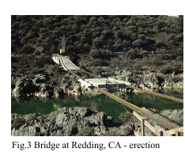
In the case of precast structures the deck is assembled from precast segments that are suspended on bearing cables and shifted along them to their final position – see Fig.3.
Prestressing is applied after casting the joints between the segments to ensure sufficient rigidity of the structures.

Slide 5
DEFINATION OF STRESS RIBBON BRIDGES
A stress ribbon bridge is a tension structure . The suspension cables are embedded in the deck which follows a catenary arc between supports.
Unlike the simple span the ribbon is stressed in compression, which adds to the stiffness of the structure .
The supports in turn support upward thrusting arcs that allow the grade to be changed between spans. Such bridges are typically made from concrete reinforced by steel tensioning cables.

Slide 6
Where such bridges carry vehicle traffic a certain degree of stiffness is required to prevent excessive flexure of the structure, obtained by stressing the concrete in compression.
This pioneered the construction sequence now typical for concrete segment bridges of this type. After placement of the principal cables, precast concrete tiles were placed to form the initial structure.
The cables were then prestressed by loading sandbags upon the tiles, followed by final concretization of the gaps between tiles.

Slide 7
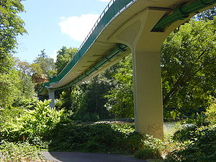
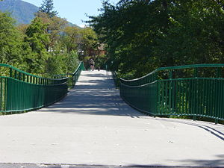
Removal of the sandbags then compressively stressed the concrete structure, enhancing its stiffness and durability under load.

Slide 8
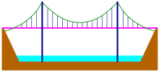
Difference OF BRIDGES
SIMPLE SUSPENSION BRIDGE:
On a simple suspension bridge, the main cables (or chains) follow a hyperbolic curve, the catenary.
SUSPENDED DECK BRIDGES:
The main cables follow a parabolic curve, the parabola. This is because the main cables are tied at uniform intervals to the bridge deck below.

Slide 9
STRESS RIBBON BRIDGES:
A stressed ribbon bridge also has one or more catenary curves and a deck laid on the main cables. Unlike a simple suspension bridge however, a stressed ribbon bridge has a stiff deck, usually due to the addition of compression elements.

Slide 10
Advantages of stress ribbon bridges
The main advantage of these structures is that they have a minimal environmental impact because they use very little material and can be erected independently from the existing terrain.
They do not need bearings or expansion joints they need only minimal long-term maintenance.

Slide 11
Stress-ribbon pedestrian bridges are very economical, aesthetical and almost maintenance-free structures.
Another characteristic feature of the stress-ribbon type structures, in addition to their very slender concrete decks, is that the stiffness and stability are given by the whole structural system using predominantly the geometric stiffness of the deck.

Slide 12
At present stress ribbon bridges constructed with arches or cables.
stress-ribbon structure supported by an arch in which
deck is fixed into the side struts. Both the arch and
struts are founded on the same footings.
Due to the dead load the horizontal force both in the arch and in the stress-ribbon have the same magnitude, but they act in opposite directions.
Fig.1 Stress-ribbon stiffened by an arch

Slide 13
Therefore the foundation is loaded only by vertical reactions.This self-anchoring system allows a reduction in the costs of substructure.
The second type of studied structures is a suspension structure formed by a straight or arched stress-ribbon fixed at the abutments (Fig.2).
External bearing cables stiffen the structure both in the vertical and horizontal directions.

Slide 14
Horizontal movements caused by live load are eliminated by stoppers, which only allow horizontal movement due to temperature changes and creep and shrinkage of concrete.

Slide 15
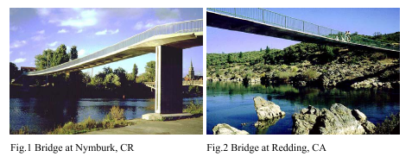
structures can be either cast in-situ or formed of precast units.

Slide 16
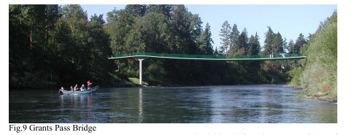
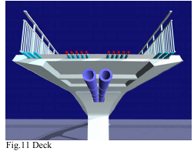
RECENT TYPICAL APPLICATIONS
BRIDGE ACROSS THE ROUGH RIVER, GRANTS PASS, OREGON

Slide 17
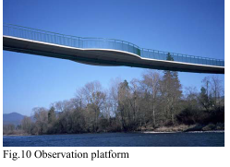
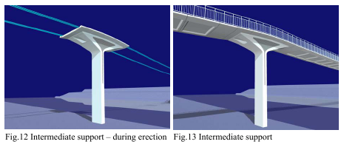

Slide 18
Overall length:200.55m
Width bridge: 4.7m width and 4.3 m wide for multi-use of span.
At the abutments and above the intermediate supports the stress ribbon is supported by concrete saddles (see Figs.12 and 13) that allow passing of the pipelines though them.
To reduce the dynamic response of the structure to seismic load, the transverse stiffness of piers was reduced as much as possible.

Slide 19
The bridge deck is formed from precast concrete segments with a coffered soffit that are composite with a cast-in-place deck slab.
The segments are suspended on bearing tendons, the composite deck is post-tensioned by prestressing tendons.
The structure was developed on basis of static and dynamic analyses.

Slide 20
Construction of the bridge was commenced by construction of the end abutments and piers. Then the solid abutment and pier segments were erected.
The segments were suspended on bearing tendons and shifted along them into the design position.
At first the segments of the side spans were erected, then the segments of the main span.

Slide 21
After that the formwork of the observation platforms was suspended on the mid-span segments, and the pre-stressing tendons and reinforcement of the deck slab were placed.
Then the observation platforms together with the composite slab were cast and subsequently post-tensioned.

Slide 22
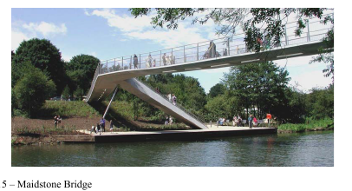
KENT MESSENGER MILLENNIUM BRIDGE, MAIDSTONE, UK
Deck of the bridge is formed by two span stress ribbon.
Length of bridge:21.50m

Slide 23
The stress ribbon is formed by precast segments with a composite deck slab .
The segments are suspended on bearing cables and serve as a false-work and formwork for casting of the composite slab that was cast simultaneously with the joints between the segments.
The stress ribbon is fixed into the abutments’ anchor blocks and it is frame connected with the intermediate support.

Slide 24
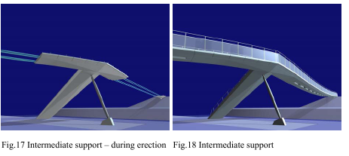
Both the precast segments and the composite slab are
post tensioned by prestressing tendons that are situated together .
The intermediate support that is situated in the axis of the angle break resists the resultant horizontal force from the adjacent spans into the foundation by a system formed by a compression strut and a tension tie – see Fig.17 and 18.

Slide 25
The value of the horizontal force depends on the position of the live load, for several loading cases the tube acts as a compression member too.
The change of direction in the bridge deck plan creates transverse and torsional forces for which the structure was carefully checked.
Similar to the all stress ribbon structures significant bending stresses originate close to the supports.
These stresses were reduced by designing of cast-in-place haunches that were checked as partially prestressed members.

Slide 26
Before the erection of the deck the abutments and the intermediate support including the haunches were cast.
The erection of the segments the tension force in the cables was corrected, the prestressing tendons and reinforcing steel of the composite slab were placed and the joints between the segments, closure and slab were cast.
When the concrete reached the sufficient strength the structure was post-tensioned to the full design level.
The function of the bridge was also verified by a dynamic test that proved that the users do not have feeling of discomfort when walking or standing on the Bridge.

Slide 27
RECENT DESIGNS AND DEVELOPMENT
BRIDGE ACROSS THE FREEWAY R3508 NEAR OLOMOUC, CZECH REPUBLIC
The one disadvantage of the classical stress-ribbon type structure is the need to resist very large horizontal forces at the abutments, which determines the economy of that solution in many cases.

Slide 28
For that reason, we have developed a self anchored structural system where the horizontal forces from the stress ribbon is balanced by force from arch.
This structural system is utilized in a design of the bridge crossing a freeway R3508 that is being built near a city of Olomouc, Czech Republic

Slide 29
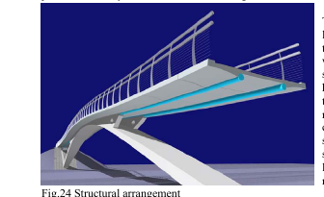
The bridge is formed by a stress ribbon that is supported by an arch.
The precast segments are designed from high-strength concrete of the characteristic strength of 80 MPa, the cast-in-place arch from a high-strength concrete of strength of 70 MPa.
.

Slide 30
The external cables are anchored at the end abutments and are deviated on saddles formed by the arch crown and short spandrel walls.
At the abutments the tendons are supported by short saddles formed by cantilevers protruded from the anchor blocks.

Slide 31
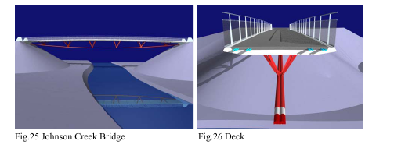
JOHNSON CREEK BRIDGE, OREGON
The bridge is formed by a partially self anchored suspension structure of span of 60.80 m.
The deck is in variable longitudinal slope with
maximum slope at abutments 5%.

Slide 32
The deck is formed by precast segments and composite deck slab .
Each third segment is connected with triangular steel struts that transfer the radial forces from the external cables into the deck.
The deck is fixed into end abutments that are founded on battered steel piles.
The segments are mutually connected by two types of steel members that guarantee their fix or pin connection. Then the external cables are erected and tension.

Slide 33
STUDY OF LONG SPAN STRESS RIBBON STRUCTURE
A study of the stress ribbon structure of the span of 198 m ( 650 ft) has been done for the four arrangements of the cross section.
The segments are supported by external bearing tendons situated at segment edges and are post-tensioned by external tendons.
They are four arrangements of the external tendons:

Slide 35
Structure A tendons are situated under the deck. The tendons follow geometry of the stress ribbon deck to which they are attached.
Structure B tendons (cables) are situated on both sides of the deck. At mid-span they are attached to the deck; along their length they are connected with the deck by stiff cross beams protruding from the segments.

Slide 36
Structure D a tendon (a cable) is situated in the bridge axis under the deck. The cable is connected with the deck by vertical struts situated at joints between the segments. In the transverse direction of the deck the struts have a triangular shape.
Structure C tendons have a shape of suspension cables. At mid-span the cables are attached to the deck, in all joints between the segments they are suspended on the suspension cables by inclined hangers

Slide 37
Curved stress ribbon bridge
The curved stress ribbon structure that is supported and post- tensioned by external cables is studied from the point of view of the architectural and structural solution and the process of it’s construction.
The function of these structures is being verified by a detailed static and dynamic analysis.

Slide 38
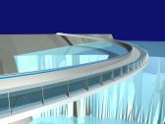
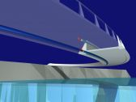

Slide 39
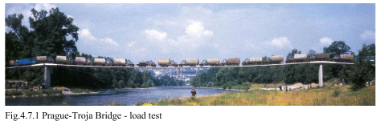
STATIC AND DYNAMIC LOADING TESTS
Measuring the deformations of the superstructure at the time of prestressing and during loading tests. Dynamic tests were also performed on these structures.

Slide 40
The pedestrian bridge in Prague-Troja was tested by 38 vehicles weighing between 2.8 and 8.4 Tons.
First, the vehicles were placed along the entire length of the structure, and then they were placed on each span.
During the test only the deformations in the middle of the spans and the horizontal displacements of all supports were measured.
Prague-Troja Bridge - deflections at mid-span

Slide 41
Precast, Post-tensioned
Concrete Stress Ribbon Bridge
1990
420-foot span
Erection Via Bearing Cables
PT Contractor: DSI

Slide 42
Preliminary Design of Prestressed Concrete Stress Ribbon Bridge
The structural response of this kind of structure is complex because of the combined effects of geometric nonlinearity, prestressing, and time-dependent materials behavior, and it has not been fully presented yet.
The structural behavior of prestressed concrete stress ribbon bridges is presented emphasizing the geometrical nonlinear character of the equations and the effects of creep and shrinkage of concrete.

Slide 43
A preliminary design of an 80-m built-in stress ribbon bridge is finally worked out based on the presented formulation.

Slide 44
THANK YOU!

