Slide 1

A SEMINAR ON
SELF COMPACTING FIBER REINFORCED CONCRETE
MOHAK N NAGRANI
SD0810
CEPT

Slide 2
CONTENTS
Introduction
Types Of Fibers
Production Of SCFRC
Fresh Concrete Tests
Concrete Mixing And Casting Of Beams
Influence Of Concrete Type And Coarse Aggregate Characteristics On Shear
Influence Of Shear Span To Depth Ratio On Shear
Influence Of Beam Size On Shear
Advantages
Conclusions
References

Slide 3
Self Compacting Fiber Reinforced Concrete (SCFRC) is the one where fibres are added to the self compacting concrete, which is able to flow under its own weight, and completely fill the formwork and encapsulate the reinforcement, while maintaining homogeneity and can consolidate without the need for vibration compaction.
Self-compacting concrete is a new generation high performance concrete known for its excellent deformability and high resistance to segregation and bleeding.
SCFRC is an engineered material consisting of cement, aggregates, water and admixtures with or without several new constituents like colloidal silica, pozzolanic materials, Portland -flyash (PFA), ground granulated blast furnace slag (GGBS), microsilica, metakaolin and chemical admixtures.

Slide 4
By the inclusion of uniformly distributed, randomly oriented, short discrete fibres in concrete shear resistance is improved owing to an increase in tensile strength, which delays the formation and growth of cracks.
Also when smaller distance exists between fibres compared with that between stirrups, greater effectiveness in the crack-arresting mechanism and better distribution of tensile cracks is enabled.
Fibers also have the ability to bridge shear cracks, improving the post-cracking behavior. Therefore, the addition of fibers in adequate quantities may be effective at supplementing or even replacing the conventional shear reinforcement such as stirrups in concrete members.

Slide 5
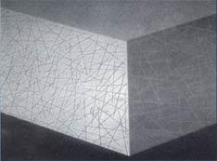
TYPES OF FIBRES
Steel Fibres
Plastic or Polymeric Fibres
Glass Fibres
Carbon Fibres
Natural Fibres
Hybrid Fibers

Slide 6
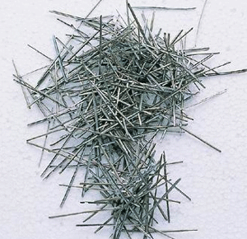
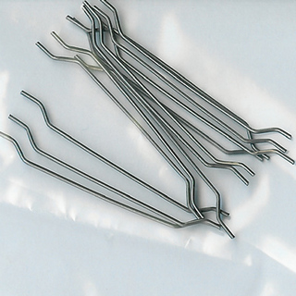
1. Steel Fibres
Obtained by cutting drawn wires, and fibres with different types of indentations, and shapes to increase mechanical bond.
Efficiency of the fibre distribution depends on the geometry of the fibre, the fibre content, the mixing and compaction techniques, the size and shape of the aggregates and the mix proportions.
Used for overlays and overslabbing for roads, pavements, airfields, bridge decks, and industrial and other flooring, particularly those subjected to wear and tear, and chemical attack.

Slide 7
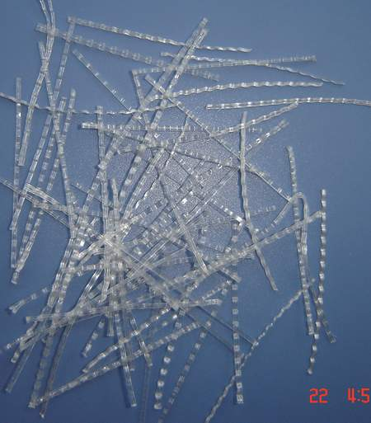
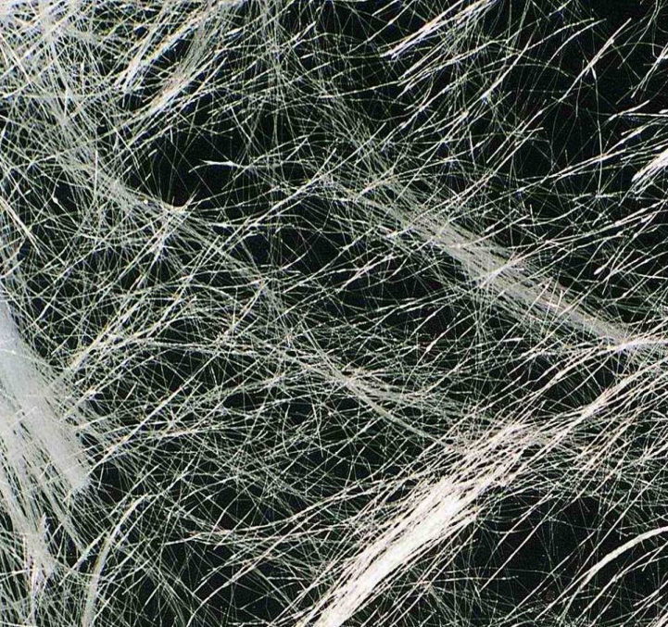
2. Plastic fibres
Plastic fibres such as nylon and polypropylene have high tensile strength, 561 – 867 N/mm², but their low modulus prevent any reinforcing effect.
Polypropylene is a polymer which softens when heated, does not possess a high temperature resistance.
Has the advantage of chemical stability in the cement paste and is not attacked by acids and alkalis.
Extensive use of polypropylene fibres is in concrete piles.

Slide 8
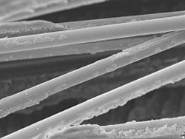
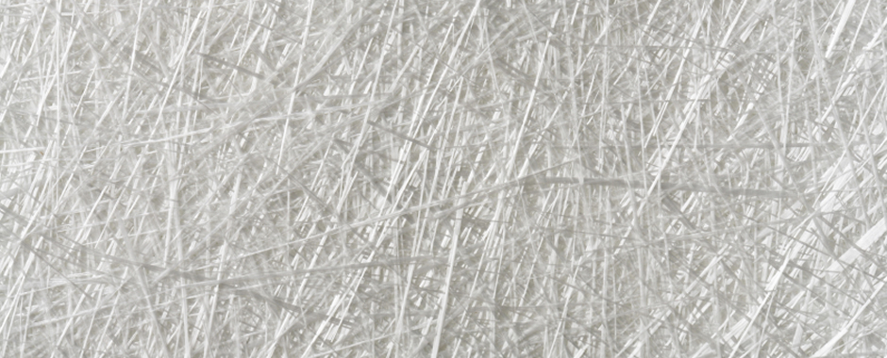
3. Glass Fibres
Vary from 10 to 20 micron, and are coated with sizing to protect the fibre from surface abrasion as well as to bind them into a strand.
Two main problems in the use of glass fibres in Portland cement products :
the breakage of fibres
surface degradation of the glass by the high alkalinity of the hydrated cement paste.

Slide 9
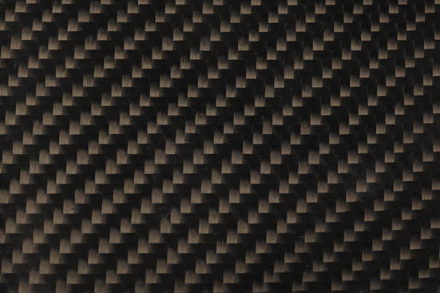
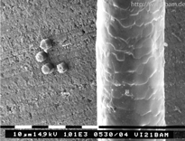
4. Carbon fibres
Posses high tensile strength and young’s modulus
Also has a high specific strength compared to steel and glass fibres.
Have linear stress-strain characteristics, and appears to possess adequate fatigue resistance and acceptable creep.

Slide 10
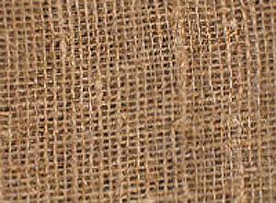
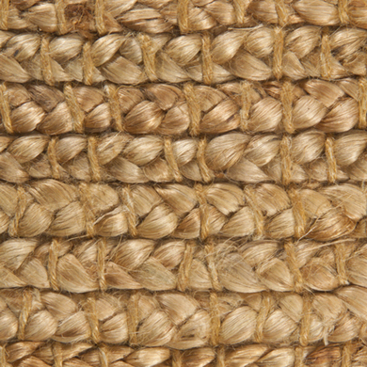
5. Natural fibres
Produced almost in all countries.
Relative cheapness of natural fibres points the direction of their development in large scale as a building material in conjunction with cement concrete for housing.
Used as reinforcing medium not only in cement matrices but also in soil cement construction, provides a wide flexibility.
This makes natural fibres a very attractive material for improving and reducing the cost of cement concrete.

Slide 11
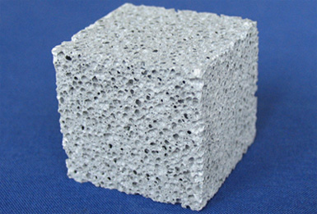
6. Hybrid fibers
Combining of various types of fibers in a mix results in the formation of hybrid fiber composites.
Addition of two fibers of different properties can improve the strain capacity of fresh concrete and prevents early cracking and makes concrete tougher.
Can produce a composite with better engineering properties than what can be achieved using only one type of fiber.
This includes combining fibers with
different shapes, dimensions, tensile
strength, Young’s modulus, ductility, and
bond properties to cementitious matrixes.

Slide 12
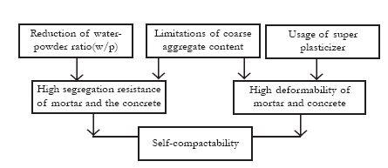
PRODUCTION OF SCFRC :

Slide 13
Materials Used
Powder : Portland cement
Fly ash
Undensified microsilica
Fine aggregate (FA) : River sand (passing 4.75 mm sieves with specific gravity 2.62and fine modulus 2.48)
Coarse aggregate (CA): Crushed stone aggregate (16 mm)
High –range water reducing admixture (HRWR) : Polycarboxylic – acid
Viscosity modifying admixture (VMA) : 1.0 to 4.0 litre / m³ of cementitious material
High Performance water reducing admixture for microsilica concrete (HPWR) : SP500
Air entraining admixture : Conplast AEA

Slide 14
TYPES OF TEST :
Slump Test
V-Funnel Test
L-Box Test
Flexure Test

Slide 15
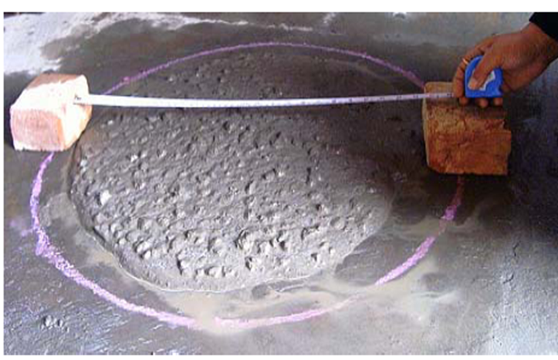
1. Slump Test
Slump flow test is conducted to determine the flowability of concrete mixture.
To measure the slump flow, an ordinary slump test cone was filled with SCC without compaction and leveled.
The cone was lifted and the average diameter of the resulting concrete spread was measured.
For SCC, the average diameter of the spread should be approximately 550 to 650mm.

Slide 16
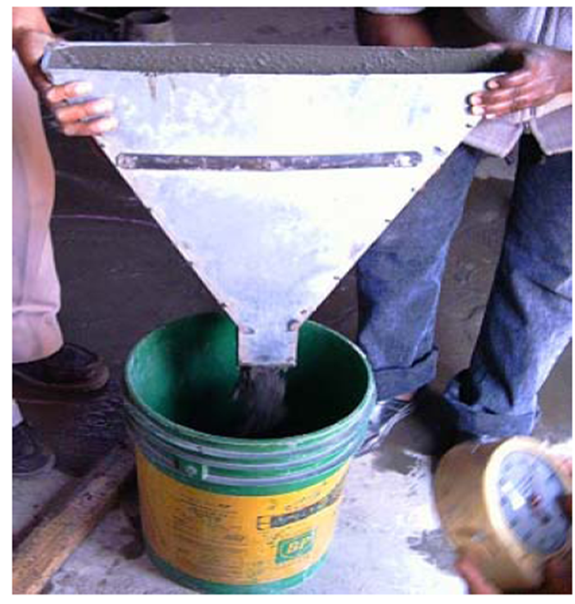
2. V – Funnel test
Wet the interior of the funnel with the
moist sponge or towel
Close the gate and place a bucket
under it in order to retain the concrete
to be passed
Fill the funnel completely with a
representative sample of SCC without
applying any compaction or rodding.
Remove any surplus of concrete from
the top of the funnel using the
straightedge
Open the gate after a waiting period of (10 ± 2) seconds.
Start the stopwatch at the same moment the gate opens and stop the time at the moment when clear space is visible through the opening of the funnel.

Slide 17
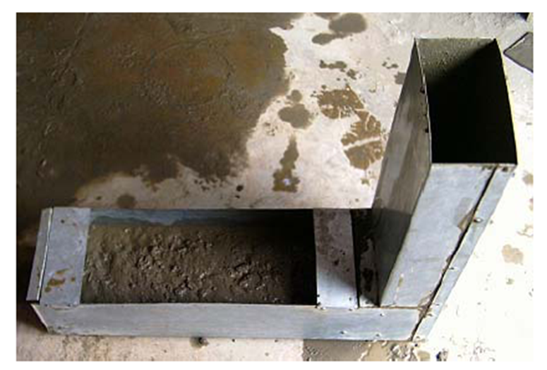
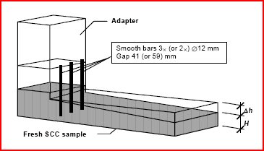
3. L-box test :
In this test the vertical portion of the L-Box was filled with concrete and leveled.
The gate between the two sections of the L-Box was lifted and the concrete flowed between three 12 mm diameter steel reinforcing bar spaced at 50mm c/c.
The height of concrete at the end of the horizontal and vertical legs of the L-Box was measured and recorded as H1 and H2, respectively.
The ratio between these two heights (H2/H1), which is usually 0.7 to 0.9 for SCC with fibers
It was used to evaluate the ability of the SCC mixtures to flow around obstructions.

Slide 18
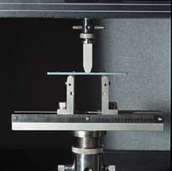
4. Flexure Test :
In this test the specimen lies on a support span and the load is applied to the center by the loading nose producing three point bending at a specified rate.
The parameters for this test are the support span, the speed of the loading, and the maximum deflection for the test.
These parameters are based on the test specimen thickness

Slide 19
Concrete Mixing and Casting Of Beam Specimen
Coarse and Fine aggregate are mixed first , then the flyash and part of the mixing water are added, followed by the cement and the rest of mixing water.
The VMA is premixed with mixing water
The HRWRA was subsequently added to the concrete. Finally , the fibers are added by hand to prevent any fiber balling.
The SCFRC is placed without any mechanical vibration and thus is not difficult compared to non -fiber reinforced concrete.
After casting the beam specimens should be covered with moist burlap and polyethylene plastic to prevent moisture loss
The form work is removed after 48 hours

Slide 20
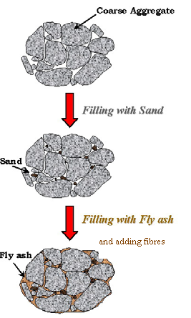

Slide 21
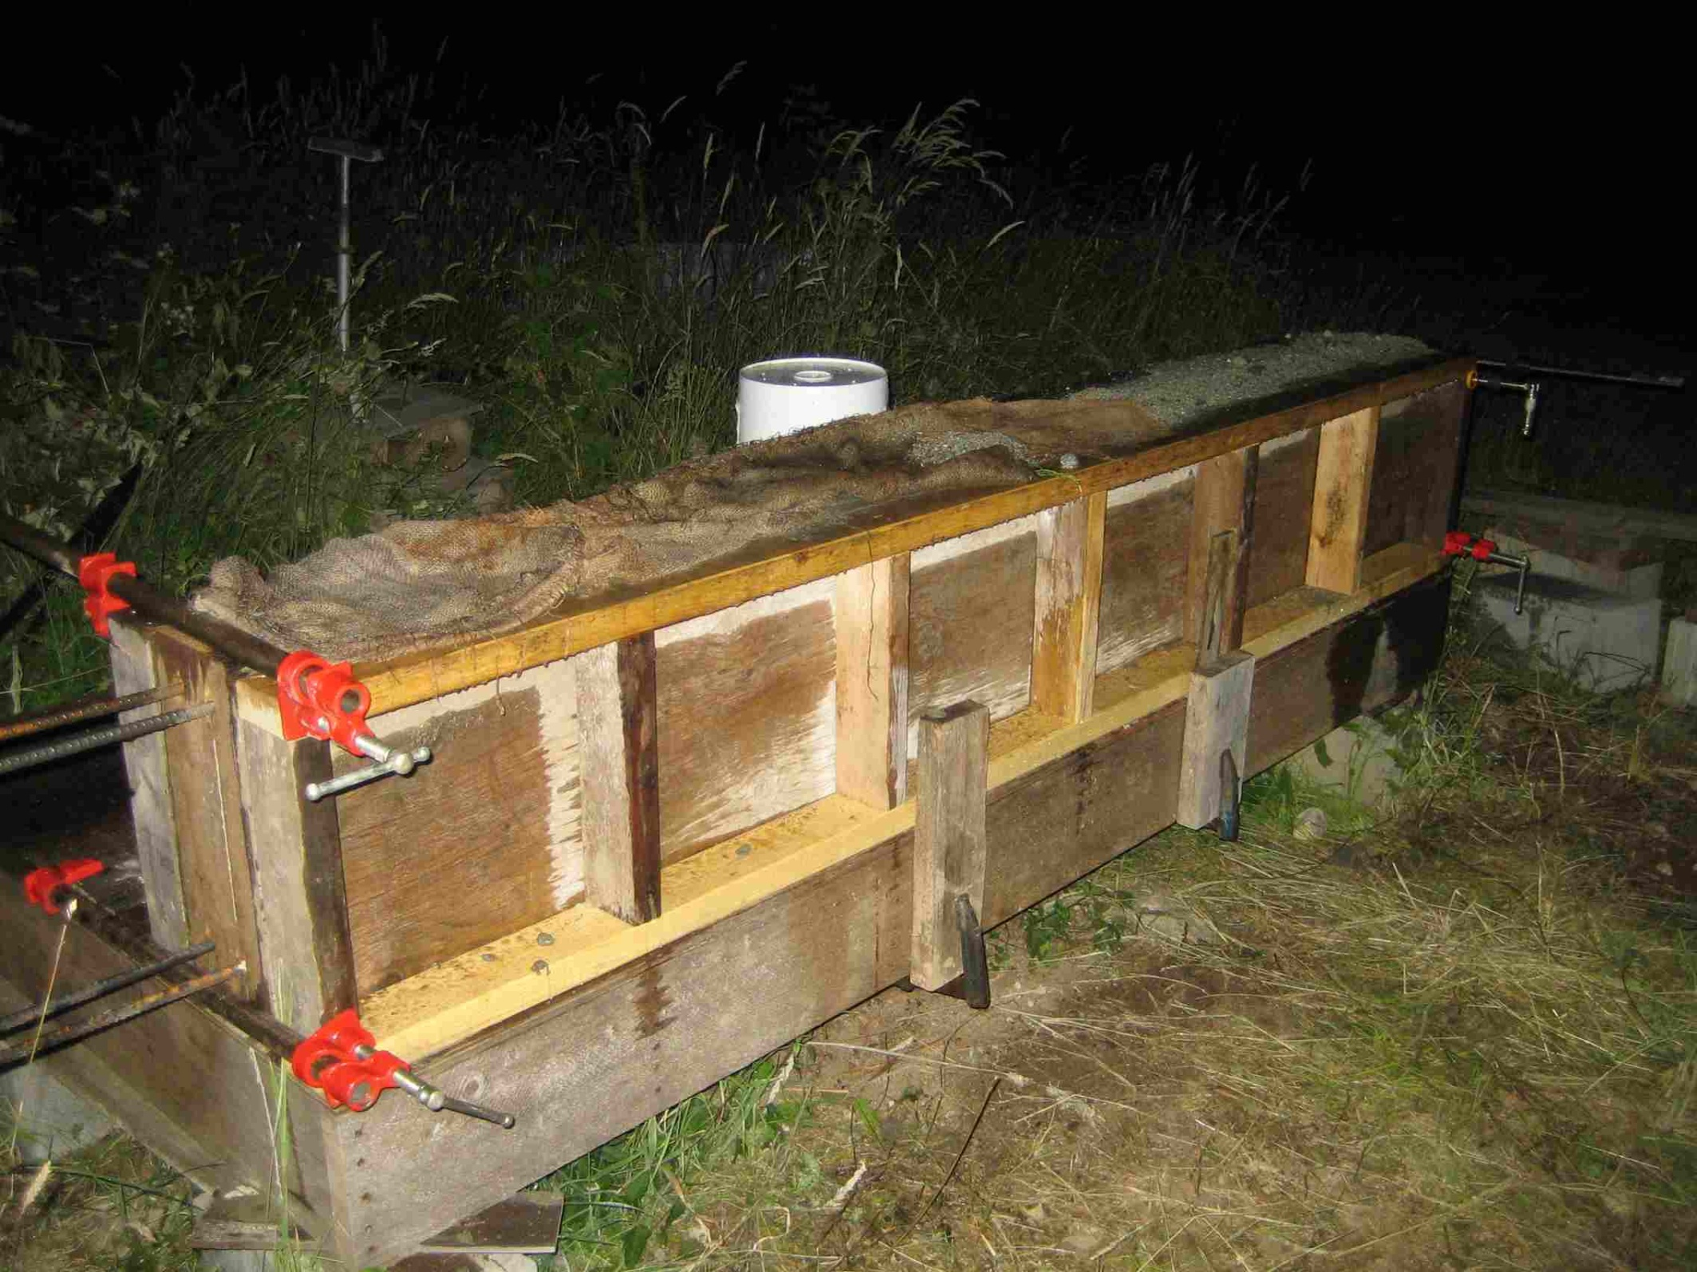

Slide 22
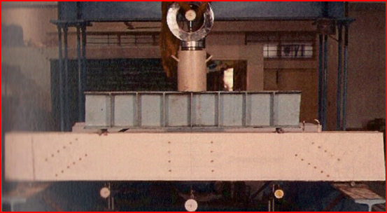
EXPERIMENTAL SETUP

Slide 23
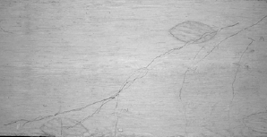
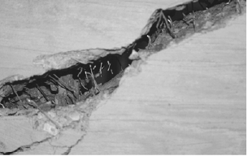
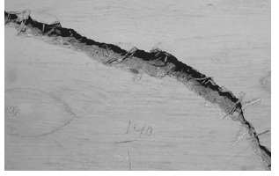
CRACKING PATTERN
Initial crack pattern

Slide 24
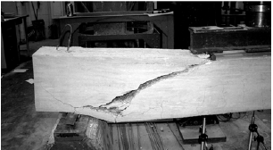
FAILURE OF SCFRC BEAM IN SHEAR

Slide 25
INFLUENCE OF CONCRETE TYPE AND COARSE AGGREGATES CHARACTERISTICS ON SHEAR
The performance of beams is analyzed based on normalized shear at the first flexure crack , the first shear crack, and influence of type of concrete and parameters related to coarse aggregate .
General trend shows an increase in the ultimate shear with maximum size of coarse aggregate from 12 mm to 19mm.
The ultimate shear resistances of SCFRC beams are comparable to those of NC beams made with same size of Coarse aggregate, though SCFRC have lower coarse aggregate content than NC and had similar compressive strength.
Increase of aggregate size seemed to decrease the shear load at first shear crack for SCFRC beams.

Slide 26
INFLUENCE OF CLEAR SPAN TO DEPTH RATIO ON SHEAR
Shear resistance of beams decreases with the increase of clear span to depth ratio
For a/d > 6, failure usually occurs in bending;
For 6 > a/d >2.5. the development of a flexural crack into an inclined flexure-shear crack results in diagonal tension failure,
For 2.5 > a/d > 1, a diagonal crack forms independently but the beam remains stable until shear-compression failure occurs;
In addition to the shear-span to depth ratio. the contribution of the concrete to the shear strength, Vc, is dependent on a number of other factors including the concrete strength (fi) the main tension reinforcement ratio (p) and the beam size (b*d).

Slide 27
The shear strength of reinforced concrete beams may be substantially increased by the provision of suitable shear reinforcement, usually in the form of stirrups or links, which serve to intercept the diagonal shear crack.
Thus, the external shear force, V, is resisted partly by the concrete, Vc, and partly by the shear reinforcement, V. such that
V=Vc +Vs

Slide 28
INFLUENCE OF BEAM SIZE ON SHEAR
It has been shown by Kani (1967) and Taylor(1972) that larger beams are proportionally weaker in shear than smaller beams.
That is , the ultimate shear stress reduces with beam depth .
It is believed that this is because the aggregate interlock contribution to shear strength Vc, does not increase in the same proportion as the beam size,.

Slide 29
SCFRC NC

Slide 30
WEB REINFORCEMENT CONTRIBUTION TO SHEAR STRENGTH
Stirrups provide a contribution to shear strength if crossed by a diagonal crack.
Therefore , the contribution of steel shear reinforcement can be estimated on the basis of the cracking pattern , depending on the number of stirrups intercepted by the primary shear crack.
It is known that the opening of the critical shear crack is not same along its length. In particular , the opening of the shear crack has the maximum value at the initiation of the critical crack, where the stirrups yield , and a low value at the end of the crack near the compressed zone, where the stirrups could not reach the yield stress.

Slide 31
SHEAR TRANSFER ACTION AND MECHANISMS
Shear transfer actions and mechanisms in concrete beams are complex and difficult to clearly identify. Complex stress redistributions occur after cracking , and those redistributions is influenced by many factors.
The important shear transfer actions for beams with shear reinforcement are:
Shear resistance in the uncracked concrete zone
Interface shear transfer
Dowel action
Residual Tensile Stresses
Shear reinforcement

Slide 32
ADVANTAGES OF SCFRC :
High-flowability
Higher compressive strength
High workability
Enhanced resistances to chemical or mechanical stresses
Lower permeability
Durability
Resistance against segregation

Slide 33
CONCLUSIONS
  General trend show that an increase in the size of coarse aggregate from 12 mm to 19mm in SCC decreases the shear capacity of concrete . The use of large coarse aggregate is found to be more beneficial for beams with low shear span to depth ratio.
  A reduction in the shear span –depth ratio increases both the diagonal cracking and ultimate shear strengths of the reinforced fiber concrete beams
  The shear strength of reinforced concrete beams may be substantially increased by the provision of suitable shear reinforcement

Slide 34
REFERENCES
Shear Strengthening of RC Beams by G C Mays and R A Barnes
Shear behaviour of Steel fiber reinforced concrete beams ( Materials and Structures April 2005)
Arabian Journal of Science and Engineering (Vol 34 April 2009)
Self-compacting fiber-reinforced concrete- a paper from S. Grunewald, J.C. Walraven, Delft University of Technology
Mechanical characteristics of fiber reinforced self compacting mortars – Asian journal of civil engineering.
http://google.co.in
http://google.co.in/images

Slide 35


