Slide 1
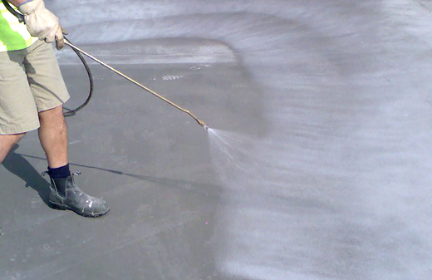
Self curing concrete
Prepared by:
HARSH SONI
SD 1910

Slide 2
What is curing of concrete?
Curing is the maintenance of a satisfactory moisture content and temperature in concrete for a period of time immediately following placing and finishing so that the desired properties may develop.
Curing has a strong influence on the properties of hardened concrete ; proper curing will increase, durability, strength, watertightness, abrasion resistance, volume stability, and resistance to freezing and thawing etc.

Slide 3
Hydration of cement:
2C₃S + 6H --------> C₃S₂H₃ + 3 Ca(OH)₂
100 + 24---------> 75 + 49
2C₂S + 4H --------> C₃S₂H₃ + Ca(OH)₂
100 + 21 ---------> 99 + 22
C3S requires 24% and c2s requires 21% of water by weight of cement. It has been estimated that avg. 23% is required for complete chemical reaction.
It has been also estimated that about 15% water by wt. Of cement is requires to fill up the gel pores.
So total 38% of water is requires by wt. Of cement for complete hydration process.

Slide 4
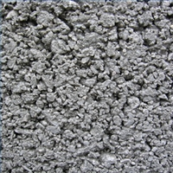
In all this it is assumed that hydration is taking place in sealed container, where moisture evaporation does not take place.
Excess or lack of water
may cause undesirable
Capillary cavities.

Slide 5
DEFINATION OF CURING;
(as per ACI-308R)
The term "curing" is frequently used to describe the process by which hydraulic-cement concrete matures and develops hardened properties over time as a result of the continued hydration of the cement in the presence of sufficient water and heat.
(as per IS:456-2000 )
“ curing is the process of preventing the loss of moisture from the concrete.”

Slide 6
Types Of Curing
Water curing:
immersion
Ponding
Spraying
Wet covering
b) Steam curing
c) Self curing/ membrane curing
miscellaneous:
like, curing by infra red radiation, electrical curing etc.

Slide 7
What is self curing concrete?
It has been pointed out earlier that curing does not means application of water ,it means also creation of condition for promotion of Uninterrupted and Progressive hydration.
It is also pointed out that the quantity of water, normally mixed for making concrete is sufficient to hydrate the cement content.

Slide 8
(…cntd. )
Concrete in which the mixing water is restricted by means of some chemical compounds, to go out from the concrete body is known as “self curing concrete.”

Slide 9


Why self curing concrete?
Some times works are carried out in place where there is acute shortage of water and the application of water curing is not possible for reasons of economy.
prevention of moisture loss from the surface of flat concrete works such as highways and airports have been challenging task for construction managers.

Slide 10
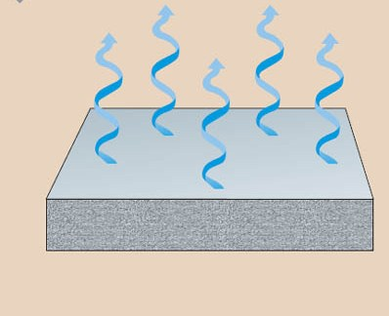
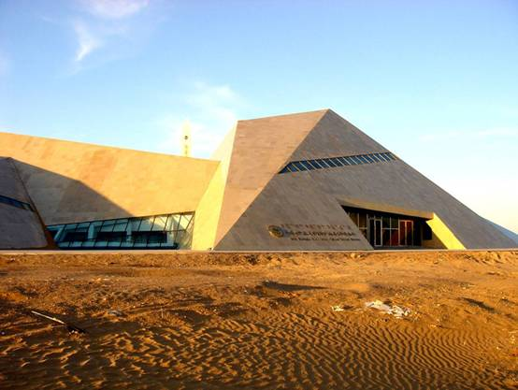
(…cntd)
If the evaporation of moisture from concrete are not prevented properly it may results in plastic shrinkage cracks, poorly formed hydrated products, finishing problems and other surface defects.
Sometimes concrete is placed in some inaccessible , difficult or far places. Where curing cannot be properly done or supervised.

Slide 11
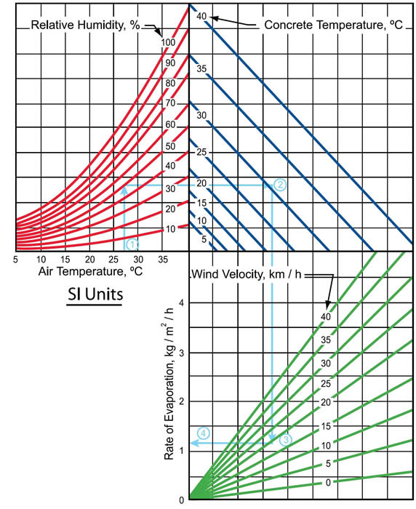
How to find out the rate of evaporation?
Drying behavior of concrete depends upon air temperature, relative humidity , concrete temperature and wind condition.
Figure shows drying behavior as per learch’s investigation.
(Based on ACI:305 R-5)

Slide 12
How the self curing is being done?
Membrane forming curing compounds are used to retard the loss of water from concrete during the early age.
They are used not only for curing fresh concrete but also further curing after removal of formwork.
Application of these compounds seals the concrete surface effectively by forming monomolecular film on the surface.
Membrane forming curing compounds is a long chain of hydrocarbon molecules.
Which forms monomolecular film on the surface of the concrete immediately after placing.

Slide 13
MECHANISM:
The compound molecules is primarily hydrophobic in nature with hydrophilic terminal group.
Hydrophilic terminal group attaches it self to the film of bleeding water.
While the long Hydrophobic chain maintains a vertical orientation away from the bleeding water.
Water molecules do not possess sufficient energy to escape through the hydrophobic layer.
Which results into quick reduction in the evaporation loss.
H H H
| | |
H-C-H H-C-H H-C-H
| | |
H-C-H H-C-H H-C-H
| | |
H-C-H H-C-H H-C-H
| | |
H-C-H H-C-H H-C-H
| | |
O O O
| | |
H H H
CURING COMPOUND
WATER
CONC.

Slide 14
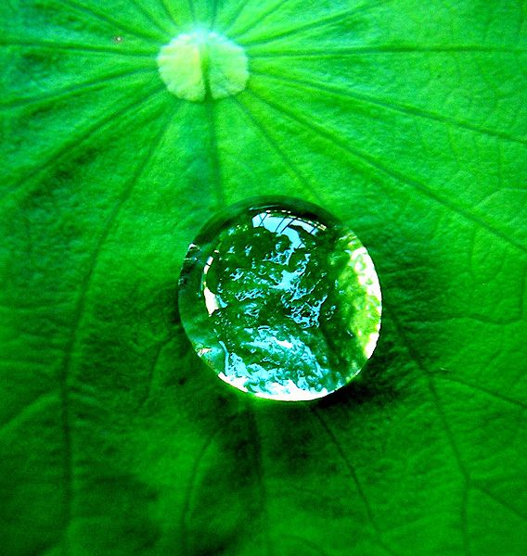
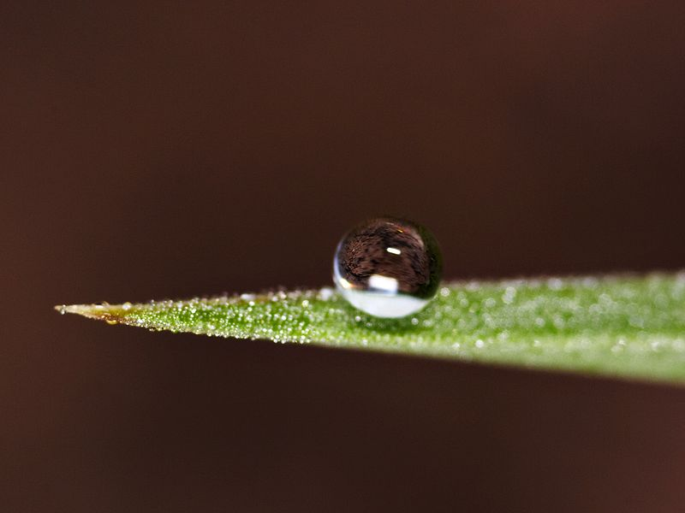
The hydrophobic effect represents the tendency of water to exclude non-polar molecules. The effect originates from the disruption of highly dynamic hydrogen bonds between molecules of liquid.
A hydrophilic molecule or portion of a molecule is one that has a tendency to interact with or be dissolved by water.
A pure hydrocarbon molecule, is incapable of forming hydrogen bonds with water.
The hydrogen bonds are partially reconstructed by building a water "cage" around the compound molecule.
The water molecules that form the "cage“ have substantially restricted mobilities.

Slide 15
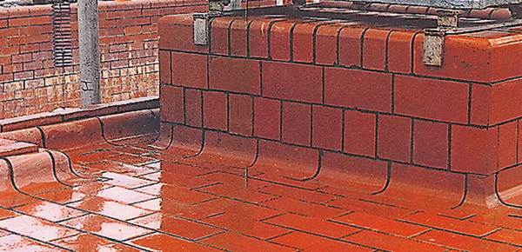
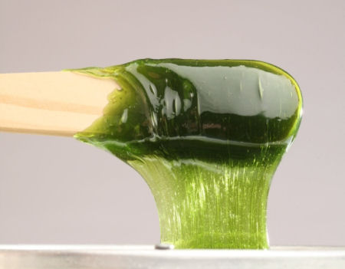
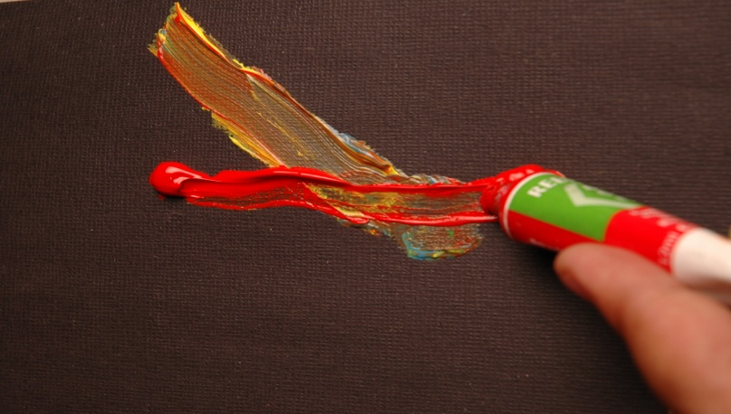
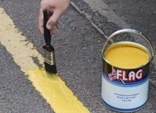
TYPES OF COMPOUNDS:
a) Synthetic resin
b) Wax
c) Acrylic
d) chlorinated rubber

Slide 16
TYPE OF COMPOUND | DESCRIPTION
resin and wax based curing compound | They seals the concrete effectively. with the time their efficiency will get reduced. if plastering is required to be done the surface can be washed off with hot water. it gives an average efficiency of about 80%.

Slide 17
TYPE OF COMPOUND | DESCRIPTION
Acrylic based membrane forming curing compound | They seals the concrete effectively. additional advantage of having better adhesion of subsequent plaster. It does not need to be washed with hot water. better bonding for plaster.
Chlorinated rubber type compound | it does not only protect concrete from drying out but also fill the minute pores in the surface of concrete. the surface film will wear out eventually.

Slide 18
APPLICATION PROCEDURE
It is applied by brushing or by spraying while the concrete is wet.
In the case of beam and column the application is done after removal of formwork
In case of road and pavements the curing compound is applied after texturing.
in case the concrete surface has dried, the surface should be sprayed with water and thoroughly wetted and made fully damp before curing compound is applied.
the container of curing compound should be well stirred before use.

Slide 19
Liquid membrane forming compound:
Following types of compounds are included in it;
clear or translucent without dye
clear translucent with fugitive dye
White pigmented
• The main performance specification for curing compounds:
ASTM C-309 Liquid Membrane – Forming Compounds for Curing Concrete. The curing compound shall not allow the concrete specimen to lose more than 0.55kg /m² of water in 72 hours

Slide 20
White-pigmented concrete curing compounds
White-pigmented concrete curing compounds are wax-based dispersions with selected white pigments.
When properly applied, which optimizes water retention. The white pigment reflects the sun's rays and helps to keep the concrete surface cooler and prevent excessive heat buildup.
It is ideal for application on exterior, horizontal surfaces, such as highways, airports pavements.

Slide 21
Advantages
When properly applied, provides a premium-grade film, which optimizes water retention.
Protects by reflecting the sun's rays to keep the concrete surface cooler and prevent excessive heat buildup, which can cause thermal cracking.
Furnished as a ready-to-use, true water-based compound. Produces hard, dense concrete ... minimizes hair checking, thermal cracking, dusting and other defects.
Offers a compressive strength significantly greater than improperly or uncured concrete.
Improves resistance to the abrasion and corrosive actions of salts and chemicals ... minimizes shrinkage.

Slide 22
Application method
Spray on in one even coat with a hand or power sprayer as soon as the surface water disappears from concrete surface.
Precautions
Keep from freezing. Do not apply when the temperature of the air and/or the concrete is less than 40º F (4º C).
Do not mix or dilute with any other products or liquids.
Do not use on surfaces that are later to be painted, tiled, hardened, sealed or treated in any manner. Not recommended for use on residential applications.
It is applied in two coats. If needed more coat may be applied.

Slide 23
Resin-Based, Water-Based Concrete Curing Compound:
Uses
Used on both interior and exterior applications where paint, resilient tile or resilient flooring may be applied later.
Because of the wide variety of coatings, paints, adhesives, and toppings available, contact the manufacturer of the flooring system for application approval over resin-based curing compounds.
A small test application is always recommended.
Technical data
Drying time: typically dries in 1-2 hours, depending on jobsite conditions (temperature, wind, etc.)
Restrict foot traffic for at least four hours; 12 hours is preferable.

Slide 24
General Tips For Application Of Liquid- Membrane Curing Compounds:
Always apply the curing compound uniformly at the specified application rate (typically 200 ft²/gallon, 4.9 m²/L).
A major problem on most jobsites is the spraying of the curing compounds at extremely high application rates, i.e., The material is applied at 300-400 ft²/gallon, rather that 200 ft²/gallon. As a result, the quality of the concrete goes down dramatically!
A good rule of thumb on flatwork is to apply the curing compound heavy enough to create a slight flood of material on the concrete surface or, as another option, apply the curing compound in two applications, one at right angles to the other.

Slide 25
Conclusion
In short, discussed all above curing compounds are effective tool to avoid the occurrence of plastic shrinkage cracks in a windy, low humid and exposed to sun condition.
Contractor can benefit by able to expedite the work schedule and placing more concrete while client benefits by obtaining concrete free of plastic shrinkage crack and having greater durability value.

Slide 26
REFERANCES:
ACI 308 R
Text book of concrete technology by M.S.shetty
article on evaporation reducer for pavement concrete, NBM & CW, april 2007
www.wikipedia.com
www.google.com
Web site of W. R. MEADOWS, 2002

Slide 27
Thank you

