Slide 1
TRENCHLESS TECHNOLOGY
Prepared By: DIMPI MISTRI
SD0710

Slide 2
CONTENTS
Introduction
Application
Advantages
Limitation
Trenchless technology method
Investigations
Prospect of adopting trenchless technology in India
Case study of San Diego Regional Airport Authority Fiber-Reinforced CIPP (Cured in Place Pipe) Project

Slide 3
Introduction to topic
Digging of open trenches is a common practice for laying of almost all underground utility services.
Cities with growing population have road congestion, vehicular traffic jams, pollution problem etc.
If streets are excavated for laying pipes and cables the situation will more difficult.
If it happens in rainy season it involves dewatering.
To overcome this problem Trenchless Technology is the best solution.

Slide 4
Definition
Trenchless technology can be defined as an innovative process of installing utilities, rehabilitating and reconstructing the existing underground utilities without digging the ground or minimum digging.
It also means no demolition of buildings, dislocation of traffic, or disruption of existing sub surface cable or pipe network.

Slide 5
Application
Gas pipeline
Oil pipeline
Water pipeline
Sewer pipeline
Electric power lines and cables
Data communication cables
Telecommunication cables

Slide 6
Advantages of trenchless
No Digging -
  The only digging involve for the access shaft located some 200M spacing.
  Even this shaft can be covered up with steel plates over which the traffic can flow during busy day time. During lean time traffic period the shafts can be open up & the work can carry out.
  Therefore the disturbance to traffic is minimum or negligible.
2) Trenching below the structure -
  It can be used to lay the services below the valuable property and existing structure like building and shades.
3) Across the River or Lake -
  It is very use full for laying the service line of gas line below the river or lake.

Slide 7
Cont.
4) Time required -
  Trenchless excavation is much faster than a conventional excavation which may also necessity extra time for shoring, strutting, dewatering, backfilling etc. All of these can be avoided in Trenchless excavation.
  Trenchless technology required about 1 to 3 days where traditional digging required about 1 to 4 weeks.
5) Site space requirement -
  At crossing trenchless technique requires 30 m² to 80 m² area whereas traditional excavation requires @ 300 m²

Slide 8
Limitation
If the underground strata consist of both soil and hard material like rock or boulders different type of machine will be required which may inconvenient and uneconomical.
Ground obstacle like existing services, old pipe lines etc. May create a problem
Precise control of gradient and alignment are sometime difficult to achieve, and large tolerance should be acceptable with certain machine and in certain ground condition.

Slide 9
cont.
4) Equipment for trenchless technology are presently not manufactured in India, additional time has to allowed while planning the work.
5) The machine operator should have extensive experience in this work.

Slide 10
TRENCHLESS TECHNOLOGY METHODS
Trenchless technology methods system have been categorized in to two groups
1) New installation
  Micro tunneling
  Horizontal directional drilling
  Short drive system
  Guided drilling
2) Rehabilitation and Renovation
  Pipe bursting
  Pipe eating
  Slip lining
  Lining Formed in Place
  Spray-On Lining
  Localized Repair
  Chemical Stabilization

Slide 11
MICRO TUNNELING
Suitable for pipe dia. less than 1000mm and sewerage work where surface disruption should be minimum.
The only excavation required from the service is for drive and receptions shafts. Soil may be removed from the face by an auger running through the newly installed pipeline.
water or bentonite may be used to convert the soil into slurry at the cutting face. The slurry then pumped to the surface

Slide 12
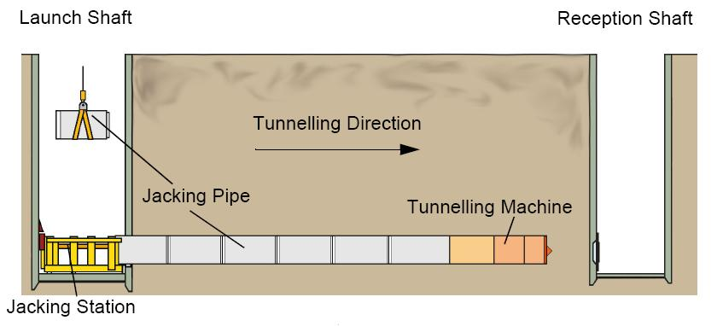

Slide 13
HORIZONTAL DIRECTIONAL DRILLING
Horizontal drilling systems are widely used for installing pressure pipes under major obstacles such a large rivers and airports runways.
A small rotating and steerable drill bit is launched from the surface at an angle 10-15 and is used to drill 90mm mud filled diameter hole

Slide 14
Cont.
During the drilling operation a 125mm diameter washer pipe is drilled over the pilot string and following some 100mm behind the head. Alternate drilling then continues on the pilot string is removed and the bore is enlarged by a rotating barrel reamer attached to and pulled back by the washer, drilling mud being used to llushed away the cuttings and to support the reamed hole. Subsequent caming continues until required diameter is achieved.
The product pipe is then attached to the reaming head and pulled through the bore drives of more than 1.5km and of up to 1200mm diameter have been carried out.

Slide 15
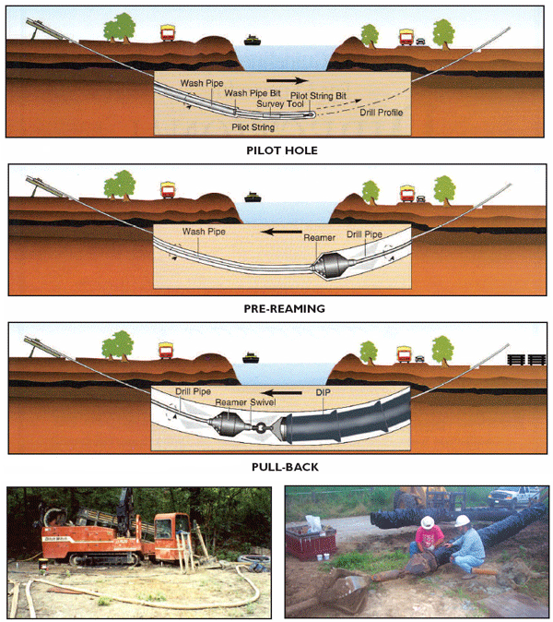

Slide 16
Investigations
Geophysical survey
Boring and sampling
Measurement of ground water table
Test pits and trenches
Penetration tests
Special analysis of surface wages
Examination and investigation of existing structure
Laboratory testing

Slide 17
Prospect of adopting trenchless technology in India
India offers a huge market for adoption of trenchless technology.
Leading equipment manufacturers world wide are eager to enter in India
Our metro pollution cities viz. Delhi, Mumbai, Chennai, and Bangalore are congested and have out grown their master plan, limits.
This was caused immediate need for rehabilitation, renovation of existing old water supply and sewage pipeline and also new installation.

Slide 18
Cont.
the number of project using trenchless technology are:
MTNL (telephone dept.) New Delhi was awarded works of laying of cable for 185 km by using trenchless method
Similar telephone cable laying works is being done in the city of Calcutta, Hyderabad and Mumbai.
Rehabilitation work is also progressing in the city of Mumbai for sewage pipe line.

Slide 19
Agencies..
The trenchless technology industry is represented by several industry associations in addition to standing committees within almost every water and sewer related industry association.
The North American Society for Trenchless Technology (NASTT) was established in 1990.
The Indian Society for Trenchless Technology or IndSTT is the apex organization to promote Trenchless Technology in India. It was established in 1995 with its head office at New Delhi.
The International Society for Trenchless Technology, established in 1986, has 25 active national trenchless technology societies associated with it.
National building Construction corp. (NBCC) is now actively engaged in the promotion of trenchless (NO-DIG) technology.

Slide 20
Role of INDSTT (Indian society of trenchless technology)
Established in 1995
Activities of INDSTT:
  To build awareness programme
  Publication of quarterly journal –No dig India
  Organize interactive seminars in major cities & regions
  Membership drive
  Back up information to and from the various users, manufacturers and contractors

Slide 21
In Gujarat
The number of project using trenchless
technology in Gujarat
road junction at narol chowk
Kaveri river crossing (rocky strata) with water
Kosamba ukai unlined canal
Rupen river crossing
Road crossing near khirai village

Slide 22
CASE STUDY
San Diego Regional Airport Authority Fiber-Reinforced CIPP (Cured in Place Pipe) Project

Slide 23
Case Study
Airport with the construction of a new 10-gate terminal, engineers for the San Diego County Regional Airport Authority identified nearly 1,700 ft of a 96-in. sanitary sewer trunk main that runs 25 ft directly below the site of the planned terminal.
20-year-old concrete pipe was not originally designed to handle the loading of an airport terminal or the aircraft that would be landing on the runways and apron adjacent to it
The challenge was to increase the load-bearing capacity of this critical pipe without digging it up while also maximizing the pipe’s flow capacity

Slide 24
Case Study
The authority considered three trenchless options for the project including slip lining, traditional cured-in-place pipe (CIPP) and composite-reinforced CIPP
The pipe rehabilitation thickness was specified not to exceed 1.26 in
This ruled out the use of slip lining technology as it would have reduced the pipe thickness by nearly 12 in
Traditional CIPP technology was also eliminated as an option on this project because it would require a minimum liner thickness of 2.07 in. at the designed load-bearing capacity
With the fiber-reinforced CIPP liner, it was possible to achieve the prescribed load-bearing capacity and reduce traditional CIPP thickness by approximately 40 percent to 1.26 in., thereby meeting the airport authority’s flow and strength criteria.

Slide 25
Case Study
Charles King Co., the general contractor for the project, brought in Insituform as the lining subcontractor.
Insituform pioneered the traditional CIPP felt and resin approach, and introduced its iPlus Composite CIPP process which was used in this project.

Slide 26
Case Study
Because there were no properly located manholes at the site, a single access point was constructed from which two CIPP installations in opposite directions were staged: one 300 ft in length and the other 1,393 ft in length
It took more than 5.8 full tankers – to impregnate the 1,700-ft-long fiber-reinforced CIPP tube.
More than 638,000 gal of water were required to cure the finished pipe
The Project was completed in 4 days

Slide 27
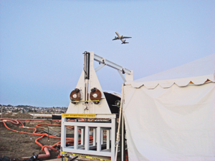

Slide 28
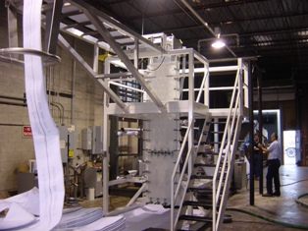
Step 1: The iPlus infusion tubes are "wet out" using a controlled resin impregnation system that fully saturates the tube with thermosetting resin.

Slide 29
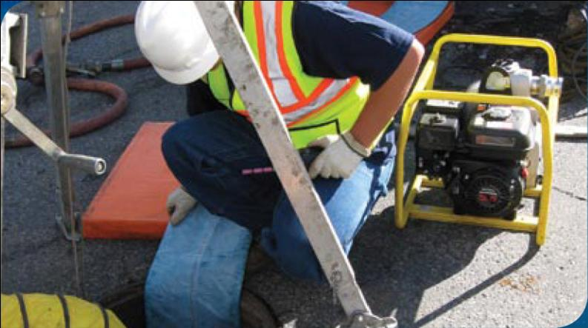
Step 2: The resin-saturated tube is pulled into a damaged pipe.

Slide 30
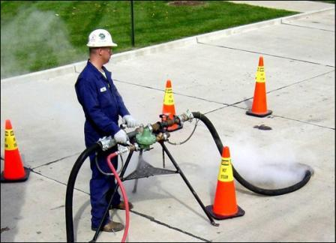
Step 3: Air is used to inflate the tube and steam is used to cure the resin and form a tight-fitting, joint less and corrosion-resistant replacement pipe.

Slide 31
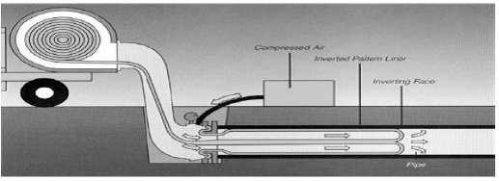

Slide 32
Reasons for lack for popularity
New technology- Engineers do not have knowledge.
Lack of awareness
No guidelines and codes available
Direct project cost is high
Essential to have in depth knowledge of sub surface condition

Slide 33
References
www.trenchlessonline.com
books.google.co.in
en.wikipedia.org
Civil engineer and construction review October 2000.

Slide 34
Thank you

