Slide 1
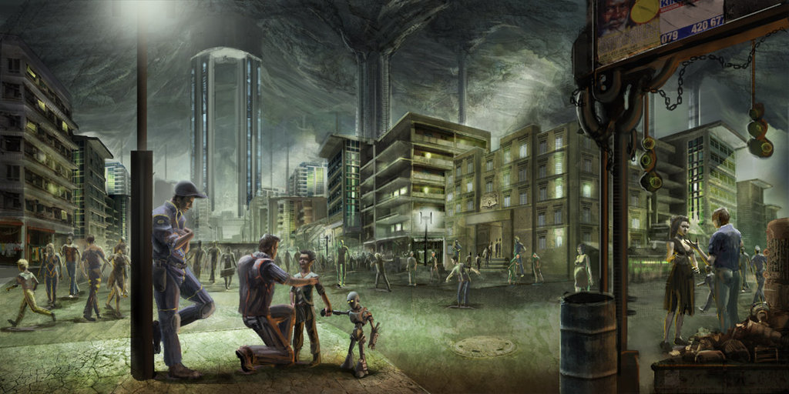
UNDERGROUND CONSTRUCTION
By Abhijitsinh A. Parmar
Code:- SD1010

Slide 2
Outline What goes Underground? Why go Underground? How is the Underground built? Where are problems encountered? When do risks get mitigated?

Slide 3
What Goes Underground?

Slide 4
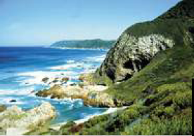
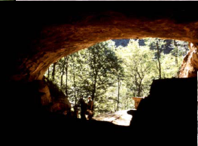
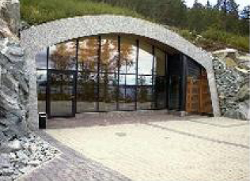
Shelters and Fully-Designed Homes..
Basic protection from enemies and elements..
Partially-modified for added protection and comfort..
Built to drawings and specifications..

Slide 5
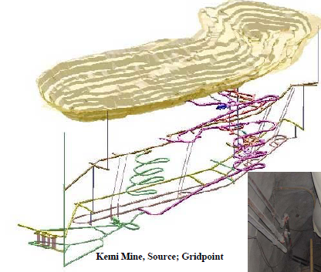
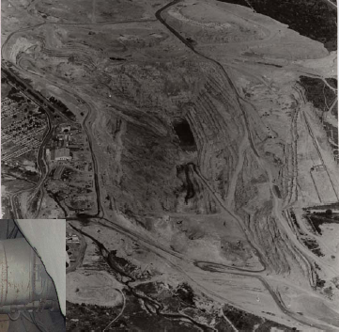
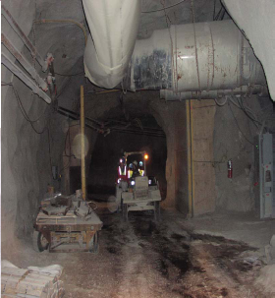
Mining Operations..
Open Pits transitioning to
Underground mines.. exploiting lodes to depth and reducing environmental footprints

Slide 6
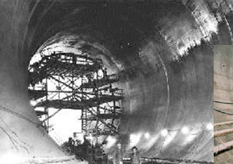
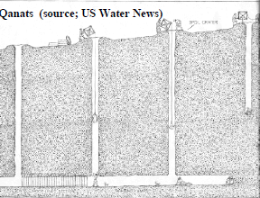
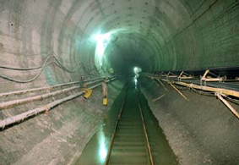
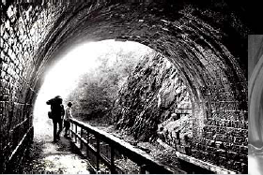
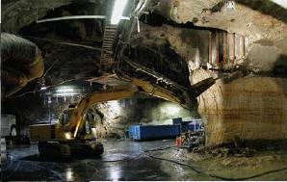
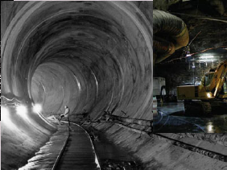
Water Systems..
Collection/Supply/Irrigation/Distribution
Underground Sewage Treatment Plant, Bondi
Canal

Slide 7
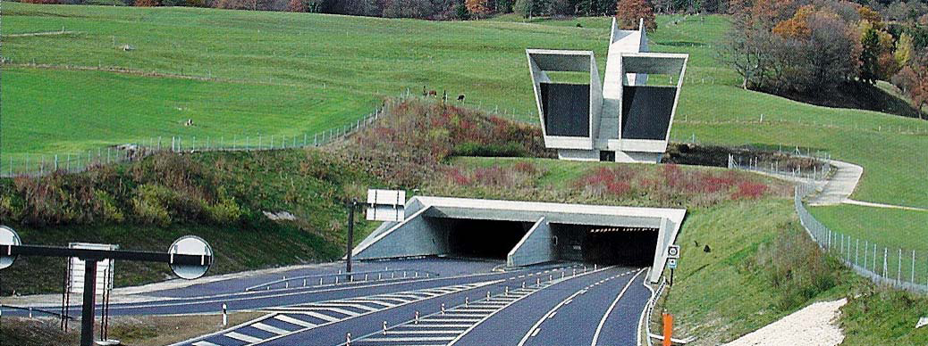
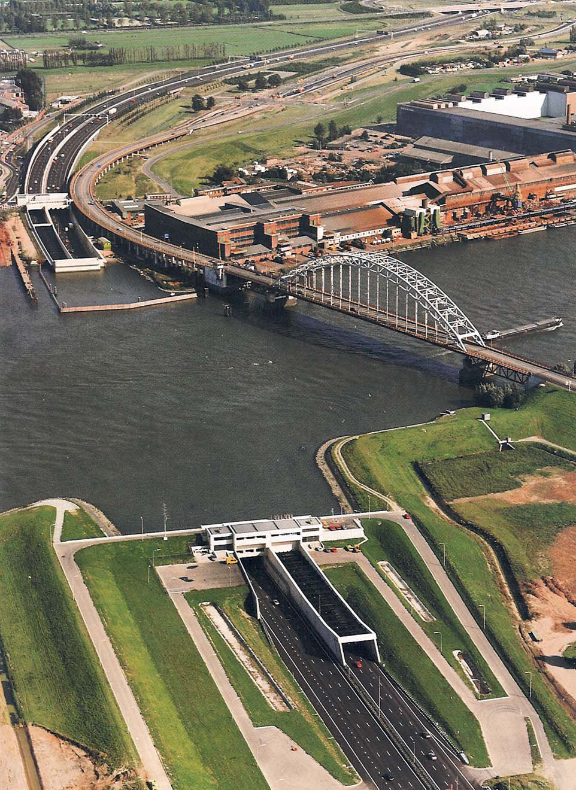
Mass Transit Systems..

Slide 8
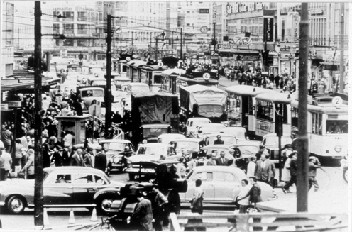
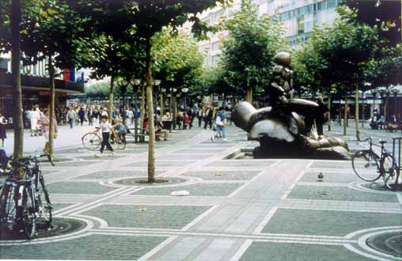
Road Traffic..

Slide 9
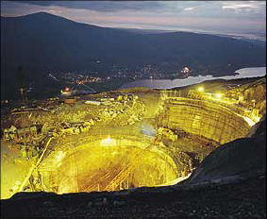
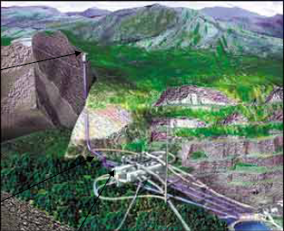
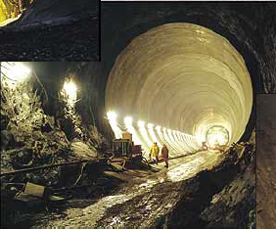
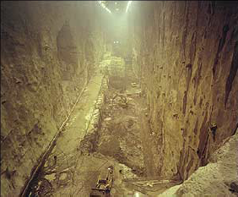
Hydro-Electric Power Plants..
Surge Shaft
Powerhouse
High Pressure Tunnel

Slide 10
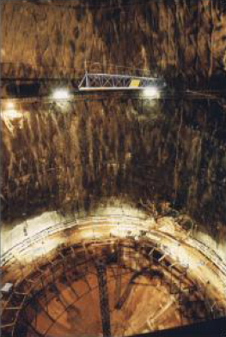
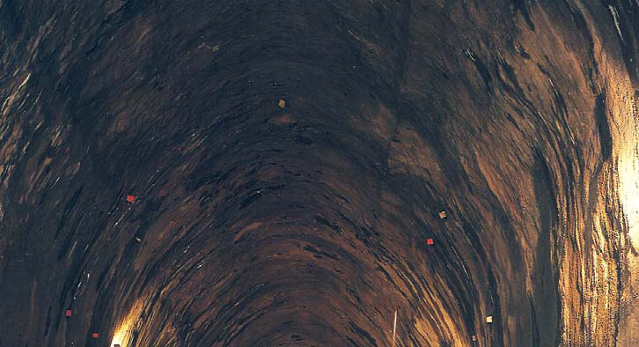
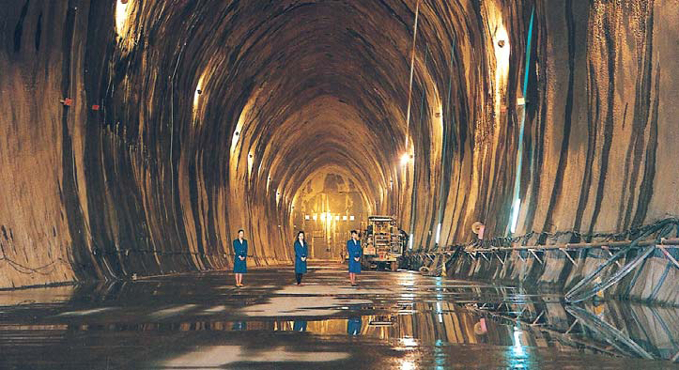
Fuel Storage..
Other Ground Storage Media..
–Solution-Mined Salt Domes
–Depleted “Reservoir Rocks”(CO2)
–Lined Hard Rock Caverns (Compressed and Liquified Natural Gas, LNG)

Slide 11
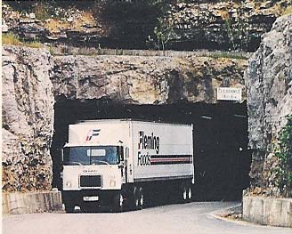
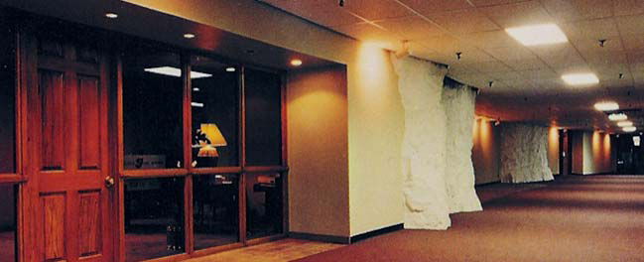
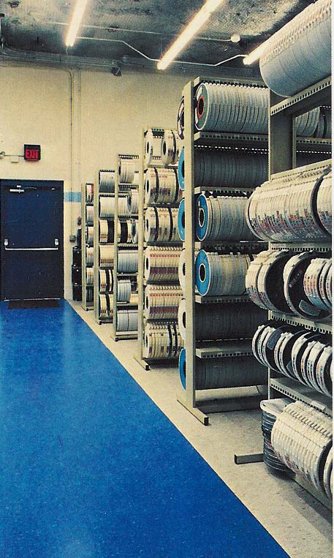
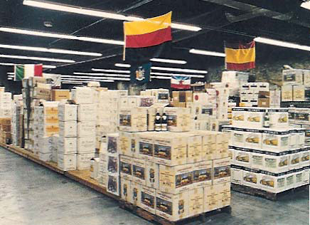
Packaged and Bulk Materials..
Silo/Bunker Storage..
–Coal, Grains, Ore..
•Warehousing
–often in converted mine space

Slide 12
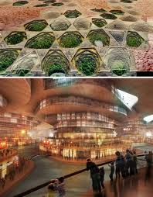
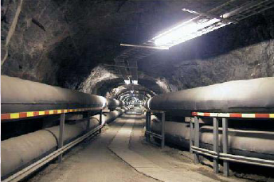
Critical Infrastructure..
•Secure sites with network
-wide access
–Controlled exit/entry
–Atmospheric control (temp., humidity, dust..)
–Ready access for modification and maintenance •Space and Cost Saving Opportunities (“Utilidors”)..
–Heating/Cooling
–Communications
–Data transfer
–Wastewater
–Freshwater
–Transport
–Power
–etcetera..

Slide 13
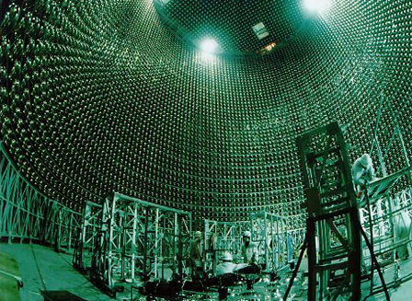
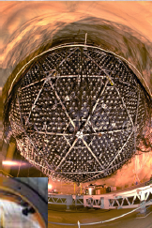
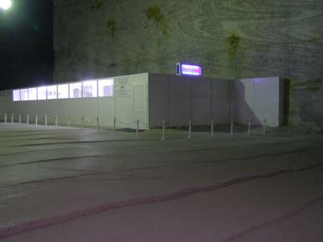
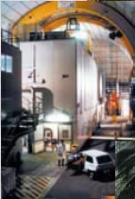
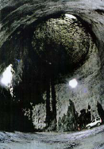
Research Facilities•
Worldwide, many underground research laboratories and test sites (waste repository characterization, physics, geo-’bio-sciences, engineering research, education/training..)

Slide 14
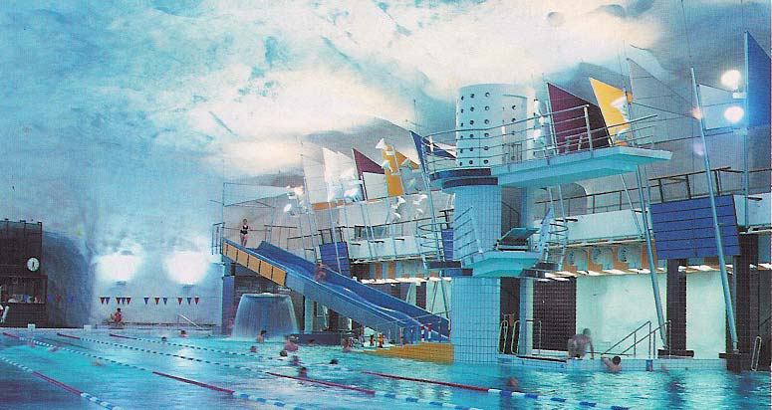
Public Facilities

Slide 15
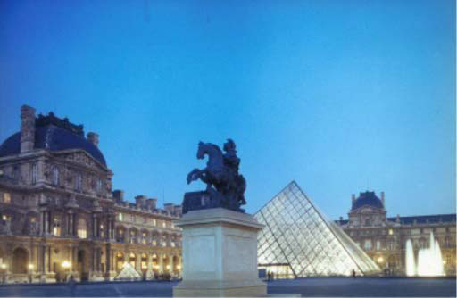
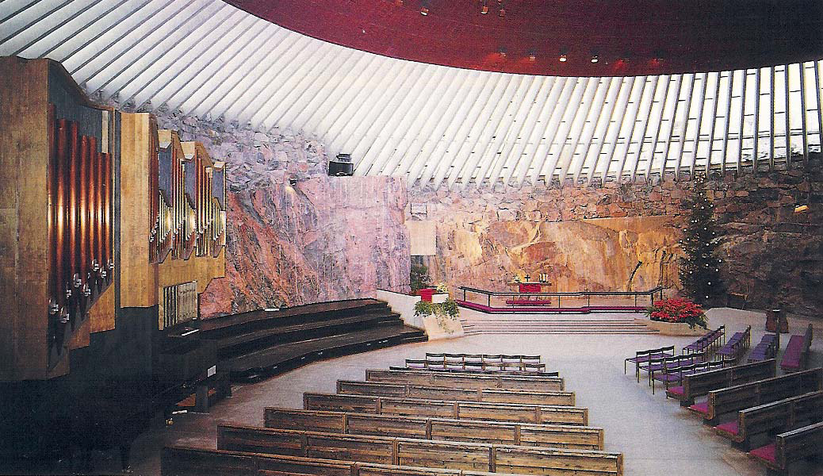
Pretty Much Anything You Want
Temppeliaukio Church
Le Grand Louvre

Slide 16
Why go underground?

Slide 17
Urban Congestion..
Go underground to avoid..
–Road pavement
–Buried infrastructure
–Basements & foundations
–Surface condemnations
–Right of way interruptions
–Minimize surface disruption

Slide 18
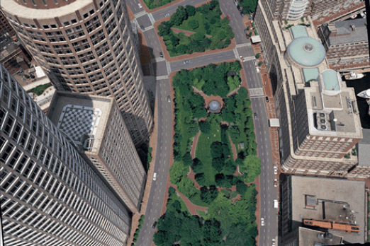
Create Green Space..
•“The Central Artery/Tunnel Project will create more than 300 acres of landscaped and restored open space, including over 45 parks and major public plazas”.

Slide 19
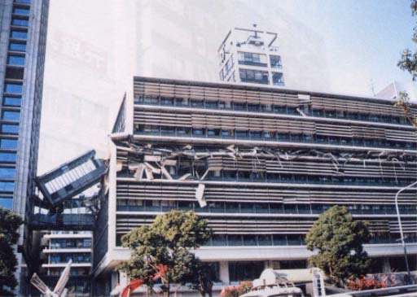
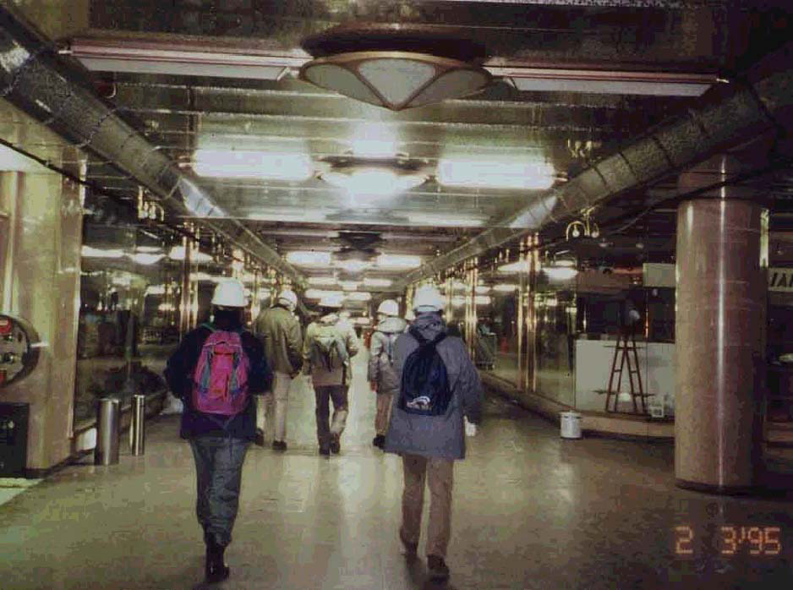
Protection..
Kobe Earthquake (Japan – 1995)
Severe damage to the Kobe City Hall
No damage to the underground shopping
mall located below

Slide 20
Isolation
Stable, Quiet and Shielded
–Waste Isolation
–Experiments and Testing..

Slide 21
How is underground built?

Slide 22
Methods for underground construction
• Cut and cover method in open excavation;
• Cut and cover method between earth retaining walls with lowering of the ground water levels;
• Cut and cover method between earth retaining walls without lowering of the ground water levels;
• Wall and roof method;
• Pneumatic caisson method;
• Immersed tunnel method;
• Bored tunnel method;
• Top Down method.

Slide 24
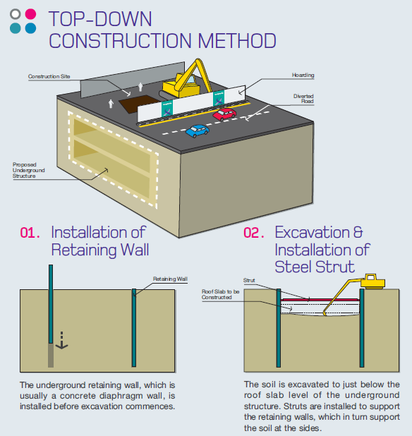
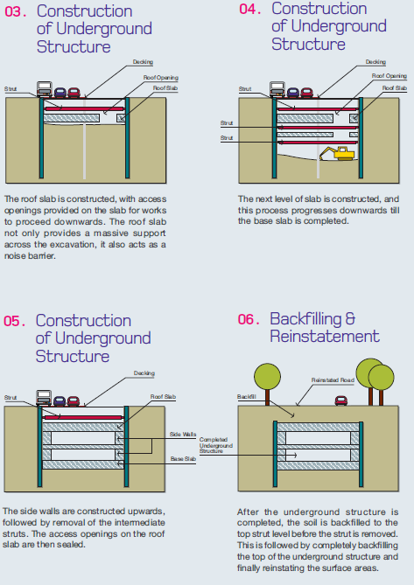

Slide 28
EXCAVATION BY TUNNEL BORING MACHINE

Slide 29
Shielded TBM involve the following activities:
1. Excavation and support of working shafts 2. Excavation and support of undercut and tail tunnel 3. Excavation of the tunnel itself 4. Disposal of soil from tunnel face 5. Hoisting the soil to ground level 6. Lining the tunnel 7. Extending services and rail tracks (if necessary) 8. Excavation and support of the removal shaft

Slide 30
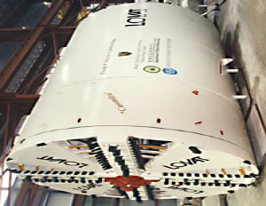
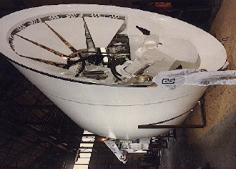
Excavation In DRY Soils
Earth Pressure Balance
Digger Shield”

Slide 31
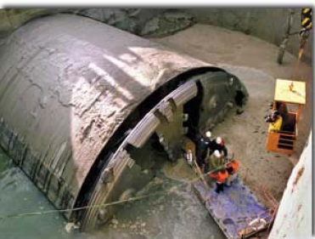
Excavation In WET Soils
Slurry Shield

Slide 34
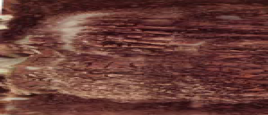
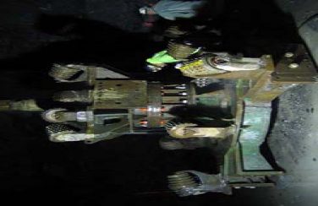
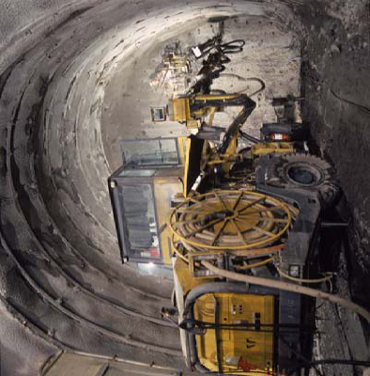
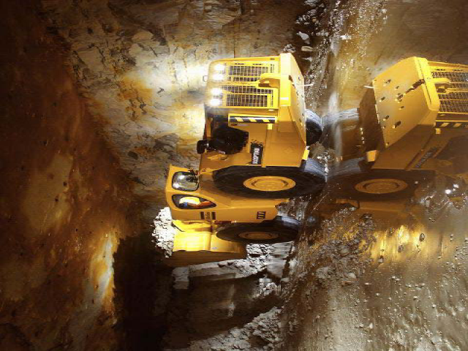
Excavation in Rocks
Mechanical Equipment
Or
Explosive

Slide 35
Blasting.
The person in charge of blasting shall be the last to leave the blast area, shall see that no one remains in the blast area, and shall operate the sectioning switches in the firing line while proceeding out of the blast area.
No persons shall enter the tunnel blast area until the ventilation system has cleared the heading of harmful gases, smoke, and dust.
After each blast, the underground supports in the blast area shall be inspected and secured as necessary work is resumed. Rock surfaces shall be inspected, scaled, and if required, provided with shoring, bracing, rock bolts, Shotcrete, or chain link fabric, before mucking is started. Rock bolts within 100 ft (30.4 m) of a blast shall be tested after each blast before drilling for the next round begins.
The muck pile shall be wet down prior to and kept wet during operations.

Slide 36
Some Ground Improvement Options..
Freezing.. to stabilize the ground and/or preserve the water table Grouting.. to stabilize the ground and/or render it ~ watertight

Slide 38
Some Ground Support Systems..
Steel Arches
Shotcrete
Rock Bolts and Steel Channel
Pre-Cast Concrete Segments
Integrated Waterproofing
Cast Iron Segments

Slide 39
Type of Ground Supports

Slide 41
The Technique Of Jacked Box Tunneling:
simplest form
A purpose designed tunnel shield is cast on to the leading end of the box, and thrust jacks are provided at the rear end reacting against the jacking base
Control of Ground Disturbance
Constructional Tolerances
Particular hazards
Alternative method for such case

Slide 43
Where are Problems Encountered?

Slide 44
Ground Surprises..
Geo-material properties vary in time/space (e.g. geo-statistics..)
–Strengths
–Loads/Stresses
–Deformations (elastic and plastic)
• Sometimes the engineering process fails to account for the impacts of geo-variability on..
–Designed structures..
–Surrounding structures/environment

Slide 45
Major Excavation Happen..
London
Shanghai
Munich
Singapore

Slide 46
Worldwide, Major Projects.. Major Losses
–1999 Hull Yorkshire Tunnel, UK Collapse
–1999 TAV Bologna -Florence, Italy Collapse
–1999 Anatolia Motorway, Turkey Earthquake
–2000 Metro Taegu, Korea Collapse
–2000 TAV Bologna -Florence, Italy Collapse
–2002 Taiwan High Speed Railway Collapse
–2003 Shanghai Metro, PRC Collapse
–2004 Singapore Metro, Singapore Collapse.
–2005 Barcelona Metro, Spain Collapse
–2005 Lausanne Metro, Switzerland Collapse
–2005 Lane Cove Tunnel, Sydney Collapse
–2005 Kaohsiung Metro, Taiwan
………etcetera..

Slide 47
Fractured Rock Subject to Stress & Gravity
Spalling/Bursting
Observed at the engineering scale rock is rarely solid..A “hard” rock mass may contain weak clays or even voids..
Ravelling
Alteration

Slide 48
Changing Groundwater Conditions
“High Water Pressure Complicates Arrowhead Tunnels..”

Slide 49
When Do Risks Get Mitigated?

Slide 50
In Studying the Regional Geology
Putting the Site in Context..
Benefit from the experience of others..–Same/similar rock–Same/similar needs–Much of the early work can be done from behind the desk

Slide 51
In Scoping the Site Investigation (SI)
Mixed-scale data sets..
experience needed
Field Investigation..
–Exposures
–Geophysics
–Boreholes
–Testing
•Field
•Lab

Slide 52
Characterizing Subsurface Site
3-D Geo-Models
–From cms to kms
–Basis of Design..
Conditions;
dry, damp, wet, massive, hard, stratified, seamy, schistose, jointed, blocky, crushed, soil-like..
•Behaviors;
raveling, running, flowing, squeezing, swelling, spalling, rock burst..
–Deciding between options..
•Siting
•Design
•Construction

Slide 53
Design & Specify for Geo-Diversity
Plan for Variation..
–Geologic Uncertainties
–Design & Construction Changes
Many Designs..One Tunnel

Slide 54
In Conclusion.. •What goes Underground? –Pretty much any thing that could be placed on surface •Why go Underground? –Many advantages.. Cost and risk are the main draw-backs •How is Underground Space Created? –Technology exists to build in pretty much any geo-material •Where Problems are Encountered Underground? –Same old problems..no foolproof solutions •When do risks get mitigated? –Opportunities for risk management are there.. they need to be seized •Who can best mitigate the risks? –Practitioners and researchers collaborating together at sites

Slide 55
Reference
American society of civil engineers - technical committee on contracting practices of the underground technology research council. 1991.
The equipment magazine for the underground construction industry
Forensic engineering for underground construction-e. T. Brown
Journal of geotechnical engineering, asce, 115(11): 1513-1531.
Seismic analysis of underground structures-kazuhiko kawashima
Underground structures engineering services for owners and contractors
Geoengineering considerations in the optimum use of underground space - raymond l. Sterling
Godard, j.P., 1999. “Sub-surface development in the urban environment,” proc. 10th australian tunnelling conference, “the race for space”, melbourne.
Ita, 1987. “Examples of benefits of underground urban public transportation systems,” report of the working group on costs-benefits of underground urban public transportation, tunnelling and underground space technology, vol. 2, no. 1, pergamon press, oxford, u.K.
Support in underground hard rock mines-evert hoek
Drilling and blasting for underground space - R pesch1 and a robertson2

Slide 56
Thank you

