Slide 1
Cloud Computing
- By Sapan shah (CE 09 58)
Computer Science

Slide 2
Outline:
What is Cloud Computing?
Explanation
How it’s works?
Types of Cloud Computing
Layers of Cloud Computing
Services
Advantages & Disadvantages

Slide 3
What Is Cloud Computing
…moving computing and data away from the desktop & the portable PC and simply displaying the result of computing that takes place in a centralized location and is then transmitted via internet to user’s screen.
It offers the ability to access software or information that can be delivered on- demand , over the internet , without the need to store it locally.

Slide 4
Explanation:
A simple example of Cloud Computing is Yahoo or Gmail etc. You don’t need a software or a server to use them. All a consumer would need is just an internet connection and you can start sending emails. The server and email management software is all on the cloud(internet) and is managed by the cloud service provider like Yahoo, Google etc.
The consumer gets to use the software alone and enjoy the benefits. The analogy is “If you only need milk, would you buy a cow?”. All the users need is to get the benefits of using the software of computer like sending emails etc.. Just to get this benefit (MILK) why should a consumer buy software (COW)?

Slide 5
How It’s Works:
In a cloud computing system, there’s a significant workload shift. Local computers no longer have to do all the heavy lifting when it comes to running application. The network of computers that make up the cloud handles them instead. Hardware and software demands on the user’s side decrease. The only thing the user’s computer needs to be able to run is the cloud computing system's interface software, which can be as simple as a web browser, and the cloud’s network takes care of the rest.

Slide 6
How It’s Works:
Can logically be divided into 2 sections
Front end
Back end
Network
Back end
Front end

Slide 7
Front end includes –
the client’s computers
application required to access the cloud computing
e.g.: Internet Explorer, FireFox etc.
Back end includes –
computer networks, servers and any data storage system
Practically, any computer program you can imagine from data processing to video games
Control node…also called as Central server.

Slide 8
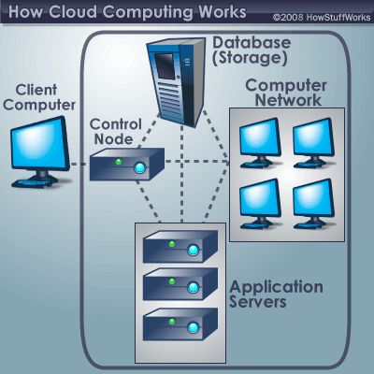

Slide 9
Types Of Cloud Computing:
Private Cloud
Public Cloud
Community Cloud
Hybrid Cloud

Slide 10
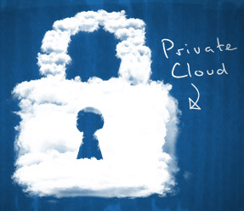
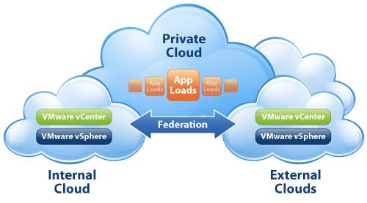
Private Cloud:
Provide hosted services to a limited number of people.
Reliable
Secure
Efficient
Controlled
Flexible

Slide 11
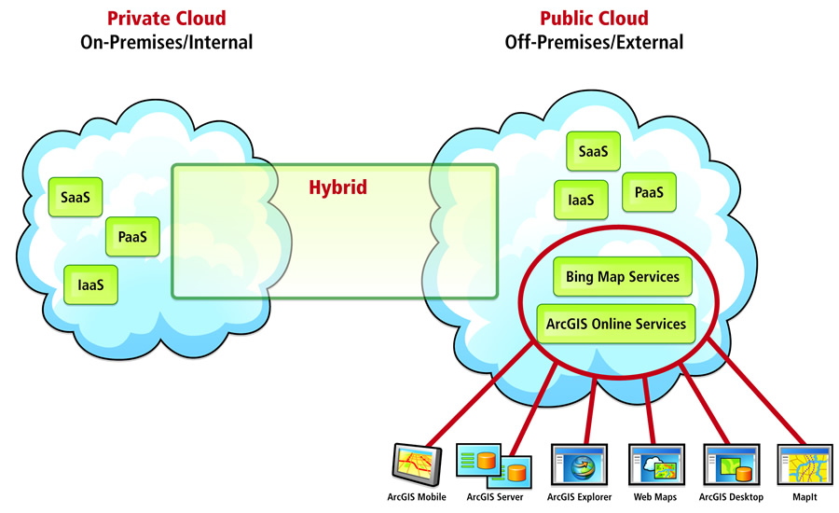
Public Cloud:
Service provider makes resources dynamically available
Benefits:
easy and in expensive setup
scalability
no wasted resources
Ex: Amazon Elastic
Computer cloud,
IBM’s Blue Cloud,
Sun Cloud, Google AppEngine.

Slide 12
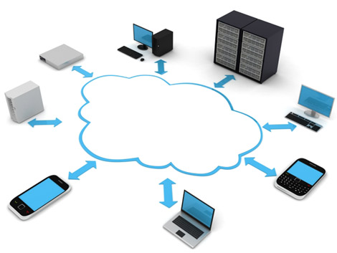
Community Cloud:
Organizations having similar requirement
Privacy, security, and policy compliance
Ex.: Google’s “Gov Cloud”

Slide 13
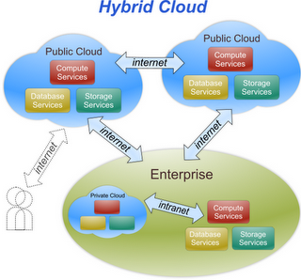
Hybrid Cloud:
Multiple internal and external providers
Composition of more clouds
Application:
Archiving of
backup functions.
deploying a web
application in the cloud.

Slide 14
Layers Of Cloud Computing:
The five layers:
Client
Application (SaaS)
Platform (PaaS)
Infrastructure (IaaS)
Server
Computer, Phones (browsers)
Google apps, SalesForce CRM
Google App Engine, Azure
Nimbus, AWS
Networks, Virtualization

Slide 15
Client:
Hardware & Software
Essentially useless
without cloud
E.g.: Computers
& phones.

Slide 16
Application (SaaS):
Run over internet
No need to
install\maintain
Complete,
customizable application
E.g.: Google Apps,
SalesForce CRM.

Slide 17
Platform (PaaS):
Deployment without
complexity
Eliminate most
management tasks
Pre-built components
E.g.: Google App
Engine, Microsoft Azure.

Slide 18
Infrastructure (IaaS):
Network of servers
Virtualized
Billed on utility ba
E.g.: Nimbus, AWS.

Slide 19
Server:
Hardware \ Software
Network of virtualized
computer
E.g.: better OS, multi-
core processors

Slide 20
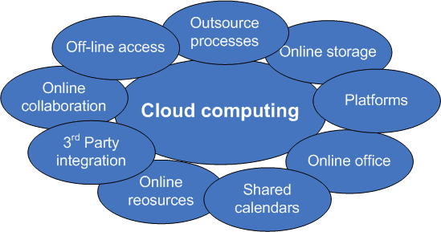
Services:

Slide 21
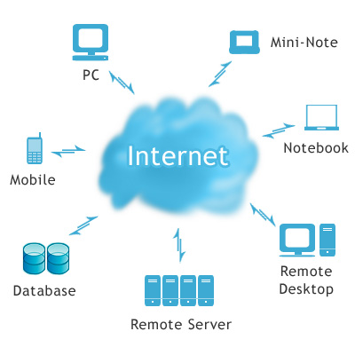
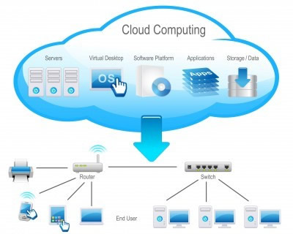

Slide 22
Advantages And Effects:
Data isn’t “chained” to one place; rather, it can be accessed anywhere, from any medium.
Processor speed becomes less important then internet connection speed.
Netbooks become practical.
Low maintenance.
Privacy.

Slide 23
Disadvantage :
No control over the business assets (data). The main assets in every company are its data files with valuable customer information.
Physical location of hardware and software is unknown. Site inspections and audits are hard.
Availability. Constant connectivity is required.
Risk of data loss due to improper backups or system failure.

Slide 24
Conclusion:
“Go Cloud”

Slide 25
Thanks…

