Slide 1
WEL COME

Slide 2
GROUP MEMBER
SATHAVARA JIGAR B. 106500309051
PRAJAPATI SUNIL B. 106500309077
CHAUDARY SURESH G. 106500309081
RAVAL JAYESH R. 106500309085

Slide 3
METAL OXIDE SEMICONDUCTOR FIELD EFFECT TRANSISTOR
BASED INVERTER

Slide 4
INTRODUCTION
During the power cut if one needs to use any electrical \electronic appliance such as fan light bulb etc. then some kind of device which could provide power to these appliances becomes essential inverter is one of most commonly used device for this purpose.

Slide 5
INVERTER
.

Slide 6
“ Inverter is basically a DC to AC converter. It is a circuit which converter DC power in to AC power at desired voltage.”
DEFINATION :

Slide 7
PROCESS:
‘’AC i/p supply given to rectifier to convert AC to DC power and range of capacity ( 5v,12v ) and DC power given by inverter card with MOSFET . MOSFET is converted AC o/p power.

Slide 8
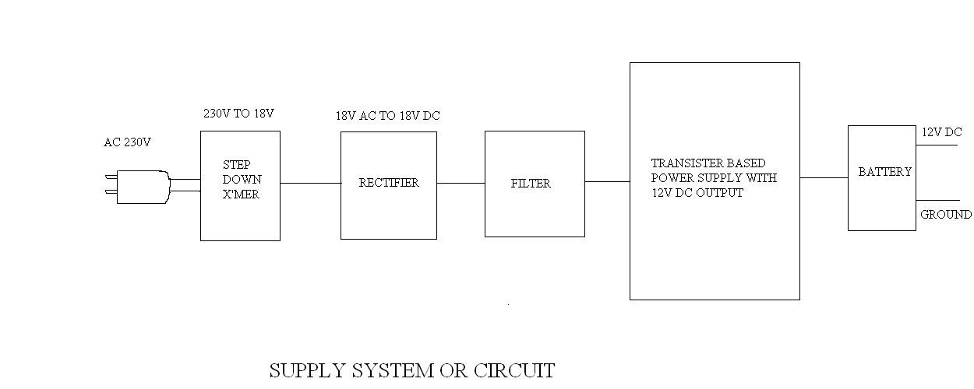
SUPPLY SYSTEM OR CIRCUIT

Slide 9
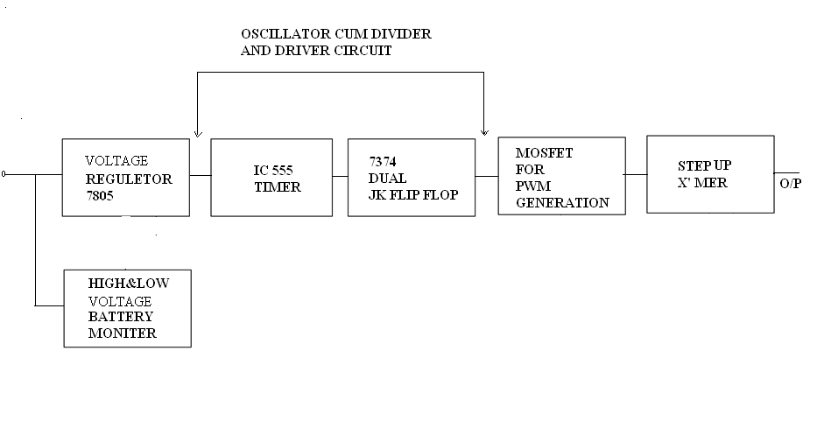
Blokdigram of MOSFET base invertar

Slide 10
.
VOLTEG REGULATOR 7805
IC 555 TIMER
7374 DUAL JK FLIP FLOP
MOSFET FOR PWM GENERATION
STEP UP X’ MER
HIGH & LOW VOLTEG BATTERY MONITER
OSCILLATOR CUN DIVIDER AND DRIVER CIRCUIT

Slide 11
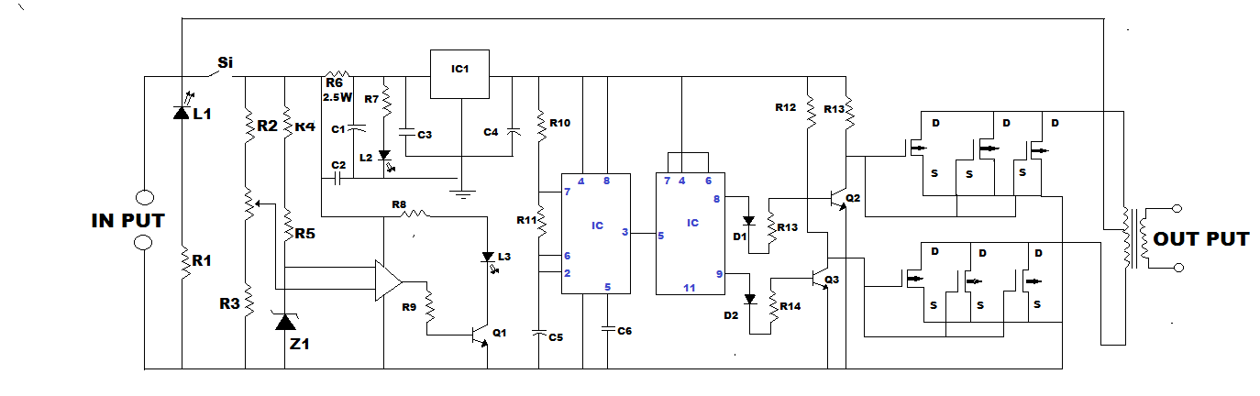
CIRCUIT DIAGRAM:-
.

Slide 12
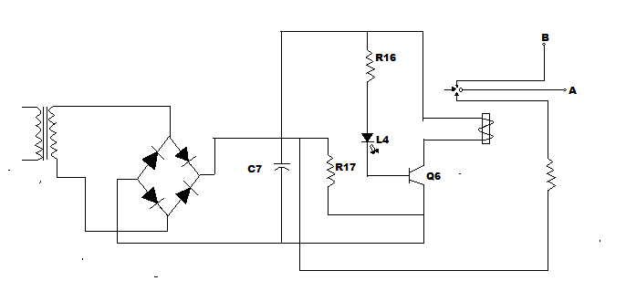
.

Slide 13
MOSFET OF WORKING
MOSFET has two type of working mode
(1) Depletion mode :
It is obvious from that is no p-n junction between and channel here the diffused channel neither insulating electric Si02 layer and the metal layer of the gate forms a parallel plate capacitor. For the depletion mode ,the gate is maintained at positive potential. when voltage gate and source; zero, a significant current flows for given Vds, like FET.
(2) Enhancement mode:
The semiconductor channel, the insulating dielectric Si02
layer and metal layer of the gate from a parallel pl ate capacitorWhen a positive potential is applied at the gate with respect to substrate negative charges.

Slide 14
ADVANTAGE:
It can operate on low level power signal with economically.
It is less expensive as compared to other inverter for small power application.
It reduces the circuit size.
It is more reliable.
The efficiency is high about 90%.

Slide 15
COMPONENTS
Resisstor
CAPACITAR
Diode
Transistor
Zener diode
MOSFET
BATTERY
LED
Inverter transformer
IC with socket
PCB

Slide 16
APPLICATION
In home shops, office, hospitals, cinemas etc.
It is used to ran electrical or electronic devise such FAN, TV, VCR, TUBE, & BULB etc.
General application of an inverter in industry application such as
Variable speed AC motor drive
In indication heating
IN U.P.S.(UN interruptible power supply)

Slide 17
Thank you…

