Slide 1
Welding of Metals

Slide 2
Welding
Welding is the process of joining together pieces of metal or metallic parts by bringing them into intimate proximity and heating the place of content to a state of fusion or plasticity

Slide 3
following are the key features of welding:
The welding structures are normally lighter than riveted or bolted structures.
The welding joints provide maximum efficiency, which is not possible in other type of joints.
The addition and alterations can be easily made in the existing structure.
A welded joint has a great strength.
The welding provides very rigid joints.
The process of welding takes less time than other type of joints.

Slide 4
largely used in the following fields of engineering:
Manufacturing of machine tools, auto parts, cycle parts, etc.
Fabrication of farm machinery & equipment.
Fabrication of buildings, bridges & ships.
Construction of boilers, furnaces, railways, cars, aeroplanes, rockets and missiles.
Manufacturing of television sets, refrigerators, kitchen cabinets, etc.

Slide 5
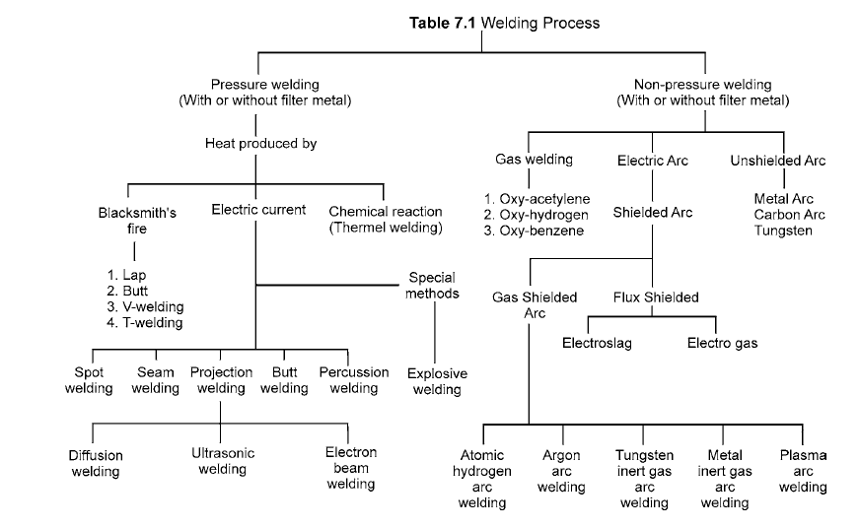
Classification according to source of energy employed to heating the metal

Slide 6
Gas Welding
Oxy-acetylene Welding:
CaC2 + 2H2O = Ca (OH)2 + C2H2
C₂H₂+2.5O₂= 2CO₂+H₂O_{(vapour)}+ 306.800 cal /mol

Slide 7
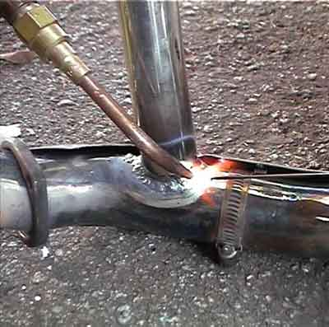
Gas welding Apparatus
1. Oxygen cylinder
2. Acetylene cylinder
3. Pressure gauges
4. Valves
5. Hose pipes
6. Torch
7. Welding tip
8. Pressure regulators
9. Lighter
10. Goggles

Slide 8
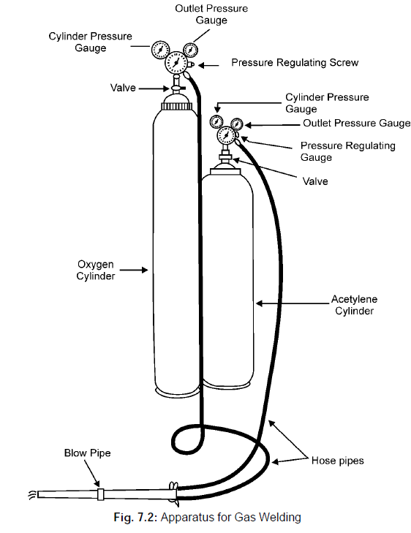
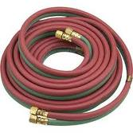

Slide 9
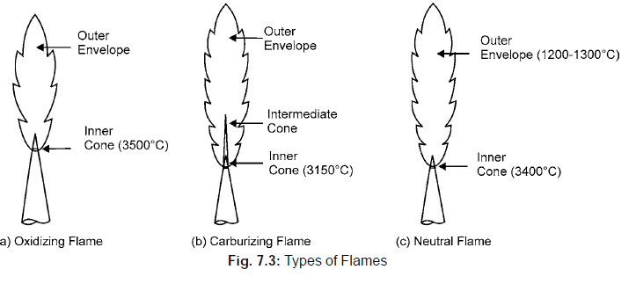

Slide 10
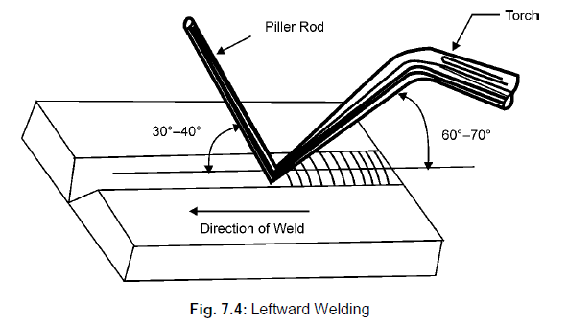
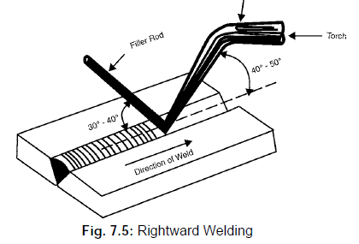
Gas welding two types

Slide 11
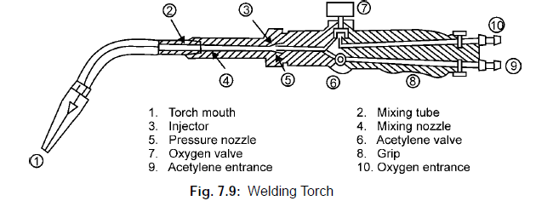
Gas welding torch

Slide 12
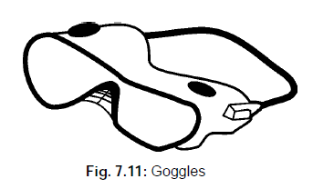
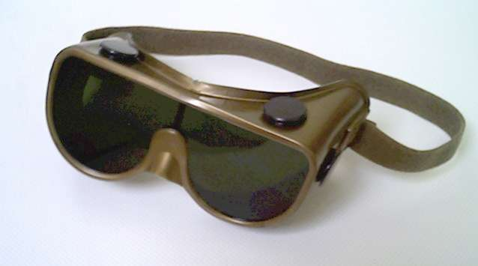
Welding Goggles

Slide 13
ELECTRIC ARC WELDING
The welding in which the electric arc is produced to give heat for the purpose of joining two surfaces is called electric arc welding.

Slide 14
Principle of Arc
A suitable gap is kept between the work and electrode
A high current is passed through the circuit.
The electric energy is converted into heat energy, producing a temperature of 3000°C to 4000°C.
This heat melts the edges to be welded and molten pool is formed.
On solidification the welding joint is obtained

Slide 15
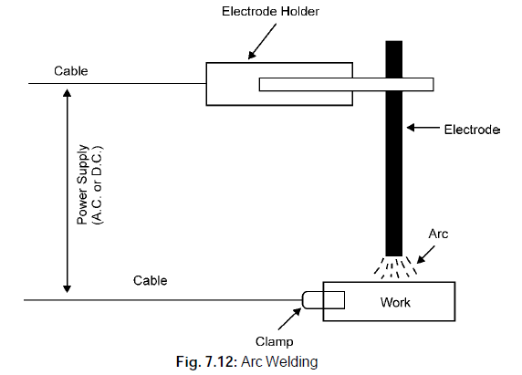
Arc Welding

Slide 16
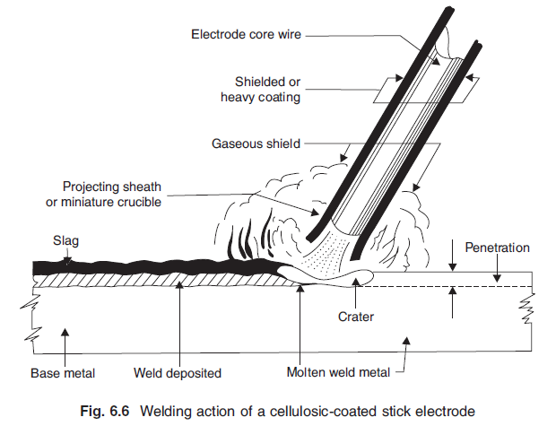
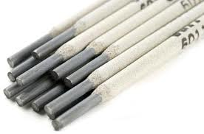

Slide 17
Electric Power for Welding
AC current or DC current can be used for arc welding. For most purposes, DC current is preferred.
D.C. machines are made up to the capacity range of 600 amperes.
45 to 95 volts
D.C. current can be given in two ways:
(a) Straight polarity welding. (b) Reverse polarity

Slide 18
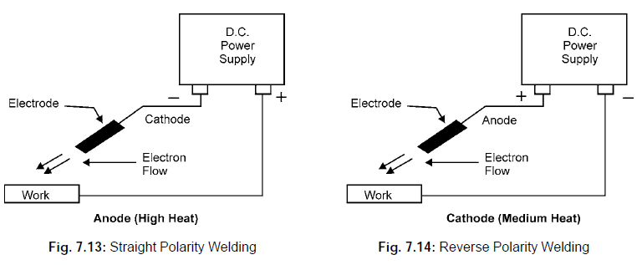
Arc welding power supply by 2 types
For Thin Metals

Slide 19
Types of Electrodes
Coated electrodes
Bare electrodes

Slide 20
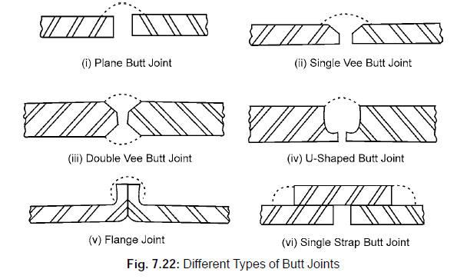
TYPES OF JOINTS
Butt Joint

Slide 21
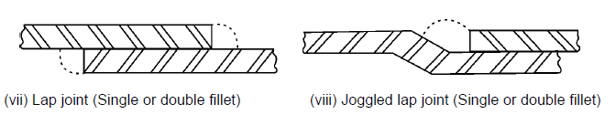
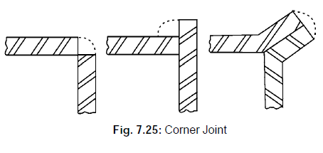
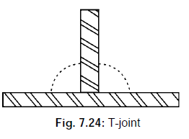
TYPES OF JOINTS
Lap joint
Corner joint
T- joint

